Slide 1
Specification No. 26-06
Contract No. C51695
2026 Levee Repairs - Colusa Basin Drain and Sacramento River
Colusa and Yolo Counties
Site Inspection Trip Presentation
June 18, 2026
Notes:
NEGATIVE SPACE
GOOD

Slide 2
Disclaimer
Site inspection trip presentation and discussion are for information only.
The files shall not be used to prepare bids or for construction purposes. Location and extents of project features shall be based on the contract drawings and specifications.
The intent of the presentation is to help guide potential bidders through the drawings and specifications and spatially identify project components.
Discussion during the inspection trip doesn’t change the plans or specifications or is binding on the Department.
Any questions will need to be submitted in writing to doe_specs@water.ca.gov
CALIFORNIA DEPARTMENT OF WATER RESOURCES

Slide 3
Safety (Document 00701)
JHA for the Site Inspection Trip Inspection
Injury & Illness Prevention Plan & Code of Safe Practices
Pre-work Safety Plan
Site Specific Emergency Response Plan
Emergency Action Plan
Fire Prevention and Control Plan
Public Safety
Job Hazard Analysis
Environmental Hazards
Trenching & Excavation
Hazardous Material
Others as referenced in the Specification.
Some submittals required 15 days prior to mobilization.
CALIFORNIA DEPARTMENT OF WATER RESOURCES

Slide 4
Plans & Specification
Plans and Specifications available at the Department website:
https://cosmos.water.ca.gov/
Contact doe_specs@water.ca.gov for login information.
Cal-eProcure https://caleprocure.ca.gov/
CALIFORNIA DEPARTMENT OF WATER RESOURCES

Slide 5
Questions on Plans &Specification
Email doe_specs@water.ca.gov
Only written responses to the questions submitted are contractually binding.
Per Document 00002 – Notice to Contractors, Paragraph 2, Questions or requests for clarification of the drawings or specifications shall be made in writing at least 5 days (June 26, 2026) before the bid opening date (July 1, 2026).
Responses is provided with either an Addendum – modifying the contract; or Information Letter to all Plan Holders.
All Addenda must be acknowledged with the bid form.
CALIFORNIA DEPARTMENT OF WATER RESOURCES

Slide 6
Prequalification – Document 00040
Department of Industrial Relations (DIR) Registered Contractors and Subcontractors at time of bid submission and throughout construction.
Safety: Required to receive bid documents for the contract.
Safety Prequalification forms, must be received by the Department at least
5 days prior (June 26, 2026) to the bid due date .
Joint Venture: Contact doe_specs@water.ca.gov bidding requirements.
CALIFORNIA DEPARTMENT OF WATER RESOURCES

Slide 7
Bid Opening
Sealed bids:
Bidders/Visitors shall allow sufficient time for checking in with Security upon entering the building. Bids will be accepted and timestamped in the main lobby of the California Natural Resources Headquarters.
Bid Due Date: | July 1, 2026
Time: | 12:00 pm – 2:00 pm
Location: | California Natural Resources Headquarters, 715 P Street, Sacramento, California, 95814
CALIFORNIA DEPARTMENT OF WATER RESOURCES

Slide 8
Bid Schedule – Document 00410
Complete all bid items
Write legibly and within the boxes/spaces provided.
Currently contains (36) Bid Items.
Initial to any changes to your bid.
Do not leave blank items.
Do not condition your bids or change the specification requirements.
CALIFORNIA DEPARTMENT OF WATER RESOURCES

Slide 9
Contracting Requirements
Use Bidder’s Bond form – Document 00430.
Bid Security in the form of Certified Check, Cash, or Bidder’s Bond (10% of bid amount).
Do Not Use Bonding companies Bidder Bond form (will not conform to the State Contract Act requirements).
The Estimated Cost Range :
$1,800,000 - $2,500,000
CALIFORNIA DEPARTMENT OF WATER RESOURCES

Slide 10
Preferences & Incentives – Bid Comparison only
Disabled Veteran Business Enterprise (DVBE) Incentive – Zero Percent Goal, however the Department has a 3% DVBE Incentive to bids that meet or exceed the 3% DVBE Participation. (Max. $100K)
Small Business Preference – 5% reduction in the bid amount, to the Certified Small Business bidder. (Max. $50K)
Non-Small Business Preference – 5% reduction in the bid amount, to bidders committing to use at least 25% CA Certified Small Business subcontractors or suppliers. (Max. $50K)
Combined amount of all incentives and preferences cannot exceed $100,000.
Contract Award is based on the Lowest Responsive Bid, considering all incentives and bid preferences.
CALIFORNIA DEPARTMENT OF WATER RESOURCES

Slide 11
Information Available – Document 00300
Department of Industrial Relations General Prevailing Wage Determinations.
Site Inspection Reports for both sites 23-078 and 97.
Historical Documents: https://ferix.water.ca.gov/lep/
Environmental Documents, Permits and References related to this project.
Geotechnical Investigation Report.
Specification 26-06, Job Walk Handout.
CALIFORNIA DEPARTMENT OF WATER RESOURCES

Slide 12
Time of Completion
    Pursuant to Document 00705 – Prosecution of Work, Paragraph 1.A, the Contractor shall begin Work, within
7 DAYS
from the date of receipt of Notice to Begin Work.
    The Contractor shall complete all work, excluding the work specified in Section 32 90 20 – Plant and Seed Establishment before the expiration of
November 30, 2026.
The Contractor shall complete the balance of the work specified in Section 32 90 20 – Plant and Seed Establishment, before the expiration of
May 31, 2027.
CALIFORNIA DEPARTMENT OF WATER RESOURCES

Slide 13
Liquidated Damages – Section 01110
Liquidated damages for failure to complete the work specified in Paragraph 1.04 B within the time specified will be $2,400 per day.
Liquidated damages for failure to complete the work specified in Paragraph 1.04 C within the time specified will be $1,000 per day.
CALIFORNIA DEPARTMENT OF WATER RESOURCES

Slide 14
Project Safety
The Department will have a Safety Engineer on-site during construction efforts.
ALL staff on the job site, both Department and Contractor, have stop work authority.
The Contractor is expected adhere to all laws and regulations (CAL/OSHA, etc.).
The Department Safety Engineer and staff will assist with the ensuring all safety expectations are met, including CAL/OSHA standards, industry standards and Contractor’s safety procedures and policies.
CALIFORNIA DEPARTMENT OF WATER RESOURCES

Slide 15
Environmental Protection – Section 01 57 19
Environmental Speciation Overview
Former Environmental Spec 01570 (Environmental Protection)
DWR now uses 6-digit spec numbers
  Current Applicable Environmental sections
    01 57 19: Temporary Environmental Controls
    01 57 23: Temporary Storm Water Pollution Control
    01 57 26: Temporary Fencing
    01 57 39: Temporary Tree and Plant Protection
    32 90 20: Plant and Seed Establishment
CALIFORNIA DEPARTMENT OF WATER RESOURCES

Slide 16
Environmental Protection – Section 01 57 19
Site Specific Environmental Requirements
Sites 78 and 97 operate under different CEQA documents
Each Site has unique permit requirements
Refer to Permit tables (Appendix III) for complete permit obligations
CALIFORNIA DEPARTMENT OF WATER RESOURCES

Slide 17
Environmental Protection – Section 01 57 19
Vegetation and Seeding Requirements
All disturbed areas must be seeded
At time of final landscape inspection, vegetation must meet:
  80% minimum vegetative cover
  If cover is not met, the contractor is responsible for re-seeding at no cost to the Department
Site 97 requires willow pole cuttings to be installed
Site 97 has many mature trees and shrubs require protection (2 types of protection measures)
  All trimming, cutting, and removal must be preformed by a certified arborist
CALIFORNIA DEPARTMENT OF WATER RESOURCES

Slide 18
Environmental Protection – Section 01 57 19
Environmental Compliance and Training
All personnel onsite must complete Worker Environmental Awareness Program (WEAP) training given by DWR prior to preforming work
Environmental monitors will be onsite throughout project activities to ensure compliance with:
  Permit conditions
  Environmental protection measures
  Resource avoidance requirements
CALIFORNIA DEPARTMENT OF WATER RESOURCES

Slide 19
Environmental Protection – Section 01 57 19
Environmental Measures
  Work Windows
    In-Water work (August 1- October 31st)
    Terrestrial work (May 1st- October 1st)
  GGS Exclusion Fencing is required
  Turbidity Curtain is required for in water work
CALIFORNIA DEPARTMENT OF WATER RESOURCES

Slide 20
Site 97 Project Features
Waterside bank repair with launch rock and soil-filled rockfill.
Surface treatment including aggregate chinking, native topsoil, agricultural soil, erosion control fabric, seeding, and fiber rolls.
Willow pole cuttings.
CALIFORNIA DEPARTMENT OF WATER RESOURCES

Slide 21
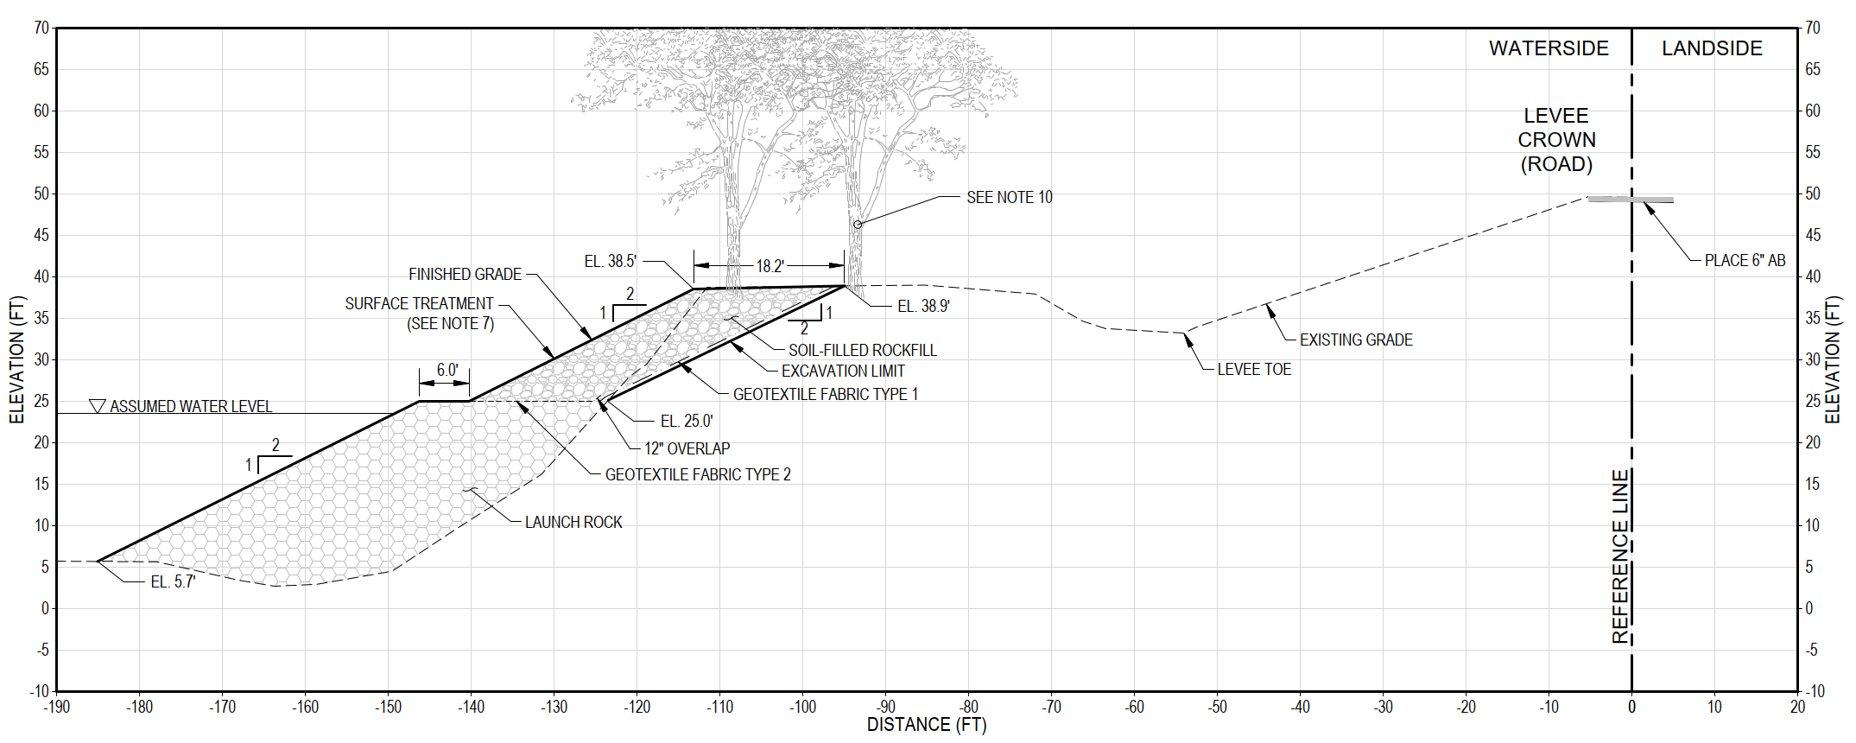
Site 97 Cross Section
CALIFORNIA DEPARTMENT OF WATER RESOURCES

Slide 22
Site 23-078 Project Features
Site 23-078
Landside slope earthfill repair.
Surface treatment including native topsoil, agricultural soil, erosion control fabric, seeding, and fiber rolls.
CALIFORNIA DEPARTMENT OF WATER RESOURCES

Slide 23
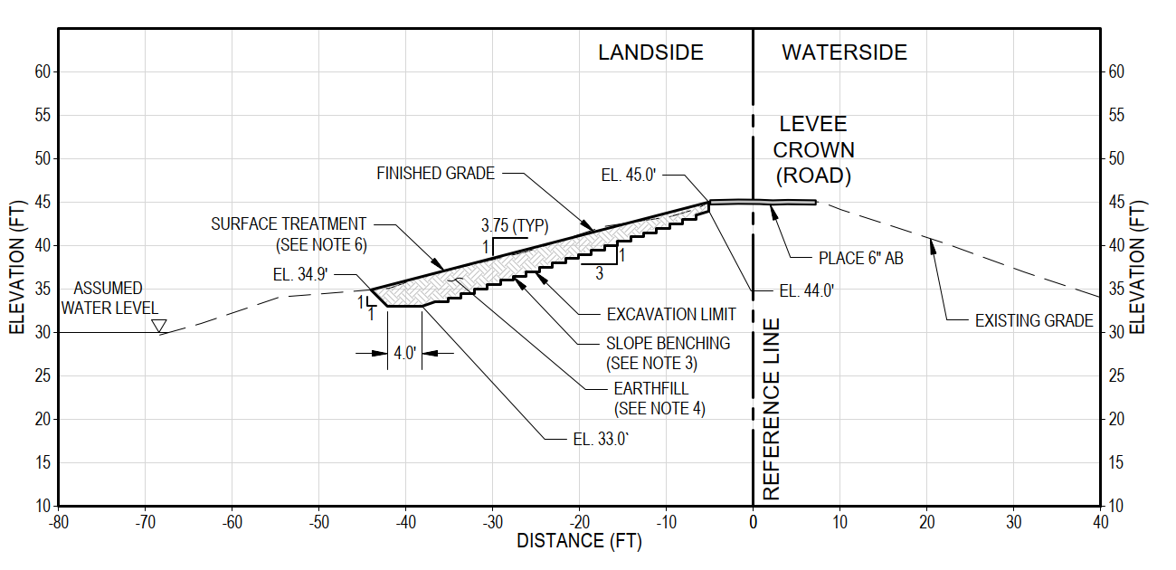
Site 23-078 Cross Section
CALIFORNIA DEPARTMENT OF WATER RESOURCES

Slide 24
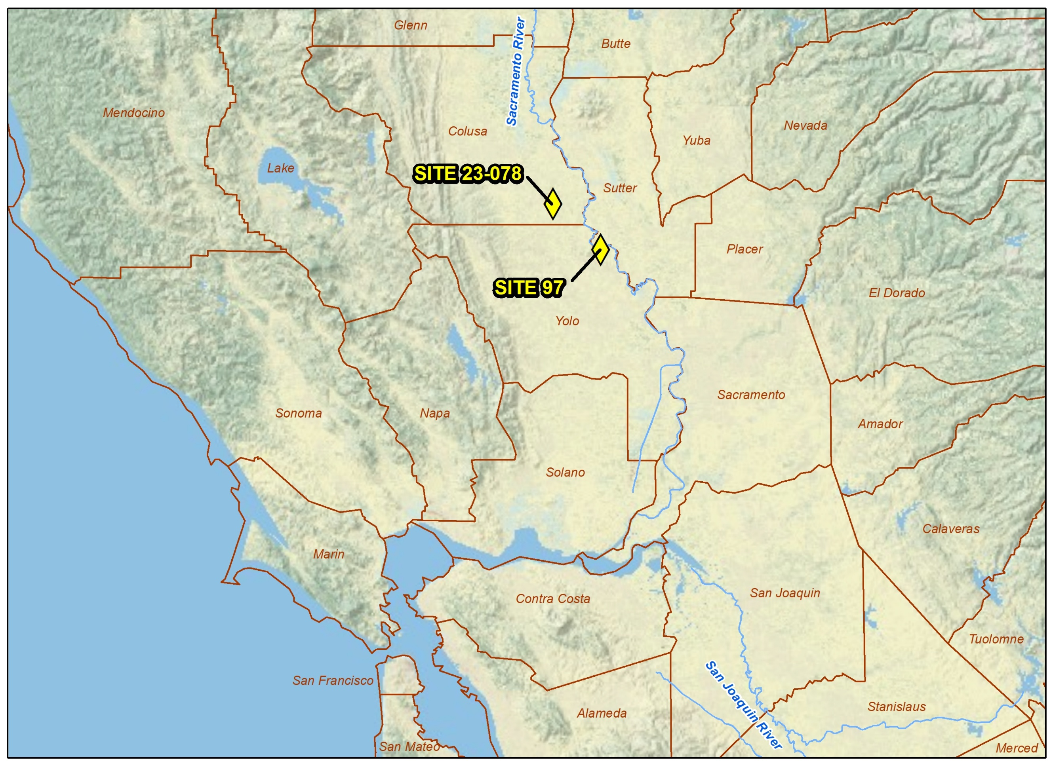
Project Locations – Area Map
CALIFORNIA DEPARTMENT OF WATER RESOURCES

Slide 25
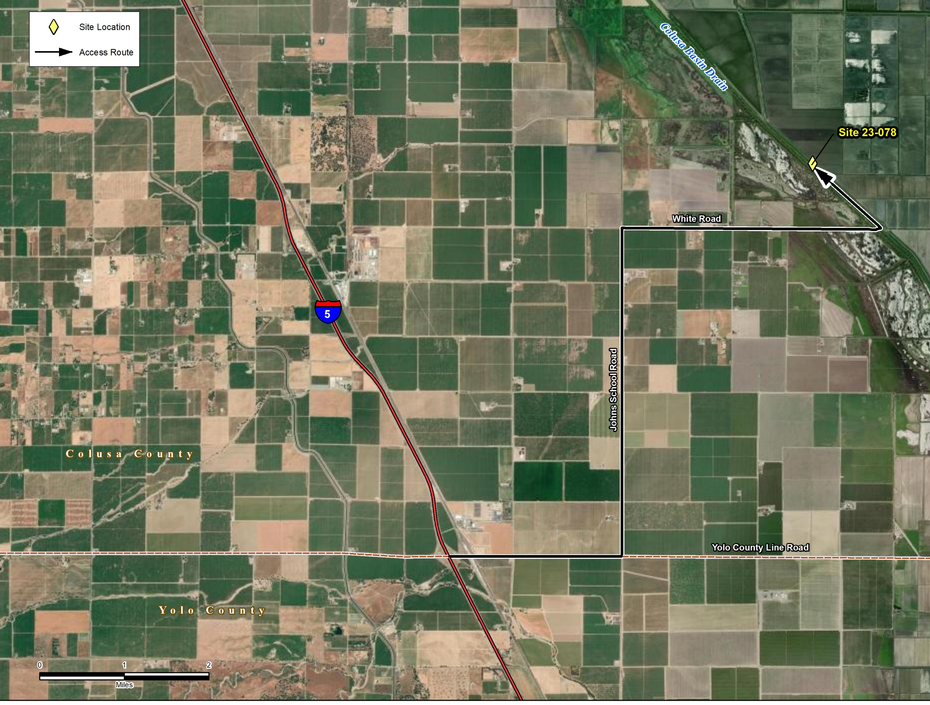
Project Site Locations
Site 23-078
Site 97
CALIFORNIA DEPARTMENT OF WATER RESOURCES

Slide 26
Site 97 Summary of Work
The proposed repair addresses waterside erosion along approximately 310 feet of riverbank. The repair includes the following construction activities:
Tree protection and removal.
Installing a turbidity curtain for in-water work.
Excavating and removing failed embankment soils on the waterside slope.
Installing geotextile fabric along the excavated slope.
Placing launch rock from the base to the height in accordance with the lines and grades shown in the plans. Placing soil-filled rockfill above the launch rock to the top of the repair.
Applying surface treatment, including aggregate chinking on the launch rock; native and agricultural topsoil, seeding, and erosion control fabric on the soil-filled rockfill.
Installing willow cuttings.
Resurfacing the levee crown road with aggregate base.
CALIFORNIA DEPARTMENT OF WATER RESOURCES

Slide 27
Site 23-078 Summary of Work
The proposed repair addresses landside erosion along approximately 450 feet of levee. The repair includes the following construction activities:
Installing Giant Garter Snake fencing.
Excavating eroded and unstable soil material from the landside slope. The backslope will be regraded to the proposed design geometry.
Placing earthfill on top of the shaped backslope in benched lifts.
Applying surface treatment, including native and agricultural topsoil, seeding, and erosion control fabric.
Resurfacing the levee crown road with aggregate base.
CALIFORNIA DEPARTMENT OF WATER RESOURCES

Slide 28
Conclusion
Thank you for participating in the Site Inspection trip.
Please submit any questions to doe_specs@water.ca.gov @water.ca.gov
CALIFORNIA DEPARTMENT OF WATER RESOURCES

