Slide 1
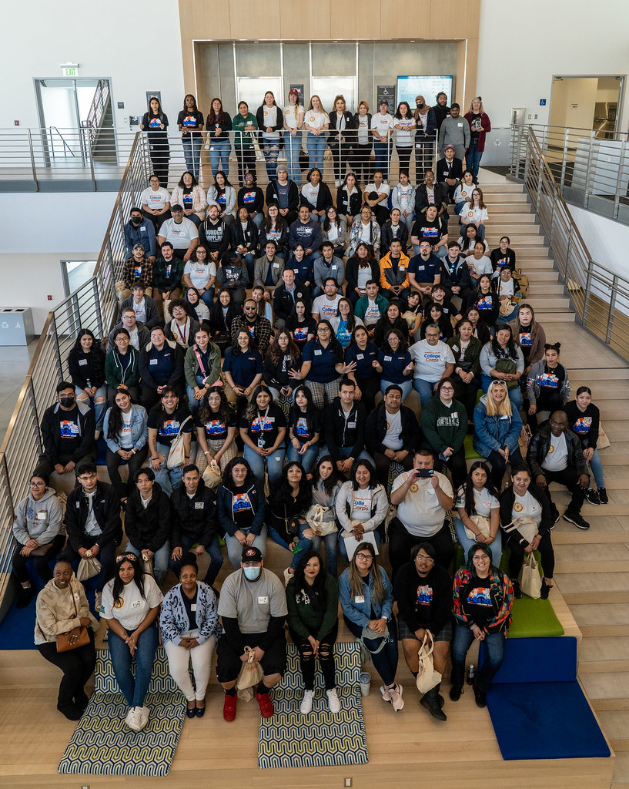


CV26-100 Webinar
June 17, 2026

Slide 2
Webinar Objectives
Today's webinar will provide an overview of:
  California Volunteers and College Corps
  Statewide Cohort Experience strategy
  Scope of work and contractor responsibilities
  Proposal requirements and evaluation process
  Contract timeline and key dates

Slide 3

California Volunteers & College Corps
California Volunteers
  Governor’s Office of Service and Community Engagement (GO-Serve)
College Corps
  Engage college students in meaningful service Opportunities that build leadership skills and civic responsibility
  Help students from diverse backgrounds graduate college on time and with less debt
  Support the work of community-based organizations focused on key local priorities
College Corps Focus Areas
  K-12 Education
  Food Insecurity
  Climate Action
  Local Community Priorities

Slide 4
Statewide Cohort Experience Strategy
The Statewide Cohort Experience is designed to:
  Build connection across campuses
  Strengthen leadership development
  Foster a shared sense of identity and purpose
  Create opportunities for reflection and peer learning
  Support a consistent fellow experience statewide

Slide 5
Events Included in this RFP
Mid-Year Leadership Workshops
January–March, 400–600 attendees per event
7 annually
In-Person Peer Exchange
June, approximately 200 attendees
1 annually
Total Contract Scope
16 statewide events over 2 years

Slide 6
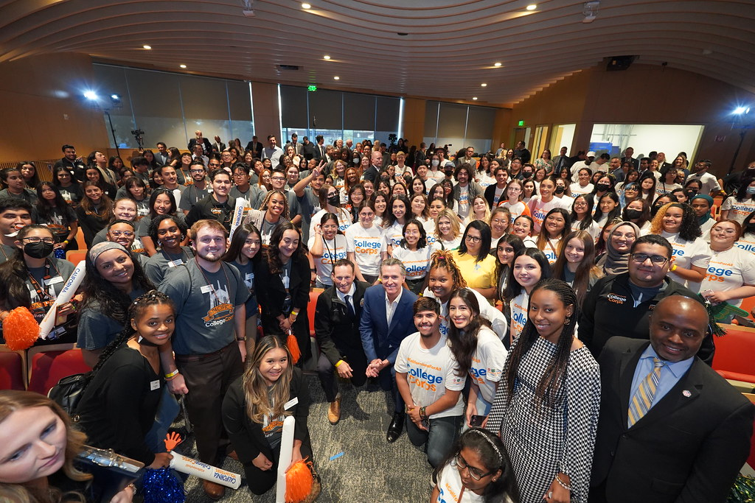
Mid-Year Leadership Workshop
College Corps fellows gather to connect, develop leadership skills, and strengthen their impact through service, learning, and community building

Slide 7
Mid-Year Leadership Workshops
Designed to provide opportunities for:
  Leadership development & peer connection
  Community building & reflection on service experiences
  Networking & professional growth
Programming may include:
    Guest speakers
    Leadership workshops
    Alumni panels
    Service activities
    Fellow-led sessions

Slide 8
Scope of Work Overview
The Scope of Work includes:
Event Planning and Logistics Management
Advisory Group Participation and Support
Facilitator Recruitment, Support, and Coordination
Event Materials Development
Program Coordination and Contract Management

Slide 9
Event Planning and Logistics Management
Contractor responsibilities include:
  Venue coordination
  Vendor management
  Registration management
  Catering and hospitality
  Transportation support
  Technology and AV coordination
  Day-of Staffing and operations
  Post-event reporting

Slide 10
Advisory Group Participation
California Volunteers will:
  Convene and lead the advisory group
  Establish event themes and priorities
  Guide programming direction
Contractor responsibilities include:
  Participate in meetings
  Provide implementation expertise
  Document meeting outcomes
  Support planning coordination

Slide 11
Facilitator Support and Coordination
Facilitators may include:
  California Volunteers staff
  Campus College Corps staff
  Community Host Partners
  College Corps fellows
Contractor responsibilities include:
  Facilitator communications
  Scheduling and tracking
  Preparation support
  Materials coordination
  Event-day support

Slide 12
Event Materials Development
Examples include:
  Participant guides
  Reflection worksheets
  Resource materials
  Facilitator guides
  Run-of-show documents
  Event signage and wayfinding
All materials must align with: ​
  College Corps branding ​
  Accessibility requirements ​
  Inclusive design practices

Slide 13
Accessibility and Participant Experience
Contractors should demonstrate experience with:
  Accessible event design
  Inclusive participant engagement
  Accommodation coordination
  Culturally responsive practices
Goal:
Deliver a welcoming and accessible experience for all participants.

Slide 14
Registration, Evaluation, and Reporting
Responsibilities include:
  Registration system management
  RSVP tracking
  Participant communications
  Event check-in
  Post-event evaluations
  Attendance reporting
  Annual reporting and recommendations

Slide 15
Staffing and Organizational Capacity
Required Key Personnel:
  Project Manager
  Event Manager
  Event Coordinator
Proposers should demonstrate:
  Statewide event management experience
  Vendor and subcontractor oversight
  Capacity to support concurrent activities
  Strong project management systems

Slide 16
Budget Expectations
Maximum Contract Amount: $1,488,074
Budgets should demonstrate sufficient resources for:
  Staffing and operations
  Event implementation
  Accessibility supports
  Transportation support
  Participant experience
  Materials and production

Slide 17
Evaluation Process
Award will be made using the High Score Method.
Phase | Method
Administrative Review | Pass/ Fail
Minimum Qualifications | Pass/ Fail
Technical Evaluation | 100 Points
Oral Interview | 40 Points
Cost Evaluation | 60 Points
Award will be made using the High Score Method.

Slide 18
Key Dates
Activity | Date
Webinar | June 17
Questions Due | June 23
Q&A Posted | June 24
Letter of Commitment Due | June 26
Proposal Due | July 3
Estimated Start Date | August 17

Slide 19
Questions and Answers
Questions regarding the RFP should be submitted to: procurement@cv.ca.gov
Thank you for your interest in partnering with California Volunteers!

