Slide 1
Optional Pre-Quote Conference
T3107 – Chapter 32 Arbitration Services- DOBI
26DPP01257
Q&a due by 2pm April 2, 2026
Quotes due by 2pm May 28, 2026

Slide 2
WELCOME & INTRODUCTIONS
Please sign in by entering your name, company, and email in the Microsoft Teams chat window.
  A list of attendees and these slides will be posted to NJSTART.
Please identify yourself and the firm you represent prior to asking a question.
Please make sure you are registered in NJSTART, and that your contact information remains current.
  NJSTART Vendor email support: njstart@treas.nj.gov
  NJSTART Vendor phone support – (609) 341-3500 Staffed Monday to Friday 8:30 a.m. to 4:30 p.m.
  https://www.state.nj.us/treasury/purchase/vendor.shtml

Slide 3
PURPOSE & GENERAL INFORMATION
The purpose of this conference is to address procedural questions only regarding the Bid Solicitation and Quote submission requirements.
No questions relating to the Scope of Work or the services or products required in the Bid Solicitation will be addressed. Vendors should utilize the Q&A Tab of the Bid Solicitation in NJSTART to submit those questions electronically.
This is also an opportunity for potential Vendors to partner with other potentials Vendors and/or meet small, woman-owned, minority-owned, veteran-owned, and disabled veteran-owned businesses.
The Bid Solicitation will be reviewed section by section with procedural questions being entertained on that basis.

Slide 4
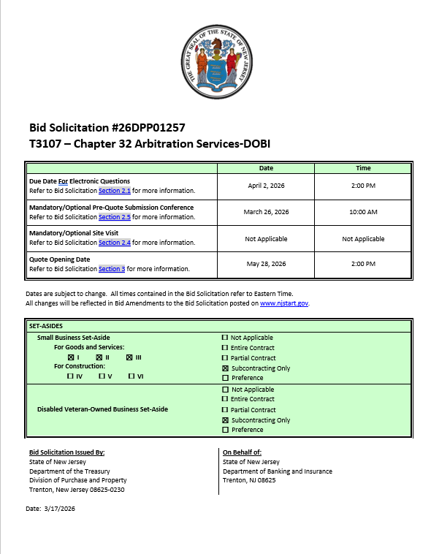
BID SOLICITATION AT A GLANCE
Cover page:
  Bid Solicitation title information
  Submission dates
  Set-aside requirements
Electronic Q&A Due: April 2, 2026 by 2PM
Quotes Due: May 28, 2026 by 2PM

Slide 5
BID SOLICITATION AT A GLANCE
Section 1: Introduction and Summary of the Bid Solicitation
  Purpose and Intent (Section 1.1)
  Background (Section 1.2)
  Order of Precedence and Contractual Terms (Section 1.4)
Section 2: Pre-Quote Submission Information (e-Q&A, exceptions to the SSTC, Bid Amendments)
  Q&A (Section 2.1)
  Exceptions to the State of NJ Standard Terms and Conditions (Section 2.2)
  Bid Amendments (Section 2.3)

Slide 6
BID SOLICITATION AT A GLANCE
Please review this section carefully:
Section 3: Quote Submission Requirements (forms, technical response, State-Supplied Price Sheet Instructions) including, but not limited to:
  Forms (Section 3.13)
  Confidentiality and Commitment to Defend (Section 3.13.7)
  Subcontractor Utilization Plan (3.13.8)
  Technical Quote (Section 3.14)
  Management Overview (3.16)
  Resumes (3.24)
  Financial Capability (3.26)
  State-Supplied Price Sheet (3.27)

Slide 7
BID SOLICITATION AT A GLANCE
Bidder SHALL submit (mandatory):
  Ownership Disclosure Form (Section 3.13.2)
  If your firm intends to subcontract, the Subcontractor Utilization Plan (Section 3.13.8)
  Technical Quote (Section 3.14)
  Management Overview (Section 3.16)
  Mobilization Plan (Section 3.19)
  Demonstrate a minimum of three (3) years’ experience in health care pricing Arbitration (Section 3.25)
  State-Supplied Price Sheet (Section 3.27)
Bidder MUST submit (before Award):
  Affirmative Action Compliance (Section 3.13.10)
  Business Registration (Section 3.13.13)

Slide 8
BID SOLICITATION AT A GLANCE
Bidder SHOULD submit with Quote (strongly recommended, due within seven (7) Business Days of the State’s request or the Quote will be deemed non-responsive):
  Offer and Acceptance Page (Section 3.13.1)
  Disclosure of Investment Activities in Iran (Section 3.13.3)
  Disclosure of Investigations and Other Actions Involving Bidder (Section 3.13.4)
  MacBride Principles (Section 3.13.5)
  Services Performed within the United States (Section 3.13.6)
  Security Due Diligence Third-Party Information Security Questionnaire (Section 3.13.12)
  Certification of Non-Involvement in Prohibited Activities in Russia or Belarus (3.13.14)
  Financial Capability (Section 3.26)
Bidder SHOULD submit:
  Confidentiality/Commitment to Defend
  (Section 3.13.7)
  Contract Management (Section 3.17)
  Contract Schedule (Section 3.18)
  Organizational Experience (Section 3.21)
  Location (Section 3.22)
  Organization Charts (Section 3.23)
  Resumes (Section 3.24)

Slide 9
BID SOLICITATION AT A GLANCE
Section 4: Scope of Work
  Required services to be provided by the awarded Contractor
Section 5: General Contract Terms
  Contractual language, including term details (Sections 5.1 and 5.2)
    Three (3) year base term
    Three (3) one (1) year extension options
  Ownership of Materials (Section 5.4)
  Staff Substitutions (Section 5.5)

Slide 10
BID SOLICTATION AT A GLANCE
Section 6: Data Security Requirements
Section 7: Modifications to the State of New Jersey Standard Terms and Conditions (SSTC)
Section 8: Quote Evaluation and Award
Section 9: Glossary
Attachment 1: State of New Jersey Standard Terms and Conditions
Attachment 2: Standard Procurement Forms Packet
Attachment 3: State of New Jersey Security Due Diligence Third-Party Information Security Questionnaire

Slide 11
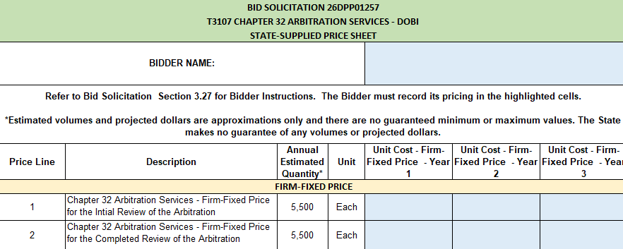

Slide 12
PRICE SHEET PITFALLS
Complete all required price lines on the State-Supplied Price Sheet pursuant to the Bid Solicitation instructions or Quote may be deemed non-responsive. Indicate “no charge” if the cost is $0. Do not leave any price line blank.
The State-Supplied Price Sheet must be completed in its entirety with no lines added or removed, or include additional language, assumptions or fees.
Do not make formatting changes to the State-Supplied Price Sheet. If the price line requires a dollar amount, don’t change it to a percentage, or vice versa. If the price line includes 2 decimal places, don’t change the settings to allow 4 decimals.
Confirm that you have completed all tabs on the State-Supplied Price Sheet.
Confirm you have completed the proper version of the State-Supplied Price Sheet; it may have been revised via Bid Amendment.
Submitting a State-Supplied Price Sheet in a format other than the supplied Excel document can lead to a price sheet being deemed non-responsive when the information in a cell cannot be confirmed by the Bureau.

Slide 13
HELPFUL TIPS & REMINDERS
  Review Bid Solicitation in its entirety and submit any questions prior to the deadline including exceptions to the SSTC. Updated documents will be posted in NJSTART and should be reviewed as posted.
  Submit Quotes on time addressing all mandatory requirements (designated by “shall”) including forms. Quotes missing mandatory requirements may be deemed non-responsive. Not submitting requested information (“should”) may impact the technical evaluation score.
  Be advised that this is NOT a Waiver or Delegated Purchasing Authority (“DPA”) procurement. The Quote may not be emailed, faxed, or hand-delivered. The Quote may only be submitted through NJSTART.
  Do not select “No Bid” on the NJSTART “General Tab” unless you are not intending to submit a bid. Your bid will not appear in the Bid Tab if this option is selected.

Slide 14
OTHER HELPFUL TIPS
Examples of additional language may deem a quote non-responsive:
  Vendor accepts all terms and conditions of this Bid Solicitation with the following additional language: Section X - Agree, as it applies to changes that impact administrative fees as outlined in this provision, provided that Vendor reserves the right to modify Contracted Terms based on changes by the State.
  Vendor’s Quote is only valid for XX days.
  Vendor reserves the right to charge additional fees for services that require extensive time and effort.
  This Quote is a nonbinding expression of interest only and is not intended to create a binding commitment on either party unless and until a definitive agreement has been executed between the parties.
  This Quote may include statements regarding plans for future products and services, or future versions of existing products and services. Any such statements are provided solely for your general information and are not part of this Quote unless specifically stated in writing in this Quote.

Slide 15


Slide 16


Slide 17


Slide 18
THANK YOU FOR ATTENDING
Q&A due by 2pm April 2, 2026
Quotes due by 2pm May 28, 2026

