Slide 1
Optional Pre-Quote Conference
T2770S – SEOC Emergency Center Planning and Staffing Services
26DPP01235
Q&a due by 2pm December 2, 2025
Quotes due by 2pm December 23, 2025

Slide 2
WELCOME & INTRODUCTIONS
Please sign in by entering your name, company, and email in the Microsoft Teams chat window.
  A list of attendees and these slides will be posted to NJSTART.
Please note this conference is being recorded.
Please identify yourself and the firm you represent prior to asking a question.
Please make sure you are registered in NJSTART, and that your contact information remains current.
  NJSTART Vendor email support: njstart@treas.nj.gov
  NJSTART Vendor phone support – (609) 341-3500 Staffed Monday to Friday 8:30 a.m. to 4:30 p.m.
  https://www.state.nj.us/treasury/purchase/vendor.shtml

Slide 3
PURPOSE & GENERAL INFORMATION
The purpose of this conference is to address procedural questions only regarding the Bid Solicitation and Quote submission requirements.
No questions relating to the Scope of Work or the services or products required in the Bid Solicitation will be addressed. Vendors should utilize the Q&A Tab of the Bid Solicitation in NJSTART to submit those questions electronically.
This is also an opportunity for potential Vendors to partner with other potentials Vendors and/or meet small, woman-owned, minority-owned, veteran-owned, and disabled veteran-owned businesses.
The Bid Solicitation will be reviewed section by section with procedural questions being entertained on that basis.

Slide 4
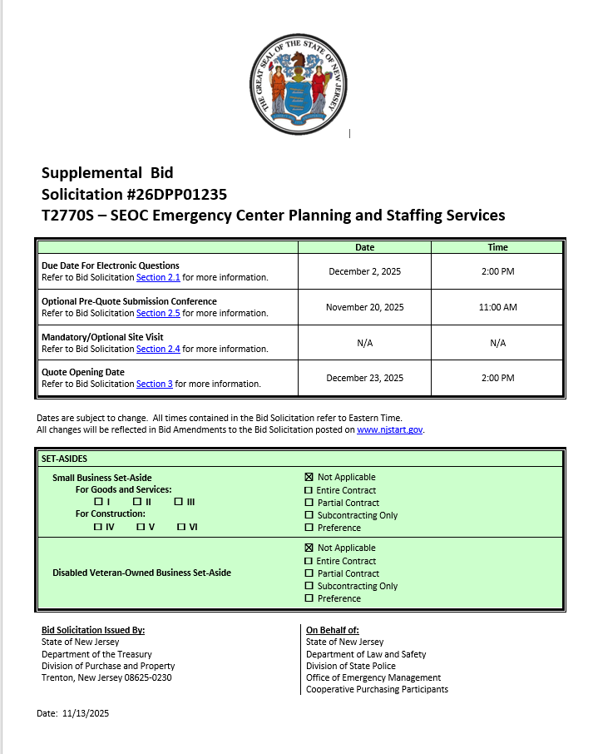
Bid Solicitation at a Glance
Cover Page:
Bid Solicitation Title Information
Submission dates
Set-aside Requirements
This supplemental Bid Solicitation is ONLY for Award Group D - Update to the State Hazard Mitigation Plan.
Electronic Q&A Due: December 2, 2025 by 2PM
Quotes Due: December 23, 2025 by 2PM

Slide 5
BID SOLICITATION AT A GLANCE
Section 1: Introduction and Summary of the Bid Solicitation
  Purpose and Intent (Section 1.1)
  Background (Section 1.2)
  Order of Precedence of Contractual Terms (Section 1.4)
Section 2: Pre-Quote Submission Information e-Q&A, exceptions to the SSTC, Bid Amendments)
  Q&A (Section 2.1)
  Exceptions to the New Jersey Standard Terms and Conditions (Section 2.2)
  Bid Amendments (Section 2.3)

Slide 6
Bid Solicitation at a Glance
Please review this section carefully:
  Section 3: Quote Submission Requirements – including, but not limited to:
    Forms (Section 3.13)
    Confidentiality/ Commitment to Defend (Section 3.13.7)
    Subcontractor Utilization Plan (Section 3.13.8)
    Technical Quote (Section 3.14)
    Management Overview (Section 3.15)
    Resumes (3.23)
    Financial Capability (Section 3.25)
    State-Supplied Price Sheet (3.26)

Slide 7
Bid Solicitation at a Glance
Bidders SHALL submit (Mandatory):
  Ownership Disclosure Form, Section 3.13.2
  Technical Quote (Section 3.14)
  Management Overview (Section 3.15)
  State-Supplied Price Sheet (Section 3.26)
  If your firm intends to subcontract, the Subcontractor Utilization Plan, Section 3.13.8
Bidders MUST submit (before Award):
  Affirmative Action Compliance, Section 3.13.10
  Business Registration, Section 3.13.13

Slide 8
Bid Solicitation at a Glance
Bidders SHOULD submit with Quote (Strongly Recommended). Due within seven (7) Business days of the State’s request or the Quote will be deemed non-responsive:
  Offer and Acceptance Page, Section 3.13.1
  Disclosure of Investment Activities in Iran, Section 3.13.3
  Disclosure of Investigations and Other Actions Involving the Bidder Form, Section 3.13.4
  MacBride Principles, Section 3.13.5
  Source Disclosure, Section 13.13.6
  Confidentiality/Commitment to Defend, Section 3.13.7
  Certification of Non-Involvement in Prohibited Activities in Russia or Belarus, Section 3.13.14
  Financial Capability of the Bidder (Section 3.25)
Bidders SHOULD submit:
  Contract Management (Section 3.16)
  Organizational Experience (Section 3.20)
  Organization Charts (Section 3.22)
  Experience with Contracts of Similar Size and Scope (Section 3.24)
  Confidentiality/Commitment to Defend, Section 3.13.7

Slide 9
Bid Solicitation at a Glance
Please review each section
Section 4: Scope of Work
  Required services to be provided by the awarded Contractor
Section 5: General Contract Terms
  Contractual language, including term details (Sections 5.1 and 5.2)
    Three (3) year base term
    Three (3) one (1) year extension options
  Ownership of Materials (Section 5.4)
  Staff Substitutions (Section 5.5)

Slide 10
BID SOLICITATION AT A GLANCE
Section 7: Modifications to the State of New Jersey Standard Terms and Conditions (SSTC)
Section 8: Quote Evaluation and Award
Section 9: Glossary

Slide 11
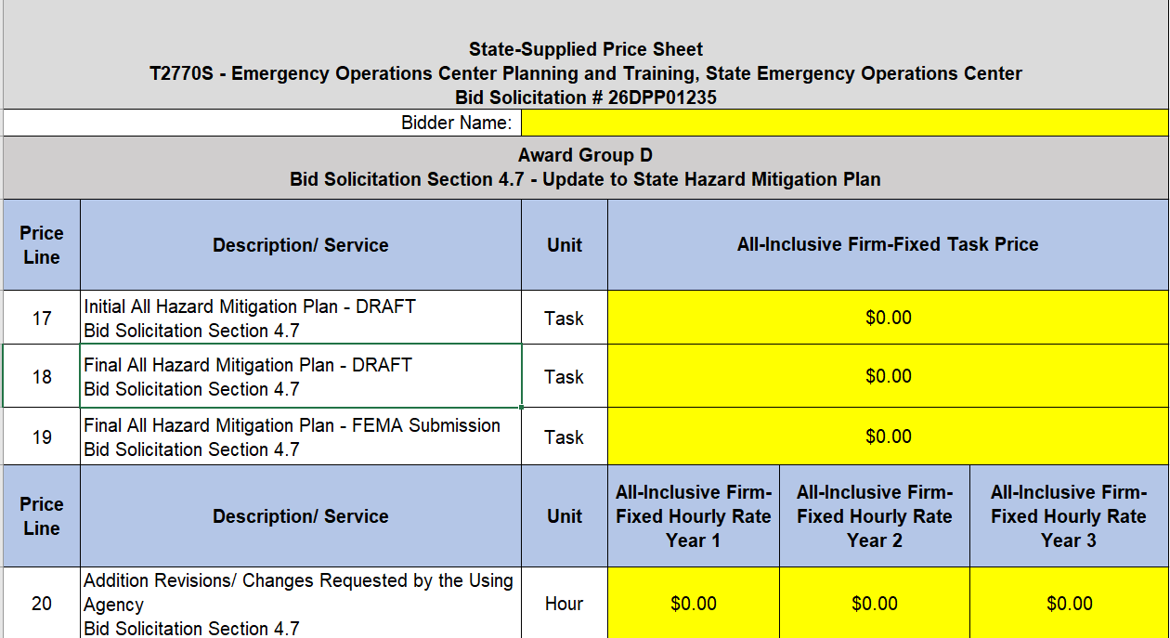

Slide 12
PRICE SHEET PITFALLS
Complete all required price lines on the State-Supplied Price Sheet pursuant to the Bid Solicitation instructions or Quote may be deemed non-responsive. Indicate “no charge” if the cost is $0. Do not leave any price line blank.
The State-Supplied Price Sheet must be completed in its entirety with no lines added or removed, or include additional language, assumptions or fees.
Do not make formatting changes to the State-Supplied Price Sheet. If the price line requires a dollar amount, don’t change it to a percentage, or vice versa. If the price line includes 2 decimal places, don’t change the settings to allow 4 decimals.
Confirm you have completed the proper version of the State-Supplied Price Sheet; it may have been revised via Bid Amendment.
Submitting a State-Supplied Price Sheet in a format other than the supplied Excel document can lead to a price sheet being deemed non-responsive when the information in a cell cannot be confirmed by the Bureau.

Slide 13
HELPFUL TIPS & REMINDERS
  Review Bid Solicitation in its entirety and submit any questions prior to the deadline including exceptions to the SSTC. Updated documents will be posted in NJSTART and should be reviewed as posted.
  Submit Quotes on time addressing all mandatory requirements (designated by “shall”) including forms. Quotes missing mandatory requirements may be deemed non-responsive. Not submitting requested information (“should”) may impact the technical evaluation score.
  Be advised that this is NOT a Waiver or Delegated Purchasing Authority (“DPA”) procurement. The Quote may not be emailed, faxed, or hand-delivered. The Quote may only be submitted through NJSTART.
  Do not select “No Bid” on the NJSTART “General Tab” unless you are not intending to submit a bid. Your bid will not appear in the Bid Tab if this option is selected.

Slide 14
OTHER HELPFUL TIPS
Examples of additional language the may deem a quote non-responsive:
  Vendor accepts all terms and conditions of this Bid Solicitation with the following additional language: Section X - Agree, as it applies to changes that impact administrative fees as outlined in this provision, provided that Vendor reserves the right to modify Contracted Terms based on changes by the State.
  Vendor’s Quote is only valid for XX days.
  Vendor reserves the right to charge additional fees for services that require extensive time and effort.
  This Quote is a nonbinding expression of interest only and is not intended to create a binding commitment on either party unless and until a definitive agreement has been executed between the parties.
  This Quote may include statements regarding plans for future products and services, or future versions of existing products and services. Any such statements are provided solely for your general information and are not part of this Quote unless specifically stated in writing in this Quote.

Slide 15


Slide 16


Slide 17


Slide 18
THANK YOU FOR ATTENDING
Questions due by 2pm December 2, 2025
Quotes due by 2pm December 23, 2025

