Slide 1
Optional Pre-Quote Conference
T3143 – Maintenance of Aircraft, Parts & Service
Bid Solicitation25DPP01148
Q&a due by 2pm, March 26, 2025
Quotes due by 2pm, May 14, 2025

Slide 2
WELCOME & INTRODUCTIONS
Please sign in by entering your name, company, and email in the Microsoft Teams chat window.
  A list of attendees and these slides will be posted to NJSTART.
Please note this conference is being recorded.
Please identify yourself and the firm you represent prior to asking a question.
Please make sure you are registered in NJSTART, and that your contact information remains current.
  NJSTART Vendor email support: njstart@treas.nj.gov
  NJSTART Vendor phone support – (609) 341-3500 Staffed Monday to Friday 8:30 a.m. to 4:30 p.m.
  https://www.state.nj.us/treasury/purchase/vendor.shtml

Slide 3
PURPOSE & GENERAL INFORMATION
The purpose of this conference is to address procedural questions only regarding the Bid Solicitation and Quote submission requirements.
No questions relating to the Scope of Work or the services or products required in the Bid Solicitation will be addressed. Vendors should utilize the Q&A Tab of the Bid Solicitation in NJSTART to submit those questions electronically.
This is also an opportunity for potential Vendors to partner with other potentials Vendors and/or meet small, woman-owned, minority-owned, veteran-owned, and disabled veteran-owned businesses.
The Bid Solicitation will be reviewed section by section with procedural questions being entertained on that basis.

Slide 4
BID SOLICITATION AT A GLANCE
Cover page: Submission dates and set-aside requirements
Section 1: Introduction and Summary of the Bid Solicitation
Section 2: Pre-Quote Submission Information e-Q&A, exceptions to the SSTC, Bid Amendments)
Section 3: Section 3: Quote Submission Requirements (forms, technical response, State-Supplied Price Sheet Instructions)
Section 4: Scope of Work

Slide 5
BID SOLICITATION AT A GLANCE
Section 5: General Contract Terms
Section 6: Data Security Requirements
Section 7: Modifications to the State of New Jersey Standard Terms and Conditions (SSTC)
Section 8: Quote Evaluation and Award
Section 9: Glossary
Attachment 1: State of New Jersey Standard Terms and Conditions

Slide 6
State Supplied Price Sheet
T3143 – Maintenance of Aircraft, Parts & Service
See Section 3.25, State-Supplied Price Sheet Instructions, for directions
There are one hundred and forty-four price lines which are divided by groups. Bidders MUST bid on all price lines contained within a group.
For Example, Group 1 – Bell Aircraft – Bidders MUST bid on Price lines 1 to 85.
Any changes or alterations to the State-Supplied Price Sheet may result in the Bidder’s Quote being deemed non-responsive.-

Slide 7
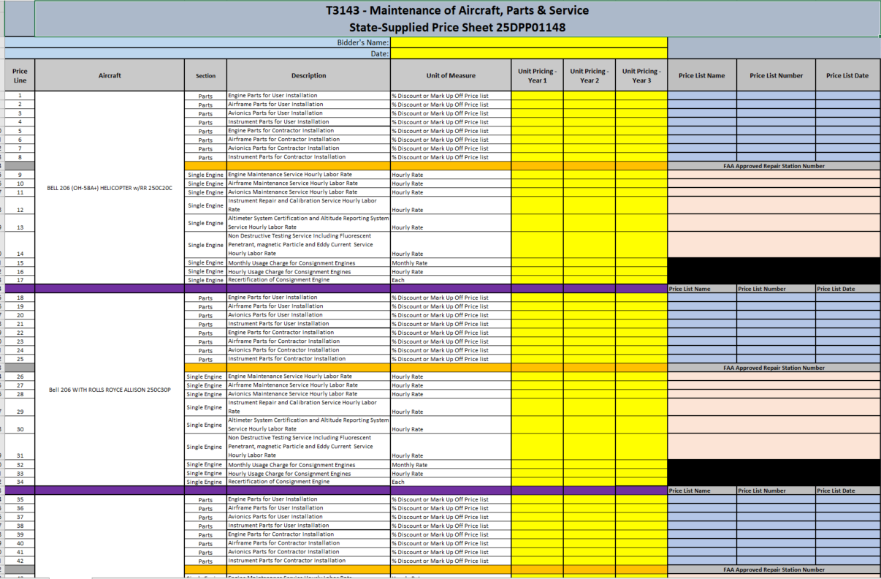

Slide 8
PRICE SHEET PITFALLS
Complete all required price lines on the State-Supplied Price Sheet pursuant to the Bid Solicitation instructions or Quote may be deemed non-responsive. Indicate “no charge” if the cost is $0. Do not leave any price line blank.
The State-Supplied Price Sheet must be completed in its entirety with no lines added or removed, or include additional language, assumptions or fees.
Do not make formatting changes to the State-Supplied Price Sheet. If the price line requires a dollar amount, don’t change it to a percentage, or vice versa. If the price line includes 2 decimal places, don’t change the settings to allow 4 decimals.
Confirm that you have completed all tabs on the State-Supplied Price Sheet.
Confirm you have completed the proper version of the State-Supplied Price Sheet; it may have been revised via Bid Amendment.
Submitting a State-Supplied Price Sheet in a format other than the supplied Excel document can lead to a price sheet being deemed non-responsive when the information in a cell cannot be confirmed by the Bureau.

Slide 9
HELPFUL TIPS & REMINDERS
  Review Bid Solicitation in its entirety and submit any questions prior to the deadline including exceptions to the SSTC. Updated documents will be posted in NJSTART and should be reviewed as posted.
  Submit Quotes on time addressing all mandatory requirements (designated by “shall”) including forms. Quotes missing mandatory requirements may be deemed non-responsive. Not submitting requested information (“should”) may impact the technical evaluation score.
  Do not select “No Bid” on the NJSTART “General Tab” unless you are not intending to submit a bid. Your bid will not appear in the Bid Tab if this option is selected.

Slide 10
OTHER HELPFUL TIPS
Examples of additional language that may deem a quote non-responsive:
  Vendor accepts all terms and conditions of this Bid Solicitation with the following additional language: Section X - Agree, as it applies to changes that impact administrative fees as outlined in this provision, provided that Vendor reserves the right to modify Contracted Terms based on changes by the State.
  Vendor’s Quote is only valid for XX days.
  Vendor reserves the right to charge additional fees for services that require extensive time and effort.
  This Quote is a nonbinding expression of interest only and is not intended to create a binding commitment on either party unless and until a definitive agreement has been executed between the parties.
  This Quote may include statements regarding plans for future products and services, or future versions of existing products and services. Any such statements are provided solely for your general information and are not part of this Quote unless specifically stated in writing in this Quote.

Slide 11


Slide 12


Slide 13


Slide 14
Question?
Your question must pertain to the Procedures and Quote Submission Requirement Only
Any question in regards to the Bid Solicitation must be submitted during the Q&A on NJSTART.

Slide 15
THANK YOU FOR ATTENDING
Q&A due by 2pm, March 26, 2025
Quotes due by 2pm, May 14, 2025

