Slide 1
Optional Pre-Quote Conference
T2435S – Environmental Emergency Response Services: NJDEP & Statewide
Bid Solicitation #25DPP01125
Q&A due by 2PM on March 26, 2025
Quotes due by 2PM on May 7, 2025

Slide 2
WELCOME & INTRODUCTIONS
Please sign in by entering your name and company in the Microsoft Teams chat window.
  A list of attending firms and this presentation will be posted to NJSTART.
Please identify yourself and the firm you represent prior to asking a question.
Please make sure you are registered in NJSTART, and that your contact information remains current.
  NJSTART Vendor email support: njstart@treas.nj.gov
  NJSTART Vendor phone support – (609) 341-3500
    Staffed Monday to Friday 8:30 a.m. to 4:30 p.m.
  https://www.state.nj.us/treasury/purchase/vendor.shtml

Slide 3
PURPOSE & GENERAL INFORMATION
The purpose of this conference is to address procedural questions only, regarding the Bid Solicitation and Quote submission requirements.
  No questions relating to the Scope of Work, services, or products required in the Bid Solicitation will be addressed. Vendors should utilize the Q&A Tab of the Bid Solicitation in NJSTART to submit those questions electronically.
The Bid Solicitation will be reviewed section by section with procedural questions being entertained on that basis.

Slide 4
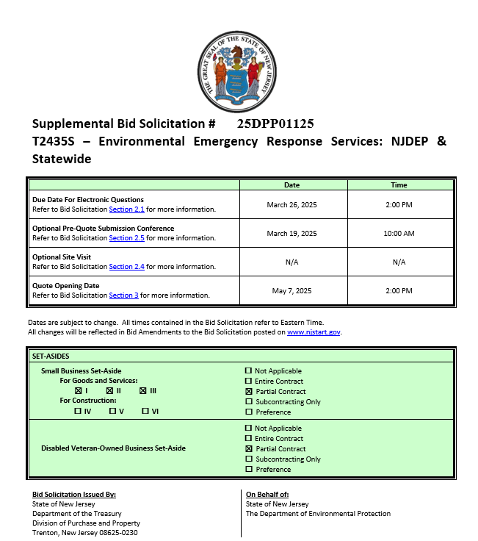
BID SOLICITATION AT A GLANCE
  Cover Page:
  Bid Solicitation Title Information
  Submission dates
  Set-aside requirements
  Electronic Q&A Due: March 26, 2025 by 2PM
  Quotes Due: May 7, 2025 by 2PM

Slide 5
BID SOLICITATION AT A GLANCE
  Section 1: Introduction and Summary
    Purpose and Intent (Section 1.1)
    Background (Section 1.2)
    Order of Precedence of Contractual Terms (Section 1.4)
  Section 2: Pre-Quote Submission Information
    Q&A (Section 2.1)
    Exceptions to the New Jersey Standard Terms and Conditions (Section 2.2)
    Bid Amendments (Section 2.3)
Please review each Section carefully:

Slide 6
BID SOLICITATION AT A GLANCE
Please review this section carefully:
  Section 3: Quote submission requirements - including, but not limited to:
    Forms (Section 3.13)
    Confidentiality/Commitment To Defend (Section 3.13.7)
    Public Works Contractor Registration (Section 3.13.8)
    A-901 License (Section 3.13.9)
    Technical Quote (Section 3.14)
    Management Overview (Section 3.15)
    Case History Form (Section, 3.19)
    Resumes (Section 3.23)
    Financial Capability (Section 3.24)
    State-Supplied Price Sheet (Section 3.25)

Slide 7
BID SOLICITATION AT A GLANCE
Bidders should submit with Quote (Strongly Recommended), required prior to award
  Offer and Acceptance Page, Section 3.13.1
  Disclosure of Investment Activities in Iran Section 3.13.3
  Disclosure of Investigations and Other Actions Involving the Bidder Form, Section 3.13.4.
  MacBride Principles, Section 3.13.5
  Source Disclosure 3.13.6
  Confidentiality/Commitment to Defend, Section 3.13.7
  Certificate of Public Convenience and Necessity, Section 3.13.10
  Certification of Non-Involvement in Prohibited Activities in Russia or Belarus, Section 3.13.17
  Affirmative Action Compliance, Section 3.13.14
  Business Registration, Section 3.13.16
Bidders shall submit with Quote (Mandatory)
  Ownership Disclosure Form, Section 3.13.2
  Public Works Contractor Registration, Section 3.13.8
  A-901 License, Section 3.13.9
  If your firm intends to subcontract, the Subcontractor Utilization Plan, Section 3.13.12

Slide 8
BID SOLICITATION AT A GLANCE
Section 3 Quote Submission Requirements
Bidders shall submit:
  Technical Quote, Section 3.14
  Management Overview, Section 3.15
  State-Supplied Price Sheet, Section 3.25
Bidders should submit:
  Contract Management, Section 3.16
  Additional Plans, Section 3.17
    Health and Safety Plan (HASP)
    Spill Prevention and Contingency Plan
    Staffing Plan
  Additional Licenses, Section 3.18
  Case History Form, Section 3.19
  Organizational Charts, Section 3.22
  Resumes, Section 3.23
  Financial Capability of the Bidder, Section 3.24
Please review Section 3 in its entirety for a full list of submission specifications.

Slide 9
BID SOLICITATION AT A GLANCE
Please review each section carefully.
  Section 4: Scope of Work
    Required services to be provided by the awarded Contractor
  Section 5: General Contract Terms
    Contractual language including term details (Section 5.1 and 5.2)
      Base Term will end on October 10, 2029
      Three 1-Year Extension Term Options
    Ownership of Materials (Section 5.4)
    Staff Substitutions (Section 5.5)

Slide 10
BID SOLICITATION AT A GLANCE
Please review each section carefully.
Section 6: Data Security Requirements
Section 7: Insurance, Modifications to the NJ Standard Terms and Conditions (SSTCs), and supplemental indemnification
Section 8: Evaluation criteria, clarifications, and Best and Final Offer (BAFO)
Section 9: Glossary (including Contract Specific Definitions)

Slide 11
HELPFUL TIPS & REMINDERS
  Review Bid Solicitation in its entirety and submit any questions prior to the deadline including exceptions to the SSTC. Updated documents will be posted in NJSTART and should be reviewed as posted.
  Submit Quotes on time addressing all mandatory requirements (designated by “shall”) including forms. Quotes missing mandatory requirements may be deemed non-responsive. Not submitting requested information (“should”) may impact the technical evaluation score.
  Do not select “No Bid” on the NJSTART “General Tab” unless you are not intending to submit a bid. Your bid will not appear in the Bid Tab if this option is selected.
  Price Sheet must be completed in its entirety with no lines added or removed, or additional language or fees referenced

Slide 12
PRICE SHEET PITFALLS
  Complete all required price lines on the State-Supplied Price Sheet pursuant to the Bid Solicitation instructions or Quote may be deemed non-responsive. Indicate “no charge” if the cost is $0. Do not leave any price line blank.
  The State-Supplied Price Sheet must be completed in its entirety with no lines added or removed, or include additional language, assumptions or fees.
  Do not make formatting changes to the State-Supplied Price Sheet. If the price line requires a dollar amount, don’t change it to a percentage, or vice versa. If the price line includes 2 decimal places, don’t change the settings to allow 4 decimals.
  Confirm that you have completed all tabs on the State-Supplied Price Sheet.
  Confirm you have completed the proper version of the State-Supplied Price Sheet; it may have been revised via Bid Amendment.
  Submitting a State-Supplied Price Sheet in a format other than the supplied Excel document can lead to a price sheet being deemed non-responsive when the information in a cell cannot be confirmed by the Bureau.

Slide 13
STATE-SUPPLIED PRICE SHEET
Please submit all pricing according to the instructions in Bid Solicitation Section 3.25
There are two (2) State-Supplied Price Sheets:
  Northern Region
  Southern Region
    Both Regions contain the same price lines
Bidders must submit pricing for at least one Region, and may submit pricing for both Regions.
Bidders must bid on all price lines within a Region to be considered for an award of that Region or the Quote may be deemed non-responsive for the respective Region.

Slide 14
OTHER HELPFUL TIPS
Do NOT include language such as this:
  Vendor accepts all terms and conditions of this Bid Solicitation with the following additional language: Section X - Agree, as it applies to changes that impact administrative fees as outlined in this provision, provided that Vendor reserves the right to modify Contracted Terms based on changes by the State.
  Vendor’s Quote is only valid for XX days.
  Vendor reserves the right to charge additional fees for services that require extensive time and effort.
  This Quote is a nonbinding expression of interest only and is not intended to create a binding commitment on either party unless and until a definitive agreement has been executed between the parties.
  This Quote may include statements regarding plans for future products and services, or future versions of existing products and services. Any such statements are provided solely for your general information and are not part of this Quote unless specifically stated in writing in this Quote.

Slide 15
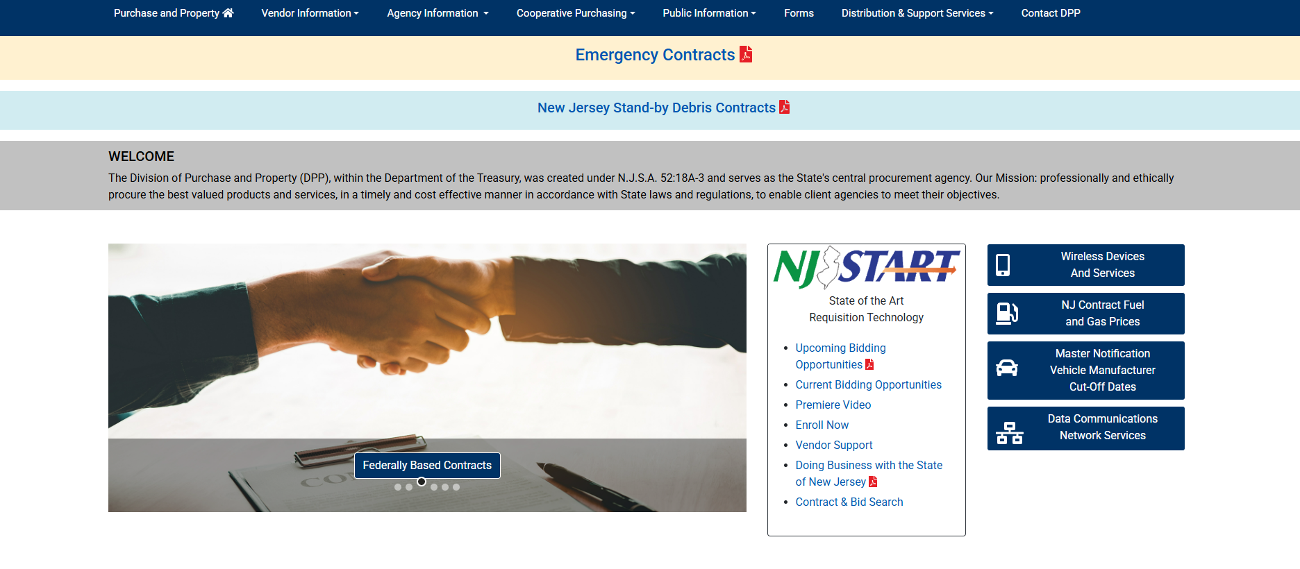

Slide 16
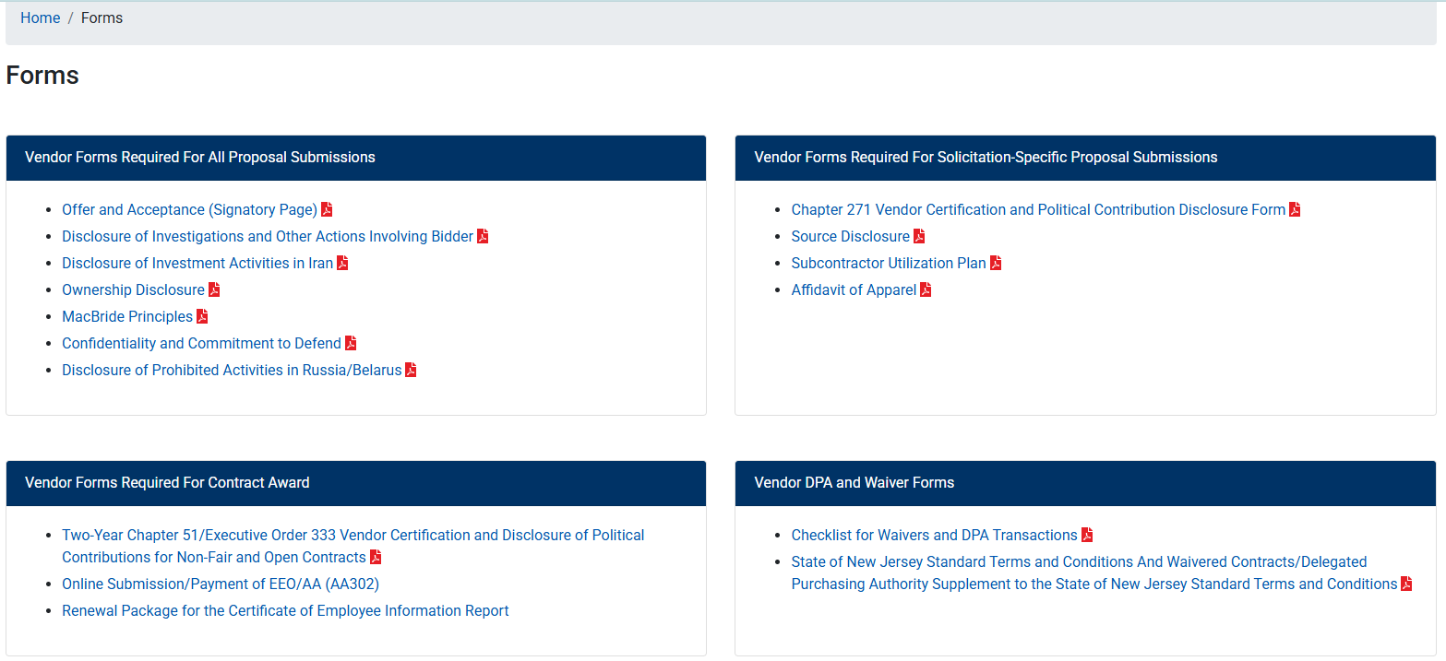

Slide 17


Slide 18
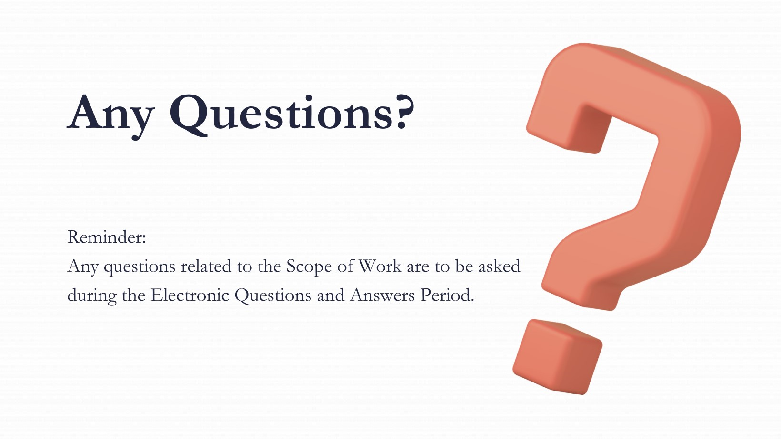

Slide 19
THANK YOU FOR ATTENDING
Q&A due by 2PM March 26, 2025
Quotes due by 2PM May 7, 2025

