Slide 1
Optional Pre-Quote Conference
T3030 Equipment Master Lease Purchasing Financing Facility
25DPP01105
Q&a due by 2pm February 19, 2026
Quotes due by 2pm date March 17, 2026

Slide 2
WELCOME & INTRODUCTIONS
Please sign in by entering your name, company, and email in the Microsoft Teams chat window.
  A list of attendees and these slides will be posted to NJSTART.
Please note this conference is being recorded.
Please identify yourself and the firm you represent prior to asking a question.
Please make sure you are registered in NJSTART, and that your contact information remains current.
  NJSTART Vendor email support: njstart@treas.nj.gov
  NJSTART Vendor phone support – (609) 341-3500 Staffed Monday to Friday 8:30 a.m. to 4:30 p.m.
  https://www.state.nj.us/treasury/purchase/vendor.shtml

Slide 3
PURPOSE & GENERAL INFORMATION
The purpose of this conference is to address procedural questions only regarding the Bid Solicitation and Quote submission requirements.
No questions relating to the Scope of Work or the services or products required in the Bid Solicitation will be addressed. Vendors should utilize the Q&A Tab of the Bid Solicitation in NJSTART to submit those questions electronically.
The Bid Solicitation will be reviewed section by section with procedural questions being entertained on that basis.

Slide 4
BID SOLICITATION AT A GLANCE
Cover page: Submission dates and set-aside requirements (not applicable)
Section 1: Introduction and Summary of the Bid Solicitation
Section 2: Pre-Quote Submission Information e-Q&A, exceptions to the SSTC, Bid Amendments)
Section 3: Quote Submission Requirements (forms, technical response, State-Supplied Price Sheet Instructions)
Section 4: Scope of Work

Slide 5
BID SOLICITATION AT A GLANCE
Section 5: General Contract Terms
Section 6: Data Security Requirements
Section 7: Modifications to the State of New Jersey Standard Terms and Conditions (SSTC)
Section 8: Quote Evaluation and Award
Section 9: Glossary
Attachment 1: Terms and Conditions for T3030 Equipment Master Lease

Slide 6
SECTION 2.1 QUESTION AND ANSWER PERIOD – GENERAL QUESTIONS
The Division will only accept questions electronically through the Q&A tab in NJSTART.
Questions should be asked in consecutive order, from beginning to end, following the organization of the Bid Solicitation and if applicable, the Master Equipment Lease Purchase Agreement.

Slide 7
SECTION 2.1 QUESTION AND ANSWER PERIOD – MASTER LEASE
Bidders should review Appendix 1 – State Master Equipment Lease Purchase Agreement, including all of its exhibits and MUST provide proposed changes during the Q&A period to email: T3030EquipmentMasterLease@treas.nj.gov.
Proposed edits to the State Master Equipment Lease Purchase Agreement must be submitted in REDLINE on the draft State Master Equipment Lease Purchase Agreement. Any explanation regarding the proposed change should be provided in a comment bubble.
Acceptance or rejection of the proposed edits to the Master Equipment Lease Purchase Agreement is at the sole discretion of the Office of Public Finance.
If a Bidder proposes a change to the State Master Equipment Lease Purchase Agreement in its Quote that was not proposed during the Q&A period, the change will not be accepted, and the Quote may be deemed non-responsive.
Please note: ONLY changes to the Master Equipment Lease Purchase Agreement will be accepted via email. ALL OTHER QUESTIONS MUST BE SUBMITTED ON THE Q&A TAB IN NJSTART.

Slide 8
Section 3: Quote Submission Requirements
3.13.1- Offer and Acceptance – SHOULD
3.13.2 – Ownership Disclosure Form - SHALL (MUST)
3.13.3 – Disclosure of Investment Activities in Iran Form – SHOULD
3.13.4 – Disclosure of Investigations and Other Actions Involving Bidder Form – SHOULD
3.13.5 – Macbride Principles Form – SHOULD
3.13.7 – Confidentiality/Commitment To Defend – SHOULD
3.13.10 – Affirmative Action – SHALL (MUST)
3.13.13 – Business Registration – SHALL (MUST)
3.13.14 – Certification of Non-Involvement in Prohibited Activities Russia or Belarus - SHOULD

Slide 9
Section 3.26 PRICE SHEET INSTRUCTIONS
Any fees or expenses of the Lessor shall be included within the interest rates on the State-Supplied Price Sheet for price line numbers 1 through 3. Refer to Sections 4.4 Interest Rate and 4.8 Payment by the State to the Lessor, when completing these price lines.
Seven (7) to ten (10) business days before the Quote Opening Date via Bid Amendment in NJSTART, the State will post a screenshot of the 490 SOFR Curve on the Bloomberg Service. The shortcut code to reach this 490 SOFR Curve is “ICVS 490”. This reference is provided so all Bidders are utilizing the same SOFR Swap Rate when preparing a price quote. Please see Appendix 6 of the Master Lease - 490 SOFR Curve (SAMPLE).
The Bidder must insert the percentage of the appropriate SOFR Swap Rate as a firm fixed price in all price lines on the State-Supplied Price Sheet. This may be done as either a discount or premium to the SOFR Swap Index. The Bidder should make certain that the financing rate is presented as a percentage of the appropriate SOFR Swap Rate and not as an interest rate. Bidders may also submit a spread on the price line provided. The spread should be presented in basis points (bp).
For each interest rate quote provided in the preparation of a price quote, the Bidder must refer to the corresponding bid SOFR Swap Rate as referenced on the 490 SOFR Curve swap rate on Bloomberg Service ICVS 490. That is, the interest rate quote referenced to for the 3-year term must be based off the 3-year bid SOFR Swap Rate; the interest rate quote referenced to for the 4-year term must be based off the 4-year bid SOFR Swap Rate; and the interest rate quote referenced to for the 5-year term must be based off the 5-year bid SOFR Swap Rate. Please round all percentages to four (4) decimal places.
Bidders should disclose their internal policies, including any restrictions, regarding financing Soft Costs. (See Section 4.12 of the Bid Solicitation and State-Supplied Price Sheet). Soft Costs are items such as software/hardware maintenance, programming, design and training, that are usually small additions to the price of the Equipment.

Slide 10
PRICE SHEET PITFALLS
Complete all required price lines on the State-Supplied Price Sheet pursuant to the Bid Solicitation instructions or Quote may be deemed non-responsive. Indicate “no charge” if the cost is $0. Do not leave any price line blank.
The State-Supplied Price Sheet must be completed in its entirety with no lines added or removed, or include additional language, assumptions or fees.
Do not make formatting changes to the State-Supplied Price Sheet. If the price line requires a dollar amount, don’t change it to a percentage, or vice versa. If the price line includes 4 decimal places, don’t change the settings to allow 5 decimals.
Confirm that you have completed all tabs on the State-Supplied Price Sheet.
Confirm you have completed the proper version of the State-Supplied Price Sheet; it may have been revised via Bid Amendment.
Submitting a State-Supplied Price Sheet in a format other than the supplied Excel document can lead to a price sheet being deemed non-responsive when the information in a cell cannot be confirmed by the Bureau.

Slide 11
HELPFUL TIPS & REMINDERS
  Review Bid Solicitation in its entirety and submit any questions prior to the deadline including exceptions to the Terms and Conditions for T3030 Equipment Master Lease. Updated documents will be posted in NJSTART and should be reviewed as posted.
  Submit Quotes on time addressing all mandatory requirements (designated by “shall”) including forms. Quotes missing mandatory requirements may be deemed non-responsive. Not submitting requested information (“should”) may impact the technical evaluation score.
  Be advised that this is NOT a Waiver or Delegated Purchasing Authority (“DPA”) procurement. The Quote may not be emailed, faxed, or hand-delivered. The Quote may only be submitted through NJSTART.
  Do not select “No Bid” on the NJSTART “General Tab” unless you are not intending to submit a bid. Your bid will not appear in the Bid Tab if this option is selected.

Slide 12
OTHER HELPFUL TIPS
Examples of additional language that may result in the quote being deemed non-responsive:
  Vendor accepts all terms and conditions of this Bid Solicitation with the following additional language: Section X - Agree, as it applies to changes that impact administrative fees as outlined in this provision, provided that Vendor reserves the right to modify Contracted Terms based on changes by the State.
  Vendor’s Quote is only valid for XX days.
  Vendor reserves the right to charge additional fees for services that require extensive time and effort.
  This Quote is a nonbinding expression of interest only and is not intended to create a binding commitment on either party unless and until a definitive agreement has been executed between the parties.
  This Quote may include statements regarding plans for future products and services, or future versions of existing products and services. Any such statements are provided solely for your general information and are not part of this Quote unless specifically stated in writing in this Quote.

Slide 13
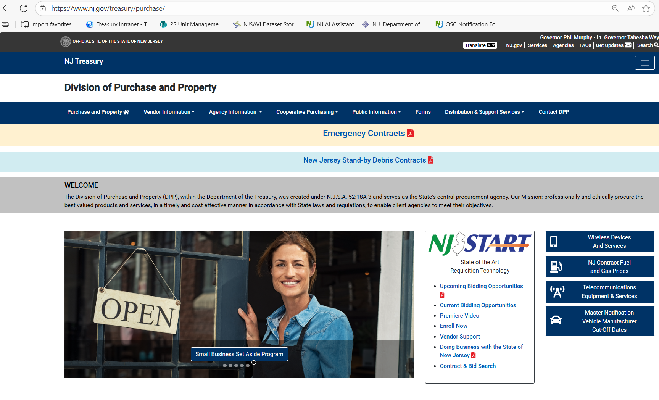


Slide 14
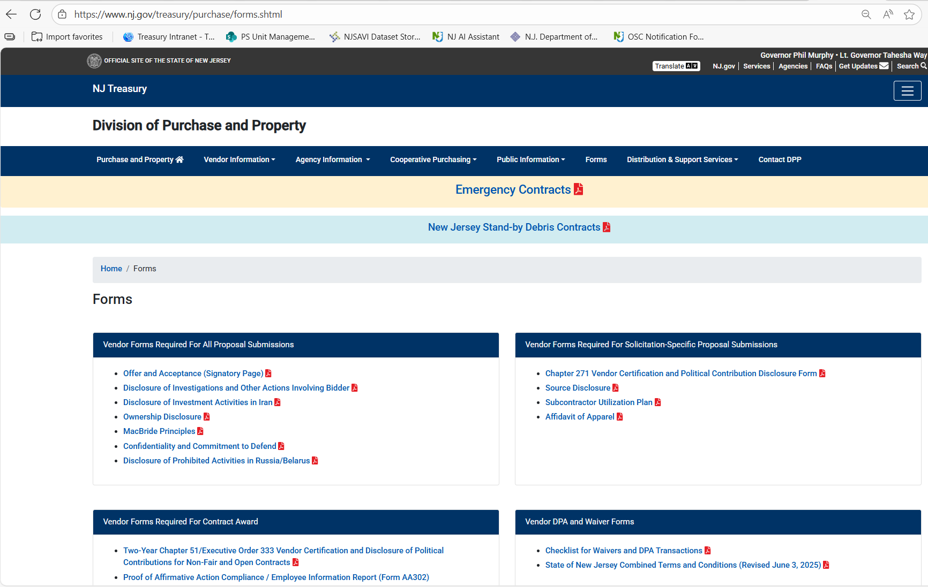

Slide 15


Slide 16
THANK YOU FOR ATTENDING
Q&A due by 2pm February 19, 2026
Quotes due by 2pm March 17, 2026

