Slide 1
Optional Pre-Quote Conference
T1464 – Substance Abuse Services
25DPP01102
Q&a due by 2pm, July 21, 2025
Quotes due by 2pm, September 9, 2025
Notes:
Good morning, my name is Tahira Maner and I am a Procurement Specialist for the Professional Services unit within the Division of Purchase and Property and I would like to welcome everyone to this optional Pre-Quote Conference for Bid Solicitation 25DPP01102 titled T1464 – Substance Abuse Services. Also on the call today are my Supervisor Wendi Higgins, and Bureau Counsel Marisa Roberts.

Slide 2
WELCOME & INTRODUCTIONS
Please sign in by entering your name, company, and email in the Microsoft Teams chat window.
  A list of attendees and these slides will be posted to NJSTART.
Please identify yourself and the firm you represent prior to asking a question.
Please make sure you are registered in NJSTART, and that your contact information remains current.
  NJSTART Vendor email support: njstart@treas.nj.gov
  NJSTART Vendor phone support:(609) 341-3500 Staffed Monday to Friday 8:30 a.m. to 4:30 p.m.
  https://www.state.nj.us/treasury/purchase/vendor.shtml
Notes:
Before we begin, I would like to review some administrative items related to the meeting format and general reminders:
#1) I need everybody to sign in by entering your full name and company, in the Microsoft TEAMS chat window. This presentation and a list of attendees will be posted to NJSTART.
#2) Please keep your microphone or phones on mute to avoid background noise.
#3) Please identify yourself and the firm you represent prior to asking a question.
#4) Companies need to be registered on NJSTART in order to submit a bid and if your firm is registered, be sure that the contact information is up to date to ensure updates posted to the Bid Solicitation are received.
#5) If you need any assistance with NJSTART, you can email or call our NJSTART Vendor Support team. Contact information can be found here on slide 2 of the presentation.
Before I proceed to the next slide, I would like to confirm that all attending today’s pre-quote conference have entered their name, email contact information, and their firm in the chat window. Thank you.

Slide 3
PURPOSE & GENERAL INFORMATION
The purpose of this conference is to address procedural questions only, regarding the Bid Solicitation and Quote submission requirements.
No questions relating to the Scope of Work or the services or products required in the Bid Solicitation will be addressed. Vendors should utilize the Q&A Tab of the Bid Solicitation in NJSTART to submit those questions electronically.
This is also an opportunity for potential Vendors to partner with other potential Vendors and/or meet small, woman-owned, minority-owned, veteran-owned, and disabled veteran-owned businesses.
The Bid Solicitation will be reviewed section by section with procedural questions being entertained on that basis.
Notes:
The purpose of this conference is to discuss procedural and Quote submission requirements. We will not be discussing or answering any questions regarding the Scope of Work, which can be found in Bid Solicitation Section 4. All questions related to the scope of work must be submitted through the Q&A Tab on NJSTART prior to the Q&A deadline which is July 21, 2025. The majority of today’s presentation will focus on Sections 1, 2, 3, 5, and 7 which I will review section by section. However, even though we will not be reviewing every single part of the Bid Solicitation, I will try to highlight some of the most important topics. Please note that this conference also provides an opportunity for potential Vendors to partner with other potential Vendors and also to be introduced to small, women-owned, minority-owned, veteran-owned, and disabled veteran-owned businesses. SWITCH OVER TO THE BID SOLICITATION.

Slide 4
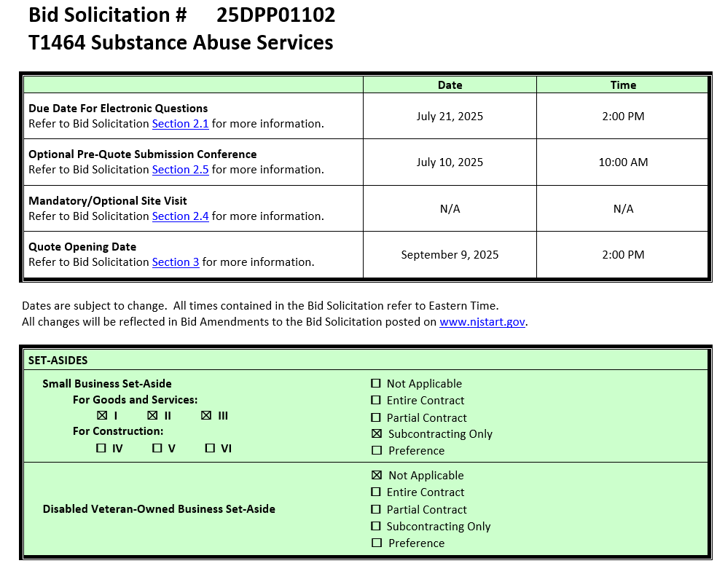
Notes:
The Cover Sheet of the Bid Solicitation, which is seen here, contains important dates and deadlines, in addition to any set-aside requirements. For this procurement, there is a Small Business Set-Aside for Subcontracting Only.
Just a reminder, electronically submitted questions are due by 2pm this July 21st and your Quotes are currently due by 2pm this September 9th. These dates are subject to change and if changed, will be reflected in a Bid Amendment posted to NJSTART.

Slide 5
BID SOLICITATION AT A GLANCE
Cover page: Submission dates and set-aside requirements
Section 1: Introduction and Summary of the Bid Solicitation
Section 1.1: Describes the Purpose & Intent
Section 1.2: Provides Background information
Section 2: Pre-Quote Submission Information, e-Q&A, exceptions to the SSTC, and Bid Amendments
Section 2.1: Instructs on how to submit the electronic questions
Section 2.2: Addresses exceptions to the State of NJ Standard Terms and Conditions
Section 2.3: Details Bid Amendments, which are revisions to this Bid Solicitation and its supporting documents. These Amendments can range from changes in dates or Bidder requirements and responses to questions received (if any).
Section 2.6: Lists all the publicly available documents that a Bidder needs to review in order to prepare and submit accurate and comprehensive Quotes.
Notes:
Sections 1 and 2 address some important information and pre-Quote housekeeping measures.
Now, I will give further descriptions on their sub-sections:
Section 1.1 of the Bid Solicitation describes the Purpose & Intent, while Section 1.2 provides Background information.
Section 2.1 lays out the instructions for submitting electronic questions and
Section 2.2 addresses exceptions to the State of New Jersey Standard Terms and Conditions. The State of New Jersey Standard Terms and Conditions can be found in the Attachments tab in NJSTART.
AN IMPORTANT REMINDER: If your firm has any objections to the State’s Standard Terms and Conditions, those objections and suggested revisions must be submitted in the Question and Answer process detailed in Section 2.2. It’s important to understand that if your Quote conflicts with the State’s Standard Terms and Conditions without it being sufficiently addressed in the Question and Answer process, your Quote may be deemed non-responsive.
Section 2.3 details Bid Amendments, which are revisions to this Bid Solicitation and its supporting documents. These Amendments can range from changes in dates or Bidder requirements and responses to questions received (if any).
If a revised document is uploaded as part of a bid amendment, it is important that your firm’s Quote reflects the most current version of whatever document has been changed.
Section 2.6 Pre-Quote Document Review – lists all the publicly available documents that a Bidder needs to review in order to prepare and submit accurate and comprehensive Quotes.

Slide 6
BID SOLICITATION AT A GLANCE
Section 3: Quote Submission Requirements – forms, technical response, State-Supplied Price Sheet Instructions
Section 3.18: Provides directions on what details the Bidder must include in its mobilization plan that is a mandatory part of the Quote submission
Section 3.25: Instructions the Bidder must follow when submitting its pricing on the State-Supplied Price Sheet
Section 4: Scope of Work – Requirements of the Contractor
Section 5: General Contract Terms
Section 6: Data Security Requirements
Section 7: Modifications to the State of New Jersey Standard Terms and Conditions (SSTC)
Notes:
Section 3 addresses the quote submission requirements. This includes how to submit your Quote and what should be included, including forms.
On NJSTART, you’ll find a checklist called the Standard Procurement Forms Packet, this will assist you in submitting the proper forms.
A few terms you will see throughout the Bid Solicitation are shall, must, should, and may. There are very important distinctions between these terms. If an item is designated as “shall” or “must,” it is a mandatory requirement and failure to comply can result in your Quote being deemed non-responsive.
Where an item is designated as “should” or “may” it is not mandatory for the bidder to submit with the quote but is strongly recommended. Please note that while “should” or “may” does not denote a mandatory requirement, technical scoring could be impacted if requested information is not provided.
Section 3.18 Mobilization Plan provides directions on what details the Bidder must include in its mobilization plan that is a mandatory part of the Quote submission
Section 3.25 State-Supplied Price Sheet Instructions details all of the mandatory instructions the Bidder must adhere to when completing the State-Supplied Price Sheet that is accompanying this Bid Solicitation
Section 4 is the Scope of Work. These are the services that the State requires. Be sure that your firm’s Quote adequately addresses how they intend to meet these requirements. Failure to do so may result in your firm’s Quote being deemed non-responsive or impact the technical score from the evaluation committee.
Section 5 details the Bid Solicitation’s General Contract Terms. This Section addresses a number of items such as the Contract Term, any available Extension Terms, the Contract Transition Term, Ownership of Material, and more.
Please be sure to carefully read the rest of Section 5 in your own time.
Section 6 explains the Contractor’s mandatory responsibility to submit a detailed Security Plan as outlined in this section. Please be sure to carefully read section 6 in your own time.
Section 7 addresses Modifications to the State of New Jersey’s Standard Terms and Conditions. Please be sure to carefully read this section. As a reminder, questions about and exceptions to this section and/or the Standard Terms and Conditions must be submitted prior to the Electronic Questions due deadline, which is 2:00 pm on July 21st.

Slide 7
BID SOLICITATION AT A GLANCE
Section 8: Quote Evaluation and Award
Section 9: Glossary
Attachment 1: State of New Jersey Standard Terms and Conditions
Attachment 2: Standard Procurement Forms Packet
Attachments 3 – 11: T1464 specific attachments
Notes:
Section 8 describes the Division of Purchase and Property’s Quote Evaluation process.
Please take the time to review this section in your own time.
And finally Section 9 covers our glossary terms. What follows are our standard definitions, which are part of a majority of our Contracts.
Any additional Scope of Work-specific definitions can be found in Section 9.3
Also, please make sure to carefully review all the Attachments to the Bid Solicitation, which can be found in the Attachments tab on NJSTART.
Remember: Bidders should review all documents specific to this Bid Solicitation. Other advertised Bid Solicitations may have different requirements.

Slide 8
Section 3: Quote Submission Requirements
Section 3.13.1 Offer and Acceptance- SHOULD
Section 3.13.2 Ownership Disclosure- SHALL (MUST)
Section 3.13.3 Disclosure of Investment Activities in Iran Form- SHOULD
Section 3.13.4 Disclosure of Investigations and Other Actions Involving Bidder Form- SHOULD
Section 3.13.5 MacBride Principles Form- SHOULD
Section 3.13.6 Service Performance Within the United States (Source Disclosure Form)- SHOULD
3.13.7 Confidentiality/Commitment to Defend- SHOULD
Notes:
Back to Bid Solicitation Section 3:
Some of the subsections in Section 3 are designated as “shall” and some are designated as “should”. Please review carefully and make the appropriate determination when preparing your response.
Of particular importance is the Ownership Disclosure form. This form is required with your Quote. Please be sure to read the instructions on the form and fill it out completely and accurately. Your quote will be deemed non-responsive if information is missing, or if boxes are checked incorrectly.

Slide 9
Section 3: Quote Submission Requirements
Section 3.13.8 Subcontractor Utilization Plan - SHALL only if planning to utilize subcontractors at time of Quote submission. If the Bidder does not intend to use subcontractors, the Subcontractor Utilization Plan form is not required.
Section 3.13.8.1 Small Business Subcontracting Set-Aside Contract - This is a Contract with set-aside subcontracting for New Jersey Small Business Enterprises.
Section 3.13.10 Affirmative Action – SHALL (MUST) – Required after issuance of Notice of Intent to Award
Section 3.13.12 State of NJ Security Due Diligence Third Party Information Security Questionnaire – SHOULD
Section 3.13.13 Business Registration- SHOULD
Section 3.13.14 Certification of Non-Involvement in Prohibited Activities in Russia or Belarus- SHOULD
Notes:
On this slide are the remaining Quote submission requirements for Section 3.
I would like to bring to your attention the following:
Section 3.13.8 contains instructions for completing the Subcontractor Utilization Plan. You do not have to subcontract, but if you choose to subcontract, you must submit a subcontractor utilization form.
Section 3.13.8.1 designates this Contract as a subcontracting set-aside for NJ Small Business Enterprises. Instructions on the steps that need to be taken to make a good faith effort to solicit and hire eligible NJ Small Business Enterprises are included here along with the potential consequences for NOT following these instructions.

Slide 10
PRICE SHEET PITFALLS
Complete all required price lines on the State-Supplied Price Sheet pursuant to the Bid Solicitation instructions, or Quote may be deemed non-responsive. Indicate “no charge” if the cost is $0. Do not leave any price line blank.
The State-Supplied Price Sheet must be completed in its entirety with no lines added or removed, or include additional language, assumptions or fees.
Do not make formatting changes to the State-Supplied Price Sheet. If the price line requires a dollar amount, don’t change it to a percentage, or vice versa. If the price line includes 2 decimal places, don’t change the settings to allow 4 decimals.
Confirm that you have completed all tabs on the State-Supplied Price Sheet.
Confirm you have completed the proper version of the State-Supplied Price Sheet; it may have been revised via Bid Amendment.
Submitting a State-Supplied Price Sheet in a format other than the supplied Excel document can lead to a price sheet being deemed non-responsive when the information in a cell cannot be confirmed by the Bureau.
Notes:
Let’s take a moment to address some common State-Supplied Price Sheet errors we see bidders making when submitting quotes.
Be sure to complete all required price lines on the Price Sheet, or the Quote may be deemed non-responsive. Do not leave any price lines blank. Only fill out the prices lines in yellow. Indicate “no charge” if the cost is $0.
Do not make formatting changes to the Price Sheet. If the price line requires a dollar amount, don’t change it to a percentage, or vice versa. If the price line includes 2 decimal places, don’t change the settings to allow 4 decimals.
Confirm you have completed the latest version of the State-Supplied Price Sheet, in the supplied Excel document, as it may have been revised via Bid Amendment. Review all posted amendments that may include changes to the Price Sheet and Bid Solicitation. These changes must be taken into account when completing the State-Supplied Price Sheets.
And, submitting a State-Supplied Price Sheet in a format other than the supplied Excel document can lead to a price sheet being deemed non-responsive when the information in a cell cannot be confirmed by the Bureau.

Slide 11
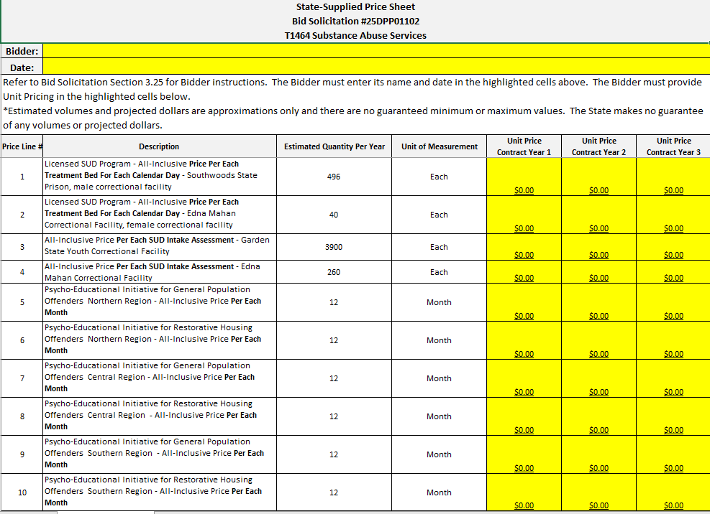
Notes:
Section 3.25 State-Supplied Price Sheet Instructions
The Bidder must submit its pricing using the State-Supplied Price Sheet accompanying this Bid Solicitation and located on the “Attachments” Tab. Each Bidder is required to hold its pricing firm through the issuance of the Contract.
There are a total of 10 Price Lines on the State-Supplied Price Sheet. The Bidder must provide All-Inclusive Unit Pricing for each Contract Year (Contract Years 1 through 3) for all 10 Price Lines. Failure to provide all required pricing in the format required will result in the Quote being deemed non-responsive. Additional instructions can be found below:
Price Lines 1 and 2 (Contract Years 1 through 3): The Bidder shall provide an All-Inclusive Unit Price per Calendar Day, per each treatment bed at each of the two (2) Facilities; Southwoods State Prison and Edna Mahan Correctional Facility hosting the SUD Program treatment services. A treatment bed may be billed for any Calendar Day that the bed is occupied at 11:59 PM by a Program Participant participating in the SUD Program on that Calendar Day;
Price Lines 3 and 4 (Contract Years 1 through 3): The Bidder shall provide an All-Inclusive Unit Price for each Offender’s full SUD intake assessment at Garden State Youth Correctional Facility and at the Edna Mahan Correctional Facility. SUD assessments done at intake are fully described in section B of Attachment 3 - Appendix A Core Program Standards;
Price Lines 5, 7, and 9 (Contract Years 1 through 3): The Bidder shall provide an All-Inclusive Unit Price per month for each region for the Psycho-Educational Initiative for Offenders in General Population within DOC Facilities. General Population refers to Offenders that are not confined to the Restorative Housing area at the facility. Regions are defined in Section 4.2.2 of this Bid Solicitation; and
Price Lines 6, 8, and 10 (Contract Years 1 through 3): The Bidder shall provide an All-Inclusive Unit Price per month for each region for the Psycho-Educational Initiative for Offenders in Restorative Housing within DOC Facilities. Restorative Housing refers to Offenders that have been removed from General Population due to disciplinary charges and non-disciplinary issues. Regions are defined in section 4.2.2 of this Bid Solicitation.

Slide 12
REQUIRED FORMS
Make sure that all required forms in the forms packet are filled out completely and accurately.
  The Ownership Disclosure Form is a form that is required, and often filled out incorrectly. Please read all directions carefully so that your Quote isn’t deemed non-responsive.
  The Subcontractor Utilization Plan is a form that is required to be filled out in its entirety if it is the Bidder’s intent to use subcontractors to complete the scope of work requirements. This Contract contains a New Jersey Small Business Enterprises set-aside subcontracting requirement. If the Bidder is planning to use subcontractors, then the Bidder shall make a good faith effort to solicit and hire eligible New Jersey Small Business Enterprises in accordance with Bid Solicitation Section 3.13.8.1, Small Business Subcontracting Set-Aside Contract.
Notes:
As a reminder, all required forms in the forms packet must be filled out accurately and completely. Failure to do so could result in your Bid being deemed non-responsive.
This includes the Ownership Disclosure Form and the Subcontractor Utilization Form.

Slide 13
HELPFUL TIPS & REMINDERS
Review Bid Solicitation in its entirety and submit any questions prior to the Q & A deadline including exceptions to the SSTC. Updated documents will be posted in NJSTART and should be reviewed as posted.
Submit Quotes on time addressing all mandatory requirements (designated by “shall”) including forms. Quotes missing mandatory requirements may be deemed non-responsive. Not submitting requested information (“should”) may impact the technical evaluation score.
Be advised that this is NOT a Waiver or Delegated Purchasing Authority (“DPA”) procurement. The Quote may not be emailed, faxed, or hand-delivered. The Quote may only be submitted through NJSTART.
Do not select “No Bid” on the NJSTART “General Tab” unless you are not intending to submit a bid. Your bid will not appear in the Bid Tab if this option is selected.
Notes:
Here are some helpful tips for the Quote Submission process:
Review the bid solicitation in its entirety. After reviewing it, submit any questions including exceptions to the SSTC before the Q&A deadline which is July 21, 2025.
Remember to submit Quotes by the due date which is currently September 9, 2025. Include all mandatory requirements which are designated by a “shall”. Quotes missing mandatory requirements may be deemed non-responsive.
Also note that not submitting requested information designated as a “should” may impact the technical evaluation score.
Be advised that this is NOT a Waiver or Delegated Purchasing Authority (“DPA”) procurement. The Quote may not be emailed, faxed, or hand-delivered. The Quote may only be submitted through NJSTART.
And, do not select “No Bid” on the NJSTART “General Tab” unless you are not intending to submit a bid. Your bid will not appear in the Bid Tab if this option is selected.

Slide 14
OTHER HELPFUL TIPS
Examples of additional language that may deem a Quote non-responsive:
  Vendor accepts all terms and conditions of this Bid Solicitation with the following additional language: Section X - Agree, as it applies to changes that impact administrative fees as outlined in this provision, provided that Vendor reserves the right to modify Contracted Terms based on changes by the State.
  Vendor’s Quote is only valid for XX days.
  Vendor reserves the right to charge additional fees for services that require extensive time and effort.
  This Quote is a nonbinding expression of interest only and is not intended to create a binding commitment on either party unless and until a definitive agreement has been executed between the parties.
  This Quote may include statements regarding plans for future products and services, or future versions of existing products and services. Any such statements are provided solely for your general information and are not part of this Quote unless specifically stated in writing in this Quote.
Notes:
Some other helpful tips for your Quote Submission – unless it was previously addressed in the Question and Answer process, do not submit any terms and conditions that contradict or attempt to add or modify the terms and conditions in the Bid Solicitation.
Do not mention that your Quote is only valid for XX days.
Do not mention any fees that were not included in the original State-Supplied Price Sheet.
Do not state that your Quote is non-binding and is only an expression of interest.
Do not mention future products or services.
Any of these could deem your quote non-responsive.

Slide 15

Notes:
This is a screenshot of the Division of Purchase and Property’s website. You can access this website by going to www.nj.gov/treasury/purchase, or by following the links throughout the Bid Solicitation. The website includes forms and other helpful information for Vendors.
(forward slash /)

Slide 16

Notes:
This is a screenshot of the Forms page on the Division of Purchase and Property’s website. The forms on this page are periodically updated, so it may not be an exact representation.

Slide 17

Notes:
Here is a screenshot of the State of New Jersey’s eProcurement website, NJSTART. This website can be found at njstart.gov.

Slide 18
THANK YOU FOR ATTENDING
Questions due by 2pm, July 21, 2025
Quotes due by 2pm, September 9, 2025
Notes:
I want to thank you very much for joining us for today’s conference. As one last reminder – electronic submission of your questions are due by 2pm on July 21, 2025 and your Quotes are due by 2pm on September 9, 2025 .
This concludes today’s Pre-Quote Conference for T1464 Substance Abuse Services.
If you have not done so already, please enter your name, email contact information, and firm in the chat window. Thank you.
If you have any questions related to the material that was covered in this presentation, please ask them now. Please make sure to state your name and company before you ask the question. You can also ask the question in the chat feature.

