Slide 1
Optional Pre-Quote Conference
T0390 – Vehicle Washing and Cleaning Services
25DPP01072
Q&a due by 2pm November 9, 2024
Quotes due by 2pm January 14, 2025

Slide 2
WELCOME & INTRODUCTIONS
Please mute your phone at all times unless speaking.
Please identify yourself and the firm you represent prior to asking a question.
Please make sure you are registered in NJSTART, and that your contact information remains current.
  NJSTART Vendor email support: njstart@treas.nj.gov
  NJSTART Vendor phone support – (609) 341-3500 Staffed Monday to Friday 8:30 a.m. to 4:30 p.m.
  https://www.state.nj.us/treasury/purchase/vendor.shtml

Slide 3
PURPOSE & GENERAL INFORMATION
The purpose of this conference is to address procedural questions only, regarding the Bid Solicitation and Quote submission requirements.
No questions relating to the Scope of Work or the services or products required in the Bid Solicitation will be addressed. Vendors should utilize the Q&A Tab of the Bid Solicitation in NJSTART to submit those questions electronically.
The Bid Solicitation will be reviewed section by section with procedural questions being entertained on that basis.

Slide 4
BID SOLICITATION AT A GLANCE
Cover page: Submission dates and set-aside requirements
Section 1: Purpose and intent, background
Section 2: Pre-quote Submission information, Q&A and exceptions to the State Standard Terms and Conditions, Bid Amendments
Section 3: Quote submission requirements including forms and State Price Sheet Instructions
Section 4: Scope of Work – Requirements of the Contractor
Section 5: General Contract Terms, Extension Option, Transition, ownership of material, and substitution of staff
Section 6: Data security requirements. Not applicable to this Bid Solicitation.
Section 7: Modifications to the State Standard Terms and Conditions
Section 8: Evaluation criteria, clarifications, best and final offers
Section 9: Glossary

Slide 5
BID SOLICITATION AT A GLANCE
Reminders
  Review Bid Solicitation in its entirety and submit any questions prior to the deadline including exceptions. Updated documents will be posted in NJSTART and should be reviewed as posted.
  Submit Quotes on time addressing all mandatory requirements including forms, or Quote may be deemed non-responsive. “Shall” denotes a mandatory requirement; however, not submitting requested information (“should”) could impact technical score
  Price Sheet must be completed in its entirety with no lines added or removed, or additional language or fees referenced

Slide 6
PRICE SHEET PITFALLS
Complete all required price lines on the Price Sheet, or Quote may be deemed non-responsive. Indicate “no charge” if the cost is $0. Do not leave any price lines blank.
Do not make formatting changes to the Price Sheet. If the price line requires a dollar amount, don’t change it to a percentage, or vice versa. If the price line includes 2 decimal places, don’t change the settings to allow 4 decimals.
Confirm that you have completed all tabs on the Price Sheet.
Do not add additional language, assumptions, or fees on the Price Sheet. Do not add or remove any price lines.
Confirm you have completed the proper version of the Price Sheet; it may have been revised via Bid Amendment.

Slide 7
OTHER HELPFUL TIPS
Do NOT include language such as this:
  Vendor accepts all terms and conditions of this Bid Solicitation with the following additional language: Section X - Agree, as it applies to changes that impact administrative fees as outlined in this provision, provided that Vendor reserves the right to modify Contracted Terms based on changes by the State.
  Vendor reserves the right to charge additional fees for services that require extensive time and effort.
  This Quote is a nonbinding expression of interest only and is not intended to create a binding commitment on either party unless and until a definitive agreement has been executed between the parties.
  This Quote may include statements regarding plans for future products and services, or future versions of existing products and services. Any such statements are provided solely for your general information and are not part of this Quote unless specifically stated in writing in this Quote.

Slide 8


Slide 9


Slide 10


Slide 11
State-Supplied Price Sheet
T0390 – Vehicle Washing and Cleaning Services
See Section 3.19, State-Supplied Price Sheet Instructions, for directions.
This Bid Solicitation is divided into two (2) service categories, Brick and Mortar Services and Mobile Services, with each represented by a separate State-Supplied Price Sheet. Bidders may submit pricing and be eligible for award of one (1) or both State-Supplied Price Sheets.
The Brick and Mortar Price Sheet contains sixteen (16) price lines, divided into three sections. Price Lines 1-3 are mandatory, and bidders must provide unit pricing for all three mandatory lines to be eligible for award. Failure to provide unit pricing for these three lines shall result in the Bidder being deemed non-responsive for the Brick and Mortar award for the respective county being bid upon.
  Bidders are not required to provide pricing for the optional Price Lines 4-16 in order to be eligible for award. For these optional lines, bidders may bid on any single line, all of them, or any combination thereof. Bidders must provide unit pricing in order to be eligible for award of each respective optional Price Line.
  The Bidder’s Brick and Mortar location must be located within the county being bid upon. A bidder may submit multiple Brick and Mortar State-Supplied Price Sheets if its Quote includes multiple locations. Bidders must provide the address of each location provided as part of its Quote.
The Mobile Price Sheet contains columns for each of the State’s twenty-one (21) counties. It is further divided into twelve (12) price lines. Bidders must provide unit pricing for ALL price lines on the Mobile State-Supplied Price Sheet for the county or counties that it wishes to perform Mobile services in. Failure to provide all unit pricing for price lines 1-12 shall result in the Bidder being deemed non-responsive for mobile services in that county.

Slide 12
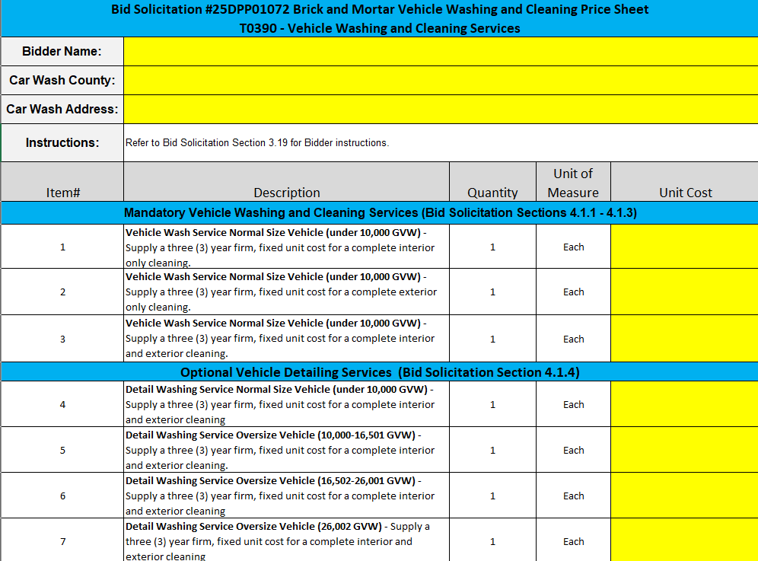
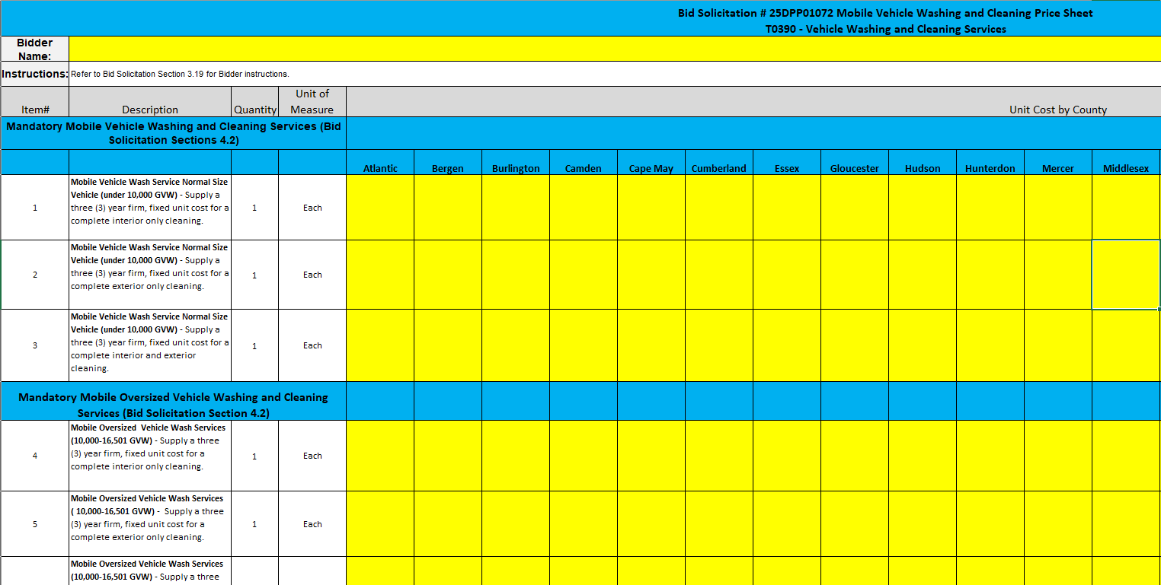
State-Supplied Price Sheet (Con’t)
Brick and Mortar Price Sheet
Mobile Price Sheet

Slide 13
THANK YOU FOR ATTENDING
Q&A due by 2pm December 10, 2024
Quotes due by 2pm January 22, 2025

