Slide 1
Optional Pre-Quote Conference
T3103 – Program Administrator – Resilience Planning Projects
24DPP01041
Q&a due by 2pm, June 19, 2025
Quotes due by 2pm, July 17, 2025
Notes:
Good morning, my name is Tahira Maner and I am the Procurement Specialist for the Professional Services unit within the Division of Purchase and Property. I would like to welcome everyone to this optional Pre-Quote Conference for Bid Solicitation 24DPP01041 titled T3103 Program Administrator-Resilience Planning Projects. Also on the call today are my Supervisor Wendi Higgins and Bureau Counsel Marissa Roberts.

Slide 2
WELCOME & INTRODUCTIONS
Please sign in by entering your name, company, and email in the Microsoft Teams chat window.
  A list of attendees and these slides will be posted to NJSTART.
Please identify yourself and the firm you represent prior to asking a question.
Please make sure you are registered in NJSTART, and that your contact information remains current.
  NJSTART Vendor email support: njstart@treas.nj.gov
  NJSTART Vendor phone support – (609) 341-3500 Staffed Monday to Friday 8:30 a.m. to 4:30 p.m.
  https://www.state.nj.us/treasury/purchase/vendor.shtml
Notes:
Before we begin, I would like to review some administrative items related to the meeting format and general reminders:
#1) I need everybody to sign in by entering your full name and company, in the Microsoft TEAMS chat window. This presentation and a list of attendees will be posted to NJSTART.
#2) Please keep your microphone or phones on mute to avoid background noise.
#3) Please identify yourself and the firm you represent prior to asking a question.
#4) Companies need to be registered on NJSTART in order to submit a bid and if your firm is registered, be sure that the contact information is up to date to ensure updates posted to the Bid Solicitation are received.
#5) If you need any assistance with NJSTART, you can email or call our NJSTART Vendor Support team. Contact information can be found here on slide 2 of the presentation.
Before I proceed to the next slide, I would like to confirm that all attending today’s pre-quote conference have entered their name and their firm in the chat window. Thank you.

Slide 3
PURPOSE & GENERAL INFORMATION
The purpose of this conference is to address procedural questions only, regarding the Bid Solicitation and Quote submission requirements.
No questions relating to the Scope of Work or the services or products required in the Bid Solicitation will be addressed. Vendors should utilize the Q&A Tab of the Bid Solicitation in NJSTART to submit those questions electronically.
This is also an opportunity for potential Vendors to partner with other potential Vendors and/or meet small, woman-owned, minority-owned, veteran-owned, and disabled veteran-owned businesses.
The Bid Solicitation will be reviewed section by section with procedural questions being entertained on that basis.
Notes:
The purpose of this conference is to discuss procedural and Quote submission requirements. We will not be discussing or answering any questions regarding the Scope of Work, which can be found in Bid Solicitation Section 4. All questions related to the scope of work must be submitted through the Q&A Tab on NJSTART prior to the Q&A deadline which is on June 19, 2025. The majority of today’s presentation will focus on Sections 1, 2, 3, 5, and 7 which I will review section by section. However, even though we will not be reviewing every single part of the Bid Solicitation, I will try to highlight some of the most important topics. Please note that this conference also provides an opportunity for potential Vendors to partner with other potential Vendors and also to be introduced to small, women-owned, minority-owned, veteran-owned, and disabled veteran-owned businesses. SWITCH OVER TO THE BID SOLICITATION.

Slide 4
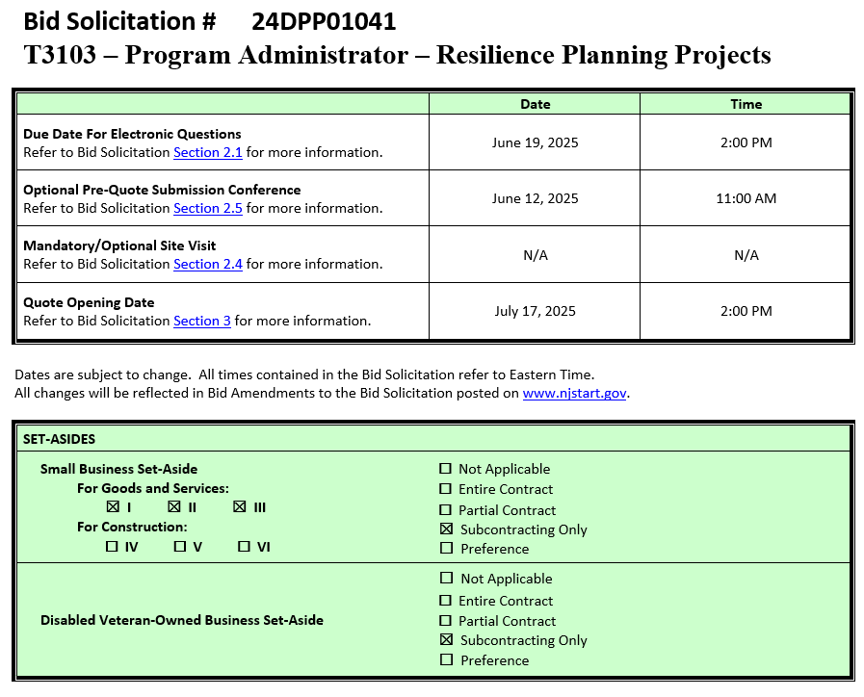
Notes:
The Cover Sheet of the Bid Solicitation, which is seen here, contains important dates and deadlines, in addition to any set-aside requirements. For this procurement, there is a Small Business Set-Aside for Subcontracting Only and a Disabled Veteran-Owned Business Set-Aside for Subcontracting Only.
Just a reminder, electronically submitted questions are due by 2pm this June 19th and your Quotes are due by 2pm this July 17th. These dates are subject to change and if changed, will be reflected in a Bid Amendment posted to NJSTART.

Slide 5
BID SOLICITATION AT A GLANCE
Cover page: Submission dates and set-aside requirements
Section 1: Introduction and Summary of the Bid Solicitation
Section 2: Pre-Quote Submission Information, e-Q&A, exceptions to the SSTC, and Bid Amendments
Section 3: Quote Submission Requirements (forms, technical response, State-Supplied Price Sheet Instructions)
Section 4: Scope of Work
Section 5: General Contract Terms
Section 6: Data Security Requirements – not applicable to this procurement
Section 7: Modifications to the State of New Jersey Standard Terms and Conditions (SSTC)
Notes:
Sections 1 and 2 address some important information and pre-Quote housekeeping measures.
Section 1.1 of the Bid Solicitation describes the Purpose & Intent, while Section 1.2 provides Background information.
Section 2.1 lays out the instructions for submitting electronic questions and
Section 2.2 addresses exceptions to the State of New Jersey Standard Terms and Conditions. The State of New Jersey Standard Terms and Conditions can be found in the Attachments tab in NJSTART.
AN IMPORTANT REMINDER: If your firm has any objections to the State’s Standard Terms and Conditions, those objections and suggested revisions must be submitted in the Question and Answer process detailed in Section 2.2. It’s important to understand that if your Quote conflicts with the State’s Standard Terms and Conditions without it being sufficiently addressed in the Question and Answer process, your Quote may be deemed non-responsive.
Section 2.3 details Bid Amendments, which are revisions to this Bid Solicitation and its supporting documents. These Amendments can range from changes in dates or Bidder requirements and responses to questions received (if any).
If a revised document is uploaded as part of a bid amendment, it is important that your firm’s Quote reflects the most current version of whatever document has been changed.
Section 3 addresses the quote submission requirements. This includes how to submit your Quote and what should be included, including forms.
On NJSTART, you’ll find a checklist called the Standard Procurement Forms Packet, this will assist you in submitting the proper forms.
A few terms you will see throughout the Bid Solicitation are shall, must, should, and may. There are very important distinctions between these terms. If an item is designated as “shall” or “must,” it is a mandatory requirement and failure to comply can result in your Quote being deemed non-responsive.
Where an item is designated as “should” or “may” it is not mandatory for the bidder to submit with the quote but is strongly recommended. Please note that while “should” or “may” does not denote a mandatory requirement, technical scoring could be impacted if requested information is not provided.
Section 3.13.9 designates this Contract with set-aside subcontracting for NJ Small Business Enterprises and/or Disabled Veterans’ Business. If the Bidder intends to subcontract, it must submit a Subcontractor Utilization Plan.
Section 3.23 this section requires that the Bidder shall provide proof of specific staff licensing and certification prior to Contract award. Please refer to this section for the actual requirements.
Section 3.27 contains all the State-Supplied Price Sheet instructions the Bidder must use to submit pricing. Failure to submit pricing as instructed will result in the Bidder’s Quote being deemed as non-responsive and ineligible for award.
Section 4 is the Scope of Work. These are the services that the State requires. Be sure that your firm’s Quote adequately addresses how they intend to meet these requirements. Failure to do so may result in your firm’s Quote being deemed non-responsive or impact the technical score from the evaluation committee.
Section 5 details the Bid Solicitation’s General Contract Terms. This Section addresses a number of items such as the Contract Term, any available Extension Terms, the Contract Transition Term, Ownership of Material, and more.
As reflected in Section 5.1, the base term of the Contract will be 4 years. It may be extended up to 2 years. Please be sure to carefully read the rest of Section 5 in your own time.
Section 7 addresses Modifications to the State of New Jersey’s Standard Terms and Conditions. Please be sure to carefully read this section. As a reminder, questions about and exceptions to this section and/or the Standard Terms and Conditions must be submitted prior to the Electronic Questions due deadline, which is 2:00 pm on June19th.

Slide 6
BID SOLICITATION AT A GLANCE
Section 8: Quote Evaluation and Award
Section 9: Glossary
Attachment 1: State of New Jersey Standard Terms and Conditions
Helpful Tips & Reminders
  Review Bid Solicitation in its entirety and submit any questions prior to the deadline including exceptions to the SSTC. Updated documents will be posted in NJSTART and should be reviewed as posted.
  Complete all required price lines in the State Supplied Price Sheet or Quote may be deemed non-responsive. Indicate “$0” if the cost is $0. Do not leave any price lines blank.
  Submit Quotes on time addressing all mandatory requirements (designated by “shall”) including forms. Quotes missing mandatory requirements may be deemed non-responsive. Not submitting requested information (“should”) may impact the technical evaluation score.
  The State-Supplied Price Sheet must be completed in its entirety with no lines added or removed, or additional language or fees referenced
Notes:
Section 8 describes the Division of Purchase and Property’s Quote Evaluation process.
Please take the time to review this section in your own time.
And finally Section 9 covers our glossary terms. What follows are our standard definitions, which are part of a majority of our Contracts.
Any additional Scope of Work-specific definitions can be found in Section 9.3
AS A REMINDER: Review the Bid Solicitation in its entirety and submit any questions prior to the Q&A deadline on June 19th including exceptions. Updated documents may be posted in NJSTART with Bid Amendments and should be reviewed as posted.
Submit Quotes on time addressing all mandatory requirements including forms, or the Quote may be deemed non-responsive. “Shall” denotes a mandatory requirement; however, not submitting requested information which is designated as a “should” could impact technical evaluation.
The State-Supplied Price Sheet must be completed in its entirety with no lines added or removed, or additional language or fees referenced.
Do not leave any price lines blank. The State is aware a “$0” input will auto populate a dash (-) on the State-Supplied Price Sheet, and the State will deem this answer responsive when it can confirm the information in the submitted price sheet.
Remember: Bidders should review all documents specific to this Bid Solicitation. Other advertised Bid Solicitations may have different requirements.

Slide 7
Section 3: Quote Submission Requirements
Section 3.13.1 Offer and Acceptance- SHOULD
Section 3.13.2 Ownership Disclosure- SHALL (MUST)
Section 3.13.3 Disclosure of Investment Activities in Iran Form- SHOULD
Section 3.13.4 Disclosure of Investigations and Other Actions Involving Bidder Form- SHOULD
Section 3.13.5 MacBride Principles Form- SHOULD
Section 3.13.6 Service Performance Within the United States (Source Disclosure Form)- SHOULD
3.13.7 Confidentiality/Commitment to Defend- SHOULD
Notes:
Back to Bid Solicitation Section 3:
Some of the subsections in Section 3 are designated as “shall” and some are designated as “should”. Please review carefully and make the appropriate determination when preparing your response.
Of particular importance is the Ownership Disclosure form. This form is required with your Quote. Please be sure to read the instructions on the form and fill it out completely and accurately. Your quote will be deemed non-responsive if information is missing, or if boxes are checked incorrectly.

Slide 8
Section 3: Quote Submission Requirements
Section 3.13.8 Subcontractor Utilization Plan - SHALL only if planning to utilize subcontractors at time of Quote submission. If the Bidder does not intend to use subcontractors, the Subcontractor Utilization Plan form is not required.
Section 3.13.9 Small Business and/or Disabled Veterans’ Business Subcontracting Set-Aside Contract - This is a Contract with set-aside subcontracting for New Jersey Small Business Enterprises and Disabled Veterans’ Businesses.
Section 3.13.11 Affirmative Action – SHALL (MUST) –Required after issuance of Notice of Intent to Award
Section 3.13.14 Business Registration- SHOULD
Section 3.13.15 Certification of Non-Involvement in Prohibited Activities in Russia or Belarus- SHOULD
Notes:
Section 3.13.8 contains instructions for completing the Subcontractor Utilization Plan. You do not have to subcontract, but if you choose to subcontract, you must submit a subcontractor utilization form.
Section 3.13.9 designates this Contract as a subcontracting set-aside for NJ Small Business Enterprises and Disabled Veterans’ Businesses. Instructions on the steps that need to be taken to make a good faith effort to solicit and hire eligible NJ Small Business Enterprises and Disabled Veterans’ Businesses are included here along with the potential consequences for NOT following these instructions.

Slide 9
PRICE SHEET PITFALLS
Complete all required price lines on the State-Supplied Price Sheet pursuant to the Bid Solicitation instructions or Quote may be deemed non-responsive. Indicate “no charge” if the cost is $0. Do not leave any price line blank.
The State-Supplied Price Sheet must be completed in its entirety with no lines added or removed. Do not add additional language, assumptions, or fees on the State-Supplied Price Sheet.
Do not make formatting changes to the State-Supplied Price Sheet. If the price line requires a dollar amount, don’t change it to a percentage, or vice versa. If the price line includes 2 decimal places, don’t change the settings to allow 4 decimals.
Confirm that you have completed all tabs on the State-Supplied Price Sheet.
Confirm you have completed the proper version of the State-Supplied Price Sheet; it may have been revised via Bid Amendment.
Submitting a State-Supplied Price Sheet in a format other than the supplied Excel document can lead to a price sheet being deemed non-responsive when the information in a cell cannot be confirmed by the Bureau.
Notes:
Let’s take a moment to address some common State-Supplied Price Sheet errors we see bidders making when submitting quotes.
Be sure to complete all required price lines on the Price Sheet, or the Quote may be deemed non-responsive. Do not leave any price lines blank. Only fill out the prices lines in yellow. Indicate “no charge” if the cost is $0.
Do not make formatting changes to the Price Sheet. If the price line requires a dollar amount, don’t change it to a percentage, or vice versa. If the price line includes 2 decimal places, don’t change the settings to allow 4 decimals.
Do not add additional language, assumptions, or fees on the Price Sheet. Do not add or remove any price lines.
Confirm that you have completed all tabs on the State-Supplied Price Sheet.
Confirm you have completed the latest version of the State-Supplied Price Sheet, in the supplied Excel document, as it may have been revised via Bid Amendment. Review all posted amendments that may include changes to the Price Sheet and Bid Solicitation. These changes must be taken into account when completing the State-Supplied Price Sheets.
And, submitting a State-Supplied Price Sheet in a format other than the supplied Excel document can lead to a price sheet being deemed non-responsive when the information in a cell cannot be confirmed by the Bureau.

Slide 10
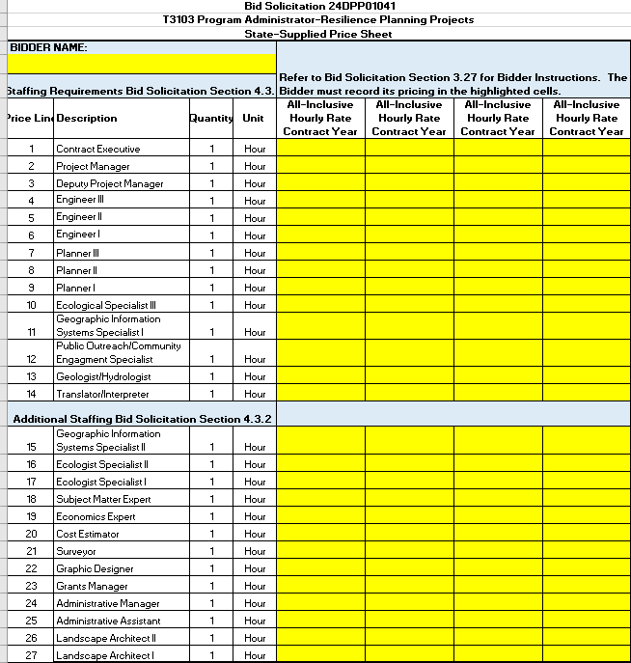
Notes:
Bid Section 3.27 - STATE-SUPPLIED PRICE SHEET INSTRUCTIONS
Each Bidder is required to hold its pricing firm through the issuance and performance of the Contract. In order to be considered for award, the Bidder must submit an all-inclusive hourly rate for each Contract year (1-4) of each price line.
For Price Lines 1 – 14: The Bidder must submit an all-inclusive hourly rate for each Contract year (1-4) of each staffing position, as identified in Bid Solicitation Section 4.3.1; and
For Price Lines 15 – 27: The Bidder must submit an all-inclusive hourly rate for each Contract year (1-4) of each additional staffing position, as identified in Bid Solicitation Section 4.3.2.
Failure to submit pricing as instructed above will result in the Bidder’s Quote being deemed as non-responsive and ineligible for award. Each Bidder shall equate their firm’s internal classifications into the staffing categories found on the State-Supplied Price Sheet and as outlined in Bid Solicitation Section 4.3.

Slide 11
REQUIRED FORMS
Make sure that all required forms in the forms packet are filled out completely and accurately.
  The Ownership Disclosure Form is a form that is required, and often filled out incorrectly. Please read all directions carefully so that your Quote isn’t deemed non-responsive.
  The Subcontractor Utilization Plan is a form that is required to be filled out in its entirety if it is the Bidder’s intent to use subcontractors to complete the scope of work requirements. This Contract contains New Jersey Small Business and Disabled Veteran-Owned Business set-aside subcontracting requirements. If the Bidder is planning to use subcontractors, then the Bidder shall make a good faith effort to solicit and hire eligible New Jersey Small Business Enterprises and Disabled Veteran-Owned Businesses in accordance with Bid Solicitation Section 3.13.9, Small Business And/Or Disabled Veterans’ Business Subcontracting Set-Aside Contract.
Notes:
As a reminder, all required forms in the forms packet must be filled out accurately and completely. Failure to do so could result in your Bid being deemed non-responsive.

Slide 12
HELPFUL TIPS & REMINDERS
  Review Bid Solicitation in its entirety and submit any questions prior to the Q & A deadline including exceptions to the SSTC. Updated documents will be posted in NJSTART and should be reviewed as posted.
  Submit Quotes on time addressing all mandatory requirements (designated by “shall”) including forms. Quotes missing mandatory requirements may be deemed non-responsive. Not submitting requested information (“should”) may impact the technical evaluation score.
  Do not select “No Bid” on the NJSTART “General Tab” unless you are not intending to submit a bid. Your bid will not appear in the Bid Tab if this option is selected.
Notes:
Here are some helpful tips for the Quote Submission process:
Review the bid solicitation in its entirety. After reviewing it, submit any questions including exceptions to the SSTC before the Q&A deadline which is June 19, 2025.
Remember to submit Quotes by the due date which is July 17, 2025. Include all mandatory requirements which are designated by a “shall”. Quotes missing mandatory requirements may be deemed non-responsive.
Also note that not submitting requested information designated as a “should” may impact the technical evaluation score.
And, do not select “No Bid” on the NJSTART “General Tab” unless you are not intending to submit a bid. Your bid will not appear in the Bid Tab if this option is selected.

Slide 13
OTHER HELPFUL TIPS
Examples of additional language the may deem a quote non-responsive:
  Vendor accepts all terms and conditions of this Bid Solicitation with the following additional language: Section X - Agree, as it applies to changes that impact administrative fees as outlined in this provision, provided that Vendor reserves the right to modify Contracted Terms based on changes by the State.
  Vendor’s Quote is only valid for XX days.
  Vendor reserves the right to charge additional fees for services that require extensive time and effort.
  This Quote is a nonbinding expression of interest only and is not intended to create a binding commitment on either party unless and until a definitive agreement has been executed between the parties.
  This Quote may include statements regarding plans for future products and services, or future versions of existing products and services. Any such statements are provided solely for your general information and are not part of this Quote unless specifically stated in writing in this Quote.
Notes:
Some other helpful tips for your Quote Submission –
Unless it was previously addressed in the Question and Answer process, do not submit any terms and conditions that contradict or attempt to add or modify the terms and conditions in the Bid Solicitation.
Do not mention that your Quote is only valid for XX days.
Do not mention any fees that were not included in the original State-Supplied Price Sheet.
Do not state that your Quote is non-binding and is only an expression of interest.
Do not mention future products or services.
Any of these could deem your quote non-responsive.

Slide 14

Notes:
This is a screenshot of the Division of Purchase and Property’s website. You can access this website by going to www.nj.gov/treasury/purchase, or by following the links throughout the Bid Solicitation. The website includes forms and other helpful information for Vendors. (forward slash /)

Slide 15

Notes:
This is a screenshot of the Forms page on the Division of Purchase and Property’s website. The forms on this page are periodically updated, so it may not be an exact representation.

Slide 16

Notes:
Here is a screenshot of the State of New Jersey’s eProcurement website, NJSTART. This website can be found at njstart.gov.

Slide 17
THANK YOU FOR ATTENDING
Q&A due by 2pm, June 19, 2025
Quotes due by 2pm, July 17, 2025
Notes:
I want to thank you very much for joining us for today’s conference. As one last reminder – electronic submission of your questions are due by 2pm on June 19, 2025 and your Quotes are due by 2pm on July 17, 2025 .
This concludes today’s Pre-Quote Conference for T3103 Program Administrator – Resilience Planning Projects. If you have any questions related to the material that was covered in this presentation, please ask them now. Please make sure to state your name and company before you ask the question. You can also ask the question in the chat feature.

