Slide 1
Optional Pre-Quote Conference
T2505 - Consulting Services: Department of Transportation (NJDOT) Infrastructure and Non-Infrastructure Research
Bid Solicitation #24DPP01009
Q&A due by 2PM on June 25, 2024
Quotes due by 2PM on July 23, 2024

Slide 2
WELCOME & INTRODUCTIONS
Please identify yourself and the firm you represent prior to asking a question.
Please make sure you are registered in NJSTART, and that your contact information remains current.
  NJSTART Vendor support email: njstart@treas.nj.gov
  https://www.state.nj.us/treasury/purchase/vendor.shtml

Slide 3
PURPOSE & GENERAL INFORMATION
The purpose of this conference is to address procedural questions only, regarding the Bid Solicitation and Quote submission requirements.
  No questions relating to the Scope of Work or the services or products required in the Bid Solicitation will be addressed. Vendors should utilize the Q&A Tab of the Bid Solicitation in NJSTART to submit those questions electronically.
The Bid Solicitation will be reviewed section by section with procedural questions being entertained on that basis.

Slide 4
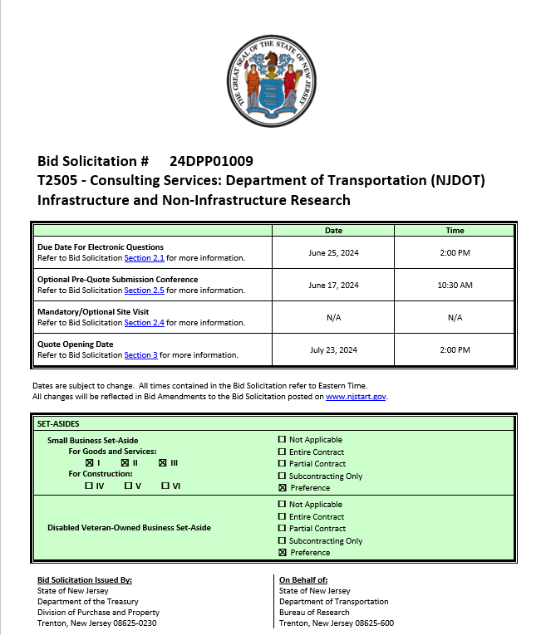
BID SOLICITATION AT A GLANCE
  Cover Page:
  Bid Solicitation Title Information
  Submission dates
  Set-aside requirements
  Electronic Q&A Due: June 25, 2024 by 2PM
  Quotes Due: July 23, 2024 by 2PM

Slide 5
BID SOLICITATION AT A GLANCE
Please review each Section carefully:
  Section 1: Introduction and Summary
    Purpose and Intent (Section 1.1)
    Background (Section 1.2)
    Order of Precedence of Contractual Terms (Section 1.4)
  Section 2: Pre-Quote Submission Information
    Q&A (Section 2.1)
    Exceptions to the New Jersey Standard Terms and Conditions (Section 2.2)
    Bid Amendments (Section 2.3)

Slide 6
BID SOLICITATION AT A GLANCE
Please review this section carefully:
  Section 3: Quote submission requirements - including, but not limited to:
    Forms (Section 3.13)
    Technical Quote (Section 3.14)
    Management Overview (Section 3.15)
    Resumes (Section 3.22)
    Firm Experience (Sections, 3.19 & 3.23)
    Confidentiality/Commitment To Defend (Section 3.13.7)
    Financial Capability (Section 3.24)
    State-Supplied Price Sheet (Section 3.25)

Slide 7
BID SOLICITATION AT A GLANCE
Bidders should submit (Strongly Recommended)
  Offer and Acceptance Page, Section 3.13.1
  Disclosure of Investment Activities in Iran Section 3.13.3
  Disclosure of Investigations and Other Actions Involving the Bidder Form, Section 3.13.4.
  MacBride Principles, Section 3.13.5
  Source Disclosure 3.13.6
  Confidentiality/Commitment to Defend, Section 3.13.7
  Certification of Non-Involvement in Prohibited Activities in Russia or Belarus, Section 3.13.14
Bidders shall submit (Mandatory)
  Ownership Disclosure Form, Section 3.13.2
  If your firm intends to subcontract, the Subcontractor Utilization Plan, Section 3.13.8
  Affirmative Action Compliance, Section 3.13.10 (Due Before Contract Award)
  Business Registration, Section 3.13.13 (Due Before Contract Award)

Slide 8
BID SOLICITATION AT A GLANCE
Section 3 Quote Submission Requirements
Bidders shall submit:
  Technical Quote, Section 3.14
  Sample Case Studies, Section 3.18
  State-Supplied Price Sheet, Section 3.25
Bidders should submit:
  Management Overview, Section 3.15
  Contract Management, Section 3.16
  Contract Schedule, Section 3.17
  Resumes, Section 3.22
  Financial Capability of the Bidder, Section 3.24
Please review Section 3 in its entirety for a full list of submission specifications.

Slide 9
BID SOLICITATION AT A GLANCE
Please review each section carefully.
  Section 4: Scope of Work
    Required services for awarded Contractor
  Section 5: General Contract Terms
    Contractual language including term details (Section 5.1 and 5.2)
      4-Year Base Term
      Two 1-Year Extension Term Options
    Staff Substitutions (Section 5.5)
    Ownership of Materials (Section 5.4)

Slide 10
BID SOLICITATION AT A GLANCE
Please review each section carefully.
Section 6: Data Security Requirements
Section 7: Modifications to the NJ Standard Terms and Conditions (SSTCs) and supplemental indemnification
Section 8: Evaluation criteria, clarifications, best and final offer
Section 9: Glossary (including Contract Specific Definitions)

Slide 11
BID SOLICITATION AT A GLANCE
Reminders
  Review Bid Solicitation in its entirety and submit any questions prior to the deadline including exceptions. Updated documents will be posted in NJSTART and should be reviewed as posted.
  Submit Quotes on time addressing all mandatory requirements including forms, or Quote may be deemed non-responsive. “Shall” denotes a mandatory requirement; however, not submitting requested information (“should”) could impact technical score
  Price Sheet must be completed in its entirety with no lines added or removed, or additional language or fees referenced

Slide 12
PRICE SHEET PITFALLS
Be sure to:
  Complete all required price lines on the Price Sheet, or Quote may be deemed non-responsive. Indicate “no charge” if the cost is $0. Do not leave any price lines blank.
  Do not make formatting changes to the Price Sheet. If the price line requires a dollar amount, don’t change it to a percentage, or vice versa. If the price line includes 2 decimal places, don’t change the settings to allow 4 decimals.
  Confirm that you have completed all tabs on the Price Sheet.
  Do not add additional language, assumptions, or fees on the Price Sheet. Do not add or remove any price lines.
  Confirm you have completed the proper version of the Price Sheet; it may have been revised via Bid Amendment.

Slide 13
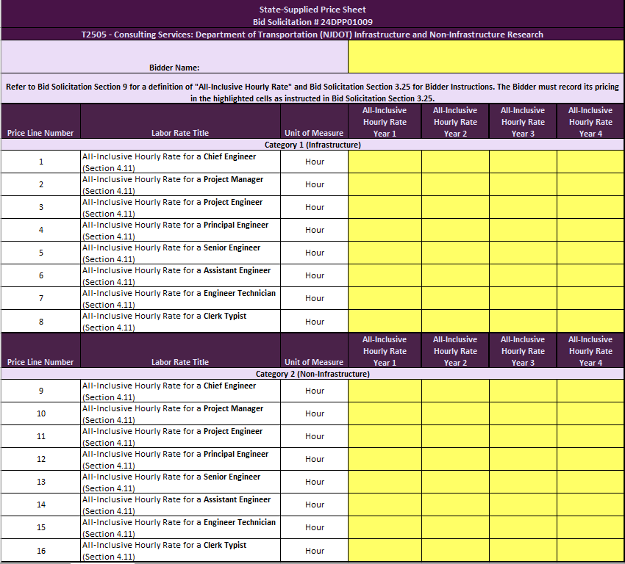
STATE-SUPPLIED PRICE SHEET
Please submit all pricing according to the instructions in Bid Solicitation Section 3.25.
Bidders shall include pricing without assumptions, exceptions, or caveats or the Quote may be deemed non-responsive.

Slide 14
OTHER HELPFUL TIPS
Do NOT include language such as this:
  Vendor accepts all terms and conditions of this Bid Solicitation with the following additional language: Section X - Agree, as it applies to changes that impact administrative fees as outlined in this provision, provided that Vendor reserves the right to modify Contracted Terms based on changes by the State.
  Vendor reserves the right to charge additional fees for services that require extensive time and effort.
  This Quote is a nonbinding expression of interest only and is not intended to create a binding commitment on either party unless and until a definitive agreement has been executed between the parties.
  This Quote may include statements regarding plans for future products and services, or future versions of existing products and services. Any such statements are provided solely for your general information and are not part of this Quote unless specifically stated in writing in this Quote.

Slide 15


Slide 16
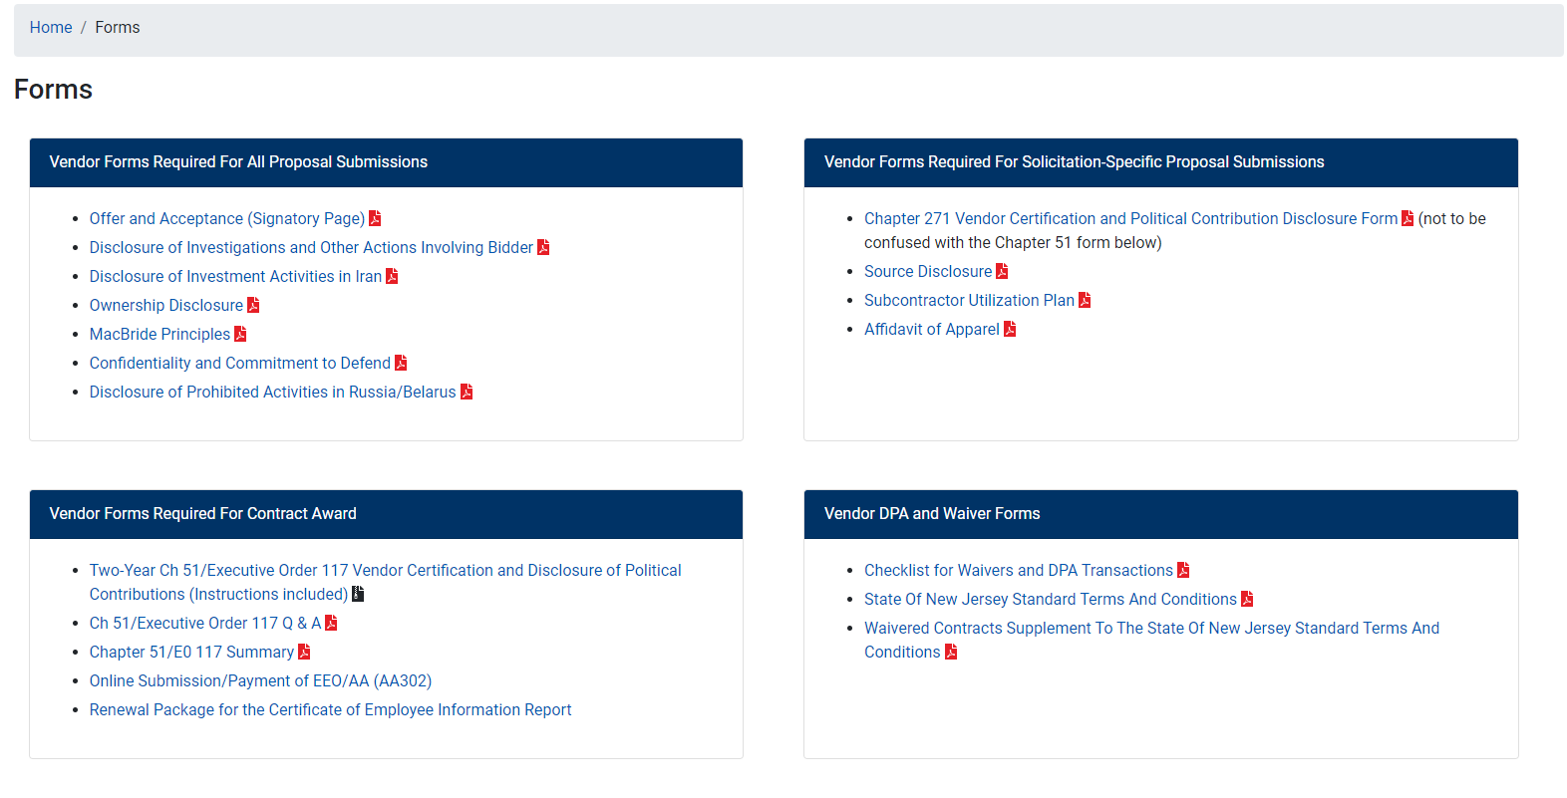

Slide 17
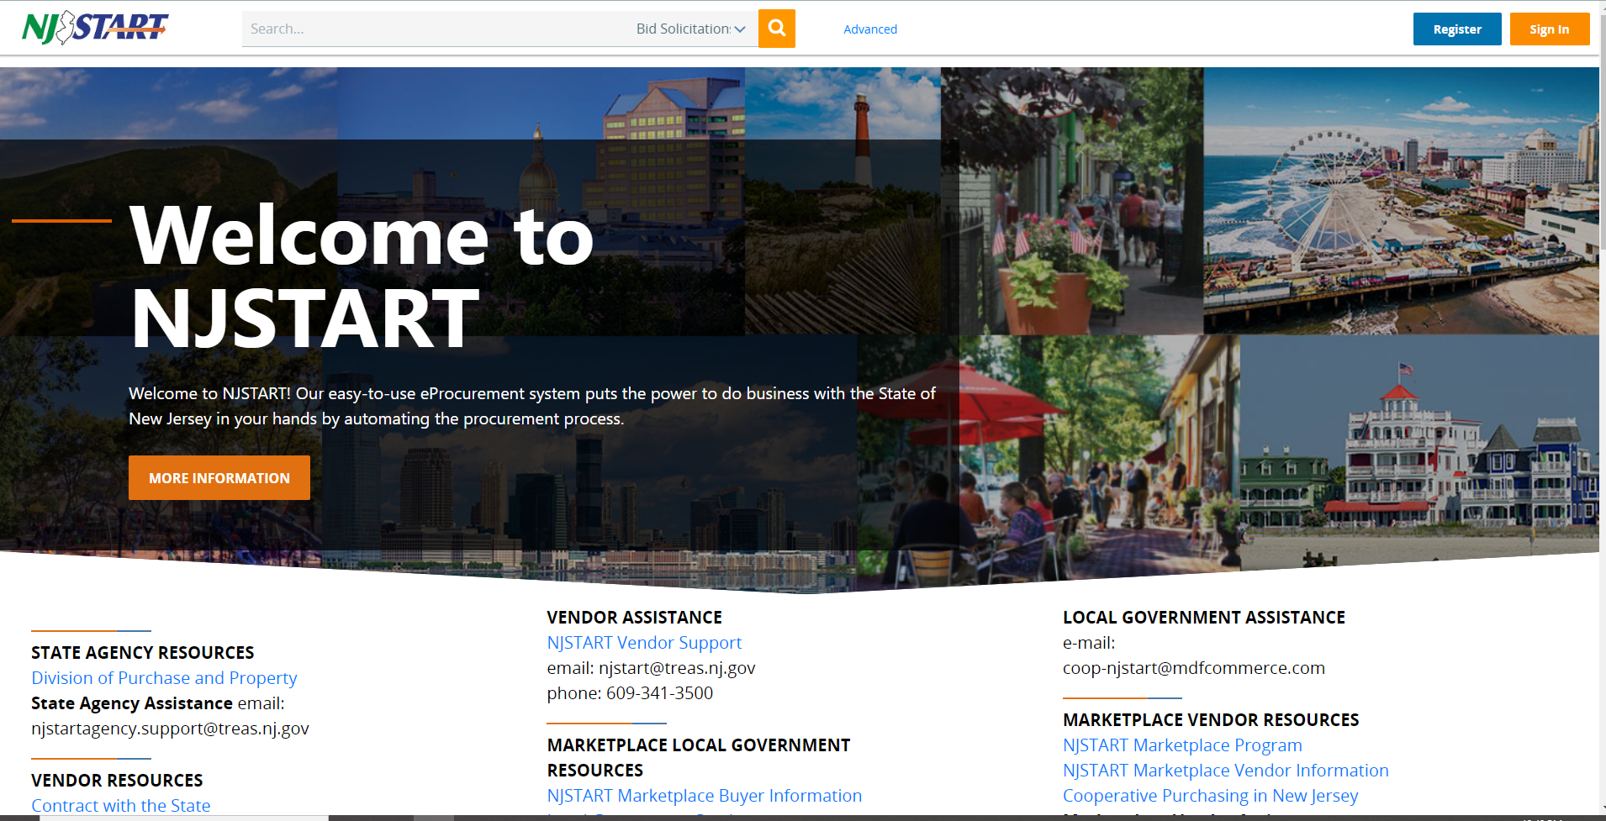

Slide 18


Slide 19
THANK YOU FOR ATTENDING
Q&A due by 2PM June 25, 2024
Quotes due by 2PM July 23, 2024

