Slide 1
Optional Pre-Quote Conference
T2533 NJDEP Remedial Design Services
Bid Solicitation 24DPP00978
Q&a due by 2PM, May 22, 2024
Quotes due by 2pm, June 19, 2024

Slide 2
WELCOME & INTRODUCTIONS
Please identify yourself and the firm you represent when prompted during roll-call so that you are properly logged for attending the conference.
Please mute your phone at all times unless speaking.
Please identify yourself and the firm you represent prior to asking a question.
Please make sure you are registered in NJSTART, and that your contact information remains current.
  NJSTART Vendor email support: njstart@treas.nj.gov
  https://www.state.nj.us/treasury/purchase/vendor.shtml

Slide 3
PURPOSE & GENERAL INFORMATION
The purpose of this conference is to address procedural questions only, regarding the Bid Solicitation and Quote submission requirements.
No questions relating to the Scope of Work or the services or products required in the Bid Solicitation will be addressed. Vendors should utilize the Q&A Tab of the Bid Solicitation in NJSTART to submit those questions electronically.
The Bid Solicitation will be reviewed section by section with procedural questions being entertained on that basis.

Slide 4
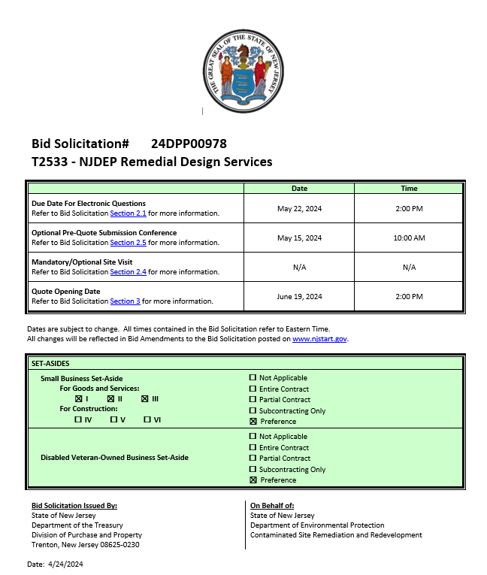
BID SOLICITATION AT A GLANCE
Cover page
  Submission dates
  Set-aside requirements
  Bid Solicitation Title Information
  Electronic Q&A Due: By 2:00pm - May 22, 2024
  Quotes Due: By 2:00pm - June 19, 2024

Slide 5
BID SOLICITATION AT A GLANCE
Please review each section carefully
Section 1: Introduction and Summary
  Purpose and Intent (Section 1.1)
  Background (Section 1.2)
  Order of Precedence of Contractual Terms (Section 1.4)
Section 2: Pre-Quote Submission Information
  Q&A Period (Section 2.1)
  Exceptions to the New Jersey Standard Terms and Conditions (Section 2.2)
  Bid Amendments (Section 2.3)

Slide 6
BID SOLICITATION AT A GLANCE
Please review each section carefully
Section 3: Quote Submission Requirements – including, but not limited to:
  Forms (Section 3.13)
  Technical Quote (Section 3.14)
  Management Overview (Section 3.15)
  Contract Management (Section 3.16)
  Staffing Plan and Resumes (Section 3.19)
  Firm experience (Section 3.23)
  Financial capability (Section 3.24)
  Price sheet (Section 3.25)

Slide 7
BID SOLICITATION AT A GLANCE
Please review each section carefully
Section 3.13: Forms & Certifications
  Bidder shall submit (Mandatory)…
    Ownership Disclosure Form (Section 3.13.2)
    If your firm intends to subcontract: the Subcontractor Utilization Plan (Section 3.13.8)
    Affirmative Action Compliance (Section 3.13.10)
    Business Registration (Section 3.13.13)
  Bidder should submit (Strongly Recommended)…
    Offer and Acceptance Page (Section 3.13.1)
    Disclosure of Investment Activities in Iran (Section 3.13.3)
    Disclosure of Investigations and Other Actions Involving the Bidder Form (Section 3.13.4)
    MacBride Principles (Section 3.13.5)
    Source Disclosure (Section 3.13.6)
    Confidentiality/Commitment to Defend (Section 3.13.7)
    Certification of Non-Involvement in Prohibited Activities in Russia or Belarus (Section 3.13.14)

Slide 8
BID SOLICITATION AT A GLANCE
Please review each section carefully
Section 3: Quote Submission Requirements
  Bidder shall submit (Mandatory)…
    Technical Quote (Section 3.14)
    Management Overview (Section 3.15)
    State-Supplied Price Sheet (Section 3.25)
  Bidder should submit (Strongly Recommended)…
    Contract Management (Section 3.16)
    Staffing Plan and Resumes (Section 3.19)
    Organizational Experience(Section 3.20)
    Location (Section 3.21)
    Organization Charts (Section 3.22)
    Experience with Contracts of Similar Size and Scope(Section 3.23)
    Financial Capability (Section 3.24)

Slide 9
BID SOLICITATION AT A GLANCE
Please review each section carefully
Section 4: Scope of Work
Section 5: General Contract Terms
  Contractual language including term details (Section 5.1/5.2)
    Base Term: 3 Years
    Number of 1-Year Extension Terms: 3
  Ownership of Materials (Section 5.4)
  Staff Substitutions (Section 5.5)
  Retainage (Section 5.7)

Slide 10
BID SOLICITATION AT A GLANCE
Please review each section carefully
Section 7: Modifications to the State Standard Terms and Conditions
Section 8: Evaluation criteria, clarifications, best and final offers
Section 9: Glossary (including Contract Specific Definitions)

Slide 11
BID SOLICITATION AT A GLANCE
Reminders
  Review Bid Solicitation in its entirety and submit any questions prior to the deadline including exceptions. Updated documents will be posted in NJSTART and should be reviewed as posted.
  Submit Quotes on time addressing all mandatory requirements including forms, or Quote may be deemed non-responsive. “Shall” denotes a mandatory requirement; however, not submitting requested information (“should”) could impact technical score
  Price Sheet must be completed in its entirety with no lines added or removed, or additional language or fees referenced

Slide 12
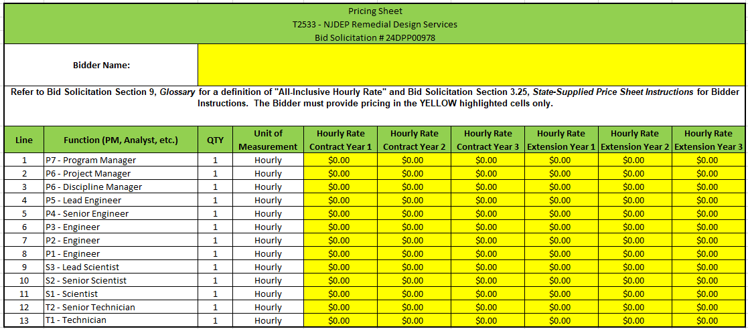
PRICE SHEET
Please submit all pricing according to the instructions in Bid Solicitation Section 3.25.
Bidders shall include pricing without assumptions, exceptions, or caveats or the Quote may be deemed non-responsive.

Slide 13
PRICE SHEET PITFALLS
Complete all required price lines on the Price Sheet, or Quote may be deemed non-responsive. Indicate “no charge” if the cost is $0. Do not leave any price lines blank.
Do not make formatting changes to the Price Sheet. If the price line requires a dollar amount, don’t change it to a percentage, or vice versa. If the price line includes 2 decimal places, don’t change the settings to allow 4 decimals.
Confirm that you have completed all tabs on the Price Sheet.
Do not add additional language, assumptions, or fees on the Price Sheet. Do not add or remove any price lines.
Confirm you have completed the proper version of the Price Sheet; it may have been revised via Bid Amendment.

Slide 14
OTHER HELPFUL TIPS
Do NOT include language such as this:
  Vendor accepts all terms and conditions of this Bid Solicitation with the following additional language: Section X - Agree, as it applies to changes that impact administrative fees as outlined in this provision, provided that Vendor reserves the right to modify Contracted Terms based on changes by the State.
  Vendor reserves the right to charge additional fees for services that require extensive time and effort.
  This Quote is a nonbinding expression of interest only and is not intended to create a binding commitment on either party unless and until a definitive agreement has been executed between the parties.
  This Quote may include statements regarding plans for future products and services, or future versions of existing products and services. Any such statements are provided solely for your general information and are not part of this Quote unless specifically stated in writing in this Quote.

Slide 15


Slide 16


Slide 17


Slide 18
Questions?

Slide 19
THANK YOU FOR ATTENDING
Q&A due by 2pm, May 22, 2024
Quotes due by 2pm, June 19, 2024

