Slide 1
Optional Pre-Quote Conference
T0764 – Printing and Mailing Services – Taxation & State Agencies
Q&a due by 2pm May 1, 2024
Quotes due by 2pm May 22, 2024
Notes:
Slide 1 - Opening Page:
Good Morning and Welcome to the Pre-quote Conference for T2924 Snow Plowing Services by Area -NJDOT
My name is Kimara Young with the General Services Unit, and on the call with me today is our legal counsel, Phoebe Volz, and my supervisor, Donald Warren, who will be sitting in.
Before we begin, please note that the documents discussed today, which are the Bid Solicitation and Price Sheet, as well as this Power Point Presentation, are all be available online through NJSTART. Be advised that there has been a slight slide adjustment to this Presentation in comparison to the NJSTART version but all information is the same.
Also, please take this time to note the following two (2) important dates:
Q&A is due by 2pm on April 12. All questions must be submitted electronically through NJSTART by that date and time.
Quotes are due by 2pm on May 8. Quotes will not be accepted after this date and time.
(Click to next slide)

Slide 2
WELCOME & INTRODUCTIONS
Please mute your phone at all times unless speaking.
Please identify yourself and the firm you represent prior to asking a question.
Please make sure you are registered in NJSTART, and that your contact information remains current.
  NJSTART Vendor email support: njstart@treas.nj.gov
  https://www.state.nj.us/treasury/purchase/vendor.shtml
Notes:
Click 2 times)
At this time I ask that all parties make sure that they are muted during this presentation.
Please hold all questions until the end. At that time, should you have questions, please state your name and the Agency you represent before asking your question.
(Click once)
In order to submit a Quote, your firm will need to be registered in NJSTART. If your firm is already, registered, please make sure that all of the information, including contact information, is up to date so you are notified of any new updates. If you need any assistance with our eProcurement website, you can email our NJSTART Vendor Support team at NJSTART@treas.nj.gov. You can also find additional helpful information, such as the Vendor Quick Reference Guide, on our website. Both the email and link can be found on this slide.
(Click to next slide)

Slide 3
PURPOSE & GENERAL INFORMATION
The purpose of this conference is to only address procedural questions regarding the Bid Solicitation and Quote submission requirements.
No questions relating to the Scope of Work or the services or products required in the Bid Solicitation will be addressed. Vendors must utilize the Q&A Tab of the Bid Solicitation in NJSTART to submit those questions electronically.
The Bid Solicitation will be reviewed section by section with procedural questions being entertained on that basis.
Notes:
Slide 3 - Purpose and General Information:
(Click 2 times)
The purpose of this conference is to discuss procedural and Quote submission requirements only.
We will not be discussing or answering questions regarding the Scope of Work, which can be found in Section 4 of the Bid Solicitation. Any questions related to the scope of work must be submitted through the Q&A Tab on NJSTART PRIOR to the Q&A deadline of April 12th.
(Click once)
This Bid Solicitation will be reviewed by sections, however, we will not be going over the Bid Solicitation in its entirety. We will try to review some of the most critical topics. Again, please save all questions for the end of the presentation and remember that they should be limited to procedure and Quote submission requirements only.
(Click to next slide)

Slide 4
BID SOLICITATION AT A GLANCE
Cover page: Submission dates and set-aside requirements
Section 1: Purpose and intent, background
Section 2: Pre-quote Submission information, Q&A and exceptions to the State Standard Terms and Conditions, Bid Amendments
Section 3: Quote submission requirements including forms, Public Works Contractor Registration, and State Price Sheet Instructions
Section 4: Scope of Work – Requirements of the Contractor
Section 5: General Contract Terms, Extension Option, Transition, ownership of material, and substitution of staff
Section 6: Data security requirements.
Section 7: Modifications to the State Standard Terms and Conditions
Section 8: Evaluation criteria, clarifications, best and final offers
Section 9: Glossary
Notes:
Slide 4 - Bid Solicitation at a Glance:
The Bid Solicitation consists of ten sections with the inclusion of the cover page. From here I will be moving over to our Bid Solicitation for a moment to go over the sections.

Slide 5
BID SOLICITATION AT A GLANCE
Reminders
  Review Bid Solicitation in its entirety and submit any questions prior to the deadline including exceptions. Updated documents will be posted in NJSTART and should be reviewed as posted.
  Submit Quotes on time addressing all mandatory requirements including forms, or Quote may be deemed non-responsive. “Shall” denotes a mandatory requirement; however, not submitting requested information (“should”) could impact technical score
  Price Sheet must be completed as specified/directed in the Bid Solicitation.
Notes:
Slide 5 - Bid Solicitation at a Glance pt. 2 - Reminders:
A reminder to Bidders. Make sure to review the Bid Solicitation in its entirety and submit any questions before the deadline. Any revisions to documents will be posted on NJSTART for public viewing.
Also. Make sure to submit Quotes on time, meeting all mandatory requirements including forms, or the Quote may be deemed non-responsive. Again, please note that where the text says that a Bidder should do something, it is strongly recommended. If the text says shall or must, it is a mandatory requirement. Failure to do something that is a ‘shall’ or must can result in your Quote being deemed non-responsive.
And a final reminder that the Price Sheet must be completed in its entirety, to the specifications noted in the Bid Solicitation’s Price Sheet Instructions, with no lines added or removed, or additional language or fees referenced.

Slide 6
PRICE SHEET PITFALLS
Complete all required price lines on the Price Sheet, or Quote may be deemed non-responsive. Indicate “no charge” if the cost is $0. Do not leave any price lines blank.
Do not make formatting changes to the Price Sheet. If the price line requires a dollar amount, don’t change it to a percentage, or vice versa. If the price line includes 2 decimal places, don’t change the settings to allow 4 decimals.
Do not add additional language, assumptions, or fees on the Price Sheet. Do not add or remove any price lines.
Confirm you have completed the proper version of the Price Sheet; it may have been revised via Bid Amendment.
Notes:
Slide 6 - Price Sheet Pitfalls:
(Click 5 times)
1. Make sure all required price lines have been completed on the Price Sheet, or the Quote may be deemed non-responsive. If the cost is $0, indicate “no charge”. Do not leave any price lines blank.
2. Do not make any changes to formatting on the Price Sheet, including language and the addition or removal of price lines.
3. Confirm that the Price Sheet you’ve completed is the proper version as it may have been revised on NJSTART.
Please note that after the Q&A period, answers will be posted via Amendment in NJSTART, and if necessary, a revised Bid Solicitation or price sheets will be posted as well. Please make sure your firm is filling out and submitting the latest version of the price sheet, and that you are taking into account all the changes in the Bid Solicitation, if there are any.

Slide 7
State-Supplied Price Sheet
This Bid Solicitation consists of one-hundred and nineteen (119) price lines, itemized and categorized as follows:
Category | Price Lines
Paper | Price Lines 1 - 10
Laser Printing | Price Lines 11 -55
Perforations and Foldings | Price Lines 56 - 62
Pre-Printed Forms - Offset Printing | Price Lines 63 - 82
Envelopes | Price Lines 83 - 94
Offset Printing - Envelopes | Price Lines 95 - 99
Services - Per Each | Price Lines 100 - 112
Minimum Order Charge <1000- Applies to All Ranges | Price Line 113
Per Item - Applies to All Ranges | Price Lines 114 - 116
Unit Price Per Hour - Applies to All Ranges | Price Lines 117 - 119

Slide 8
State-Supplied Price Sheet Cont.
Price Lines 1 – 112 are broken up into 6 Ranges:
  • Range 1,001 – 5,000;
  • Range 5,001 – 10,000;
  • Range 10,001 – 50,000;
  • Range 50,001 – 100,000;
  • Range 100,001 – 500,000;
  • Range 500,001 and UP;
Bidder must bid on all price lines (1 – 119) and all 6 ranges on each price line to be considered for award. Failure to submit pricing for all price lines and all 6 ranges on each price line will result in the Bidder’s Quote being deemed nonresponsive. The State intends to award all price lines and one (1) Contract to a single Bidder.
  •Step 1 - The Bidder should enter the Bidder’s name in the field titled “Bidder Name:” located at the top of the State-Supplied Price Sheet.
  •Step 2 – For Price Lines 1- 112, the Bidder shall insert a firm, fixed price in US dollars for all 6 ranges in the corresponding columns titled “Range 1,001 – 5,000”, “Range 5,001 – 10,000”, “Range 10,001 – 50,000” “Range 50,001 – 100,000”, “Range 100,001 – 500,000” and “Range 500,001 and UP” on the State-Supplied Price Sheet. If a Bidder leaves the unit price column blank, it shall be considered that the Bidder provided no Quote for that price line item.
  •Step 3 – For Price Lines 113 – 119, the Bidder shall insert a firm, fixed price in US dollars. Note the single price for each of these price lines apply to all Ranges. If a Bidder leaves the unit price column blank, it shall be considered that the Bidder provided no Quote for that price line item.

Slide 9
OTHER HELPFUL TIPS
Do NOT include language such as this:
  Vendor accepts all terms and conditions of this Bid Solicitation with the following additional language: Section X - Agree, as it applies to changes that impact administrative fees as outlined in this provision, provided that Vendor reserves the right to modify Contracted Terms based on changes by the State.
  Vendor reserves the right to charge additional fees for services that require extensive time and effort.
  This Quote is a nonbinding expression of interest only and is not intended to create a binding commitment on either party unless and until a definitive agreement has been executed between the parties.
  This Quote may include statements regarding plans for future products and services, or future versions of existing products and services. Any such statements are provided solely for your general information and are not part of this Quote unless specifically stated in writing in this Quote.
Notes:
Some other helpful tips.
Unless it was previously addressed in the Q&A period, do not submit any terms and conditions that contradict or attempt to add or modify the terms and conditions of the Bid Solicitation. Do not mention any fees that were not included in the Price Sheet. Do not state that your Quote is non-binding and is only an expression of interest. Do not mention future products or services. Bottom line, if we didn’t request or require it, and it wasn’t addressed during Q&A, Please DO NOT INCLUDE IT WITH YOUR QUOTE! Doing any of these things may result in your Quote being deemed non-responsive.
(Click to next slide)

Slide 10

Notes:
Slide 8 - *Screen Shot 1* - This slide is a screen shot of the Division of Purchase and Property’s website. You can access this site by going to www.nj.gov/treasury/purchase. You can also follow the links located in the Bid Solicitation.
Below the title Division of Purchase and Property is a line of tab in blue. You can locate the forms requested on the Bid Solicitation by clicking into the ‘Forms” tab, located next to the Public Information drop down tab.
(Click to next slide)

Slide 11

Notes:
Slide 11 - *Screen Shot 2* - Once you click on the ‘Forms’ tab, this is what the page should look like what it comes up.
(Click to next slide)

Slide 12
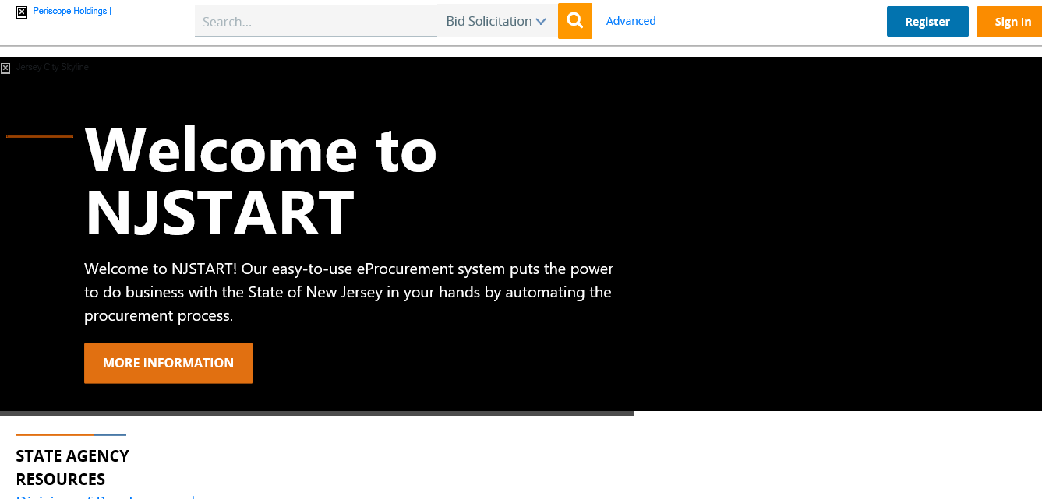
Notes:
Slide 12 - *Screen Shot 3* - Finally, this is a front page screen shot of our e-procurement website, NJSTART, which can be found at www.njstart.gov. From this page you can search for all Open Bids and Active Contracts.
(Click to next slide)

Slide 13
THANK YOU FOR ATTENDING
Q&A due by 2pm May 1, 2024
Quotes due by 2pm May 22, 2024
Notes:
Slide 11 – Thank you for Attending:
I understand that that may have been a lot to take in. At this time I would like to extend the invitation for any procedural questions. Please remember that questions regarding the Scope of Work will not be answered at this time and should be submitted electronically on NJSTART before the Q&A deadline.
[If that’s all, I thank you for attending today’s Pre-Quote Conference. A reminder that Q&A will close at 2pm on April 12th, 2024, and that Quotes are due by 2pm on May 8th, 2024.
I advise not waiting until just before the cut off time just in case you run into any system or internet troubles.
Again, I thank you for joining me for this Pre-Quote Conference and wish you well in preparing your Quotes. ]

