Slide 1
Optional Pre-Quote Conference
T2794 Dental Program: State Health Benefits Program and School Employees’ Health Benefits Program 23DPP00888
Q&a due by 2pm, January 10, 2024
Quotes due by 2pm, February 8, 2024

Slide 2
WELCOME & INTRODUCTIONS
Please introduce yourself by providing your name and the firm you represent in the chat room.
Please identify yourself and the firm you represent prior to asking a question.
Please make sure you are registered in NJSTART, and that your contact information remains current.
  NJSTART Vendor email support: njstart@treas.nj.gov
  NJSTART Vendor phone support:(609) 341-3500 Staffed Monday to Friday 8:30 a.m. to 4:30 p.m.
  https://www.state.nj.us/treasury/purchase/vendor.shtml

Slide 3
PURPOSE & GENERAL INFORMATION
The purpose of this conference is to address procedural questions only, regarding the Bid Solicitation and Quote submission requirements.
No questions relating to the Scope of Work or the services or products required in the Bid Solicitation will be addressed. Vendors should utilize the Q&A Tab of the Bid Solicitation in NJSTART to submit those questions electronically.
The Bid Solicitation will be reviewed section by section with procedural questions being entertained on that basis.

Slide 4
BID SOLICITATION AT A GLANCE
Cover page: Submission dates
Section 1: Purpose, background, Q&A and exceptions, Bid Amendments, Quote content, support
Section 2: Pre-Quote Submission Information
Section 3: Quote Submission Requirements – Requirements of the Bidder, including forms, technical approach, schedules, resumes, firm experience, financial capability, and price sheet instructions, as well as additional terms and prohibition on conflicting terms and conditions
Section 4: Scope of Work – Requirements of the Contractor
Section 5: General Contract Terms, including Contract Term and Extension Option, performance security, ownership of material, and staff substitutions
Section 6: Data Security Requirements - Contractor Responsibility
Section 7: Modifications to the State of New Jersey Standard Terms and Conditions – Contractor Insurance Requirements

Slide 5
BID SOLICITATION AT A GLANCE
Section 8: Evaluation criteria, clarifications, best and final offer
Section 9: Glossary
Reminders
  Review Bid Solicitation in its entirety and submit any questions prior to the deadline including exceptions. Updated documents will be posted in NJSTART and should be reviewed as posted.
  Submit Quotes on time addressing all mandatory requirements including forms, or Quote may be deemed non-responsive. “Shall” denotes a mandatory requirement; however, not submitting requested information (“should”) could impact technical score
  Price Sheet must be completed in its entirety with no lines added or removed, or additional language or fees referenced

Slide 6
PRICE SHEET PITFALLS
Complete all required price lines on the Price Sheet, or Quote may be deemed non-responsive. Indicate “no charge” if the cost is $0. Do not leave any price lines blank.
Do not make formatting changes to the Price Sheet. If the price line requires a dollar amount, don’t change it to a percentage, or vice versa. If the price line includes 2 decimal places, don’t change the settings to allow 4 decimals.
Confirm that you have completed all tabs on the Price Sheet.
Do not add additional language, assumptions, or fees on the Price Sheet. Do not add or remove any price lines.
Confirm you have completed the proper version of the Price Sheet; it may have been revised via Bid Amendment.

Slide 7
OTHER HELPFUL TIPS
Do NOT include language such as this:
  Vendor accepts all terms and conditions of this Bid Solicitation with the following additional language: Section X - Agree, as it applies to changes that impact administrative fees as outlined in this provision, provided that Vendor reserves the right to modify Contracted Terms based on changes by the State.
  Vendor reserves the right to charge additional fees for services that require extensive time and effort.
  This Quote is a nonbinding expression of interest only and is not intended to create a binding commitment on either party unless and until a definitive agreement has been executed between the parties.
  This Quote may include statements regarding plans for future products and services, or future versions of existing products and services. Any such statements are provided solely for your general information and are not part of this Quote unless specifically stated in writing in this Quote.

Slide 8
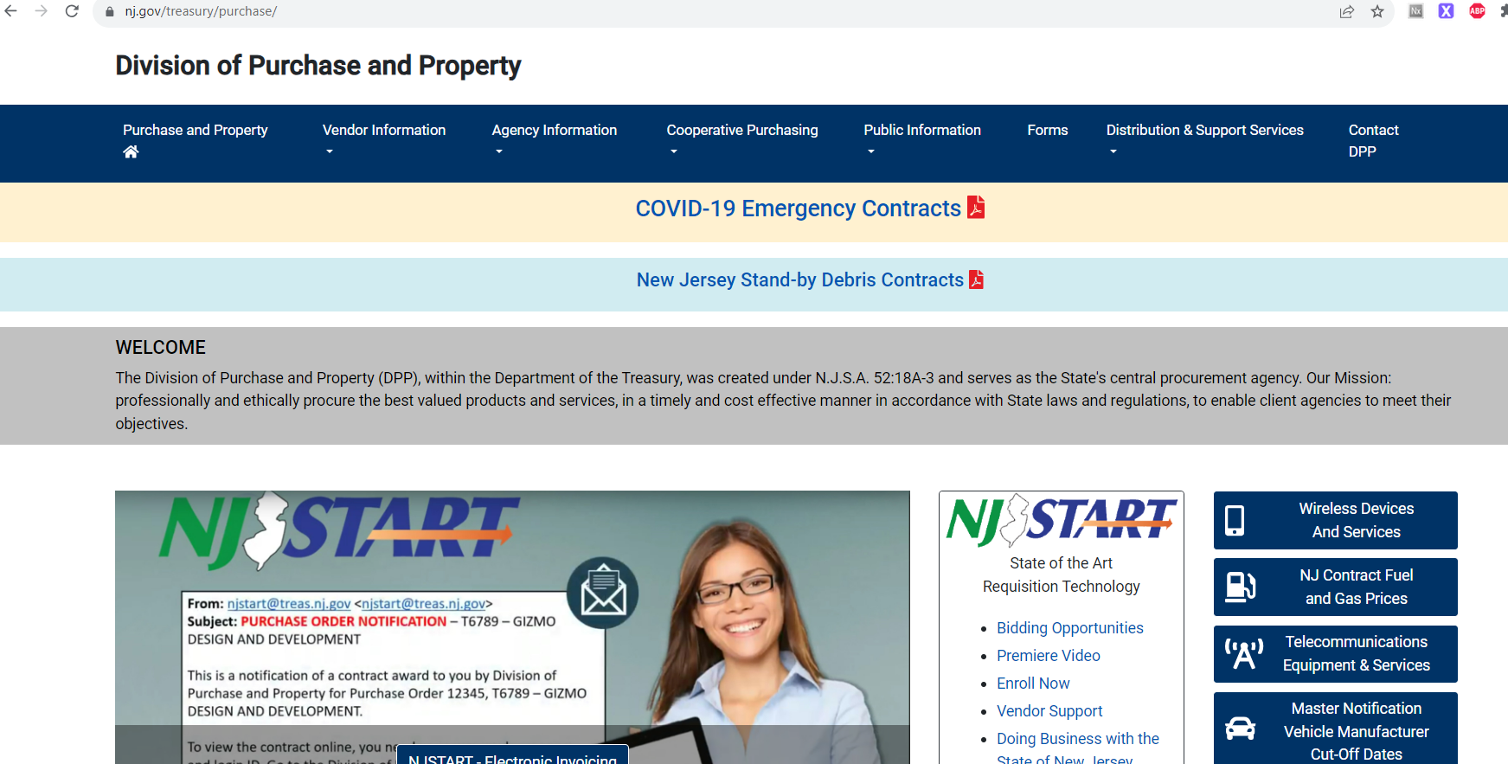

Slide 9
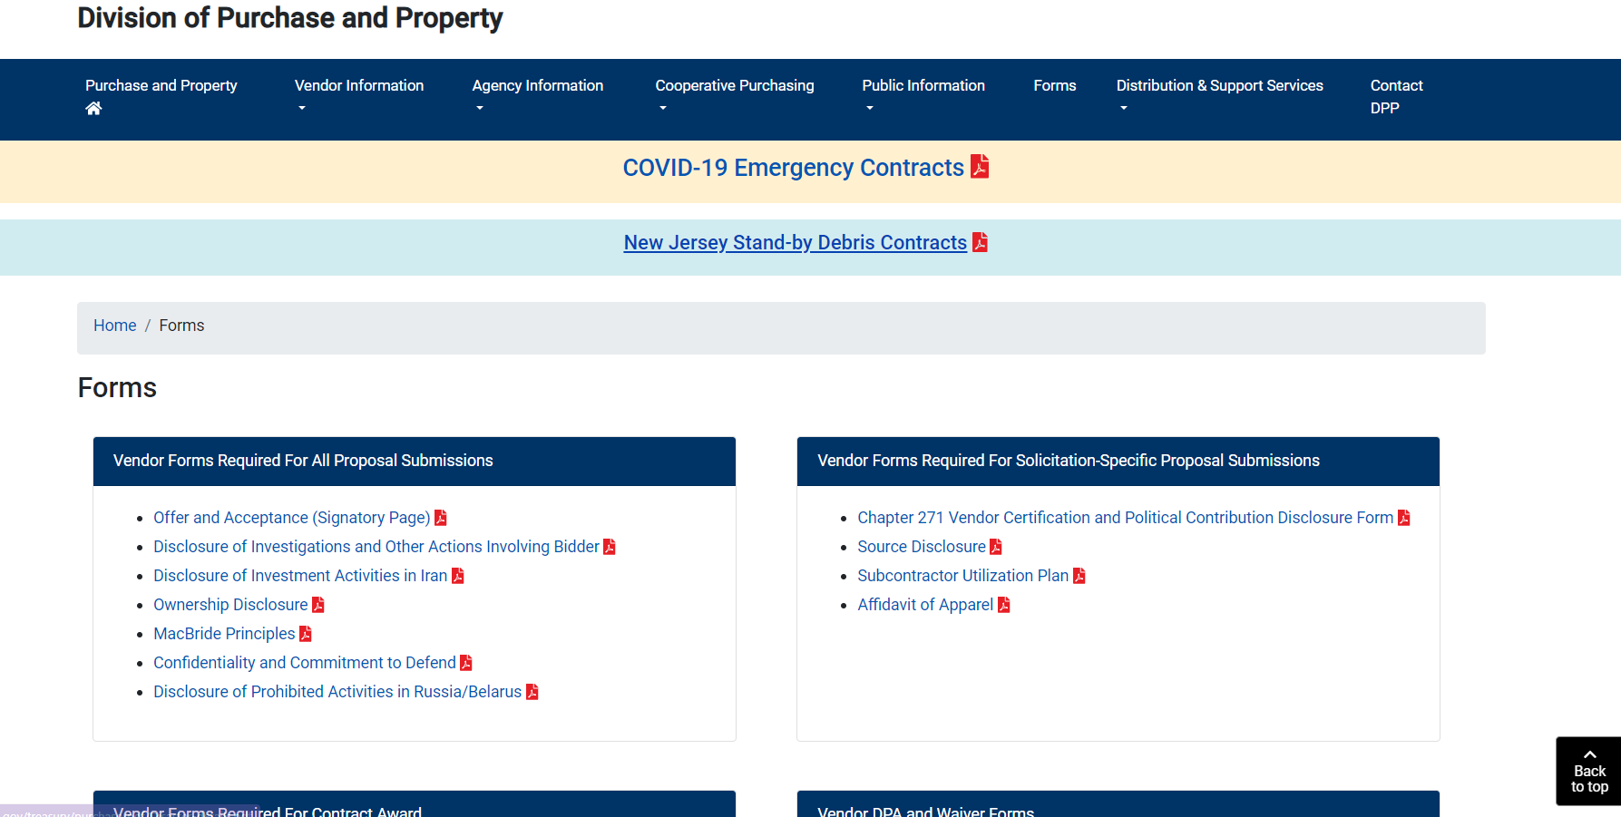

Slide 10


Slide 11
THANK YOU FOR ATTENDING
Q&A due by 2PM, January 10, 2024
Quotes due by 2PM, February 8, 2024

