Slide 1
Optional Pre-Quote Conference
Bid Solicitation #23DPP00870
T2983 – HOMELAND SECURITY FUSION
CENTER ANALYST SERVICE
Q&a due by 2pm, April 18, 2023
Quotes due by 2pm, June 7, 2023

Slide 2
WELCOME & INTRODUCTIONS
Please sign in by entering your name, company, and email in the Microsoft Teams chat window.
Please note that this conference is being recorded. Please identify yourself and the firm you represent prior to asking a question.
Please make sure you are registered in NJSTART, and that your contact information remains current.
  NJSTART Vendor email support: njstart@treas.nj.gov
  NJSTART Vendor phone support – (609) 341-3500 Staffed Monday to Friday 8:30 a.m. to 4:30 p.m.
  https://www.state.nj.us/treasury/purchase/vendor.shtml

Slide 3
PURPOSE & GENERAL INFORMATION
The purpose of this conference is to address procedural questions regarding the Bid Solicitation and Quote submission requirements.
Questions relating to the Scope of Work, the services, or products required in the Bid Solicitation will not be addressed at this time. Vendors are to electronically submit those questions through the Q&A Tab of the Bid Solicitation in NJSTART.
The Bid Solicitation will be reviewed section by section with procedural questions being entertained on that basis.

Slide 4
HELPFUL TIPS & REMINDERS
  Review Bid Solicitation in its entirety and submit any questions prior to the deadline including exceptions to the SSTC. Updated documents will be posted in NJSTART and should be reviewed as posted
  Complete all required price lines in the State Supplied Price Sheet. The Quote may be deemed non-responsive. Do not leave any price lines blank.
  Submit Quotes on time addressing all mandatory requirements (designated by “shall”) including forms. Quotes missing mandatory requirements may be deemed non-responsive. Not submitting requested information (“should”) may impact the technical evaluation score.
  The State Supplied Price Sheet must be completed in its entirety with no lines added or removed, or additional language or fees referenced

Slide 5
COMMON PRICE SHEET MISTAKES
Complete all required price lines in the State Supplied Price pursuant to the State Price Sheet Instructions in Section 3.23, or Quote may be deemed non-responsive. Do not leave any price lines blank.
Do not make formatting changes to the State Supplied Price Sheet. If the price line requires a dollar amount, don’t change it to a percentage, or vice versa. If the price line includes 2 decimal places, don’t change the settings to allow 4 decimals.
Do not add additional language, assumptions, or fees to the State Supplied Price Sheet. Do not add or remove any price lines.
Confirm you have completed the proper version of the State Supplied Price Sheet; it may have been revised via Bid Amendment.

Slide 6
Examples of additional language the may deem a quote non-responsive:
  Vendor accepts all terms and conditions of this Bid Solicitation with the following additional language: Section X - Agree, as it applies to changes that impact administrative fees as outlined in this provision, provided that Vendor reserves the right to modify Contracted Terms based on changes by the State.
  Vendor reserves the right to charge additional fees for services that require extensive time and effort.
  This Quote is a nonbinding expression of interest only and is not intended to create a binding commitment on either party unless and until a definitive agreement has been executed between the parties.
  This Quote may include statements regarding plans for future products and services, or future versions of existing products and services. Any such statements are provided solely for your general information and are not part of this Quote unless specifically stated in writing in this Quote.

Slide 7


Slide 8


Slide 9
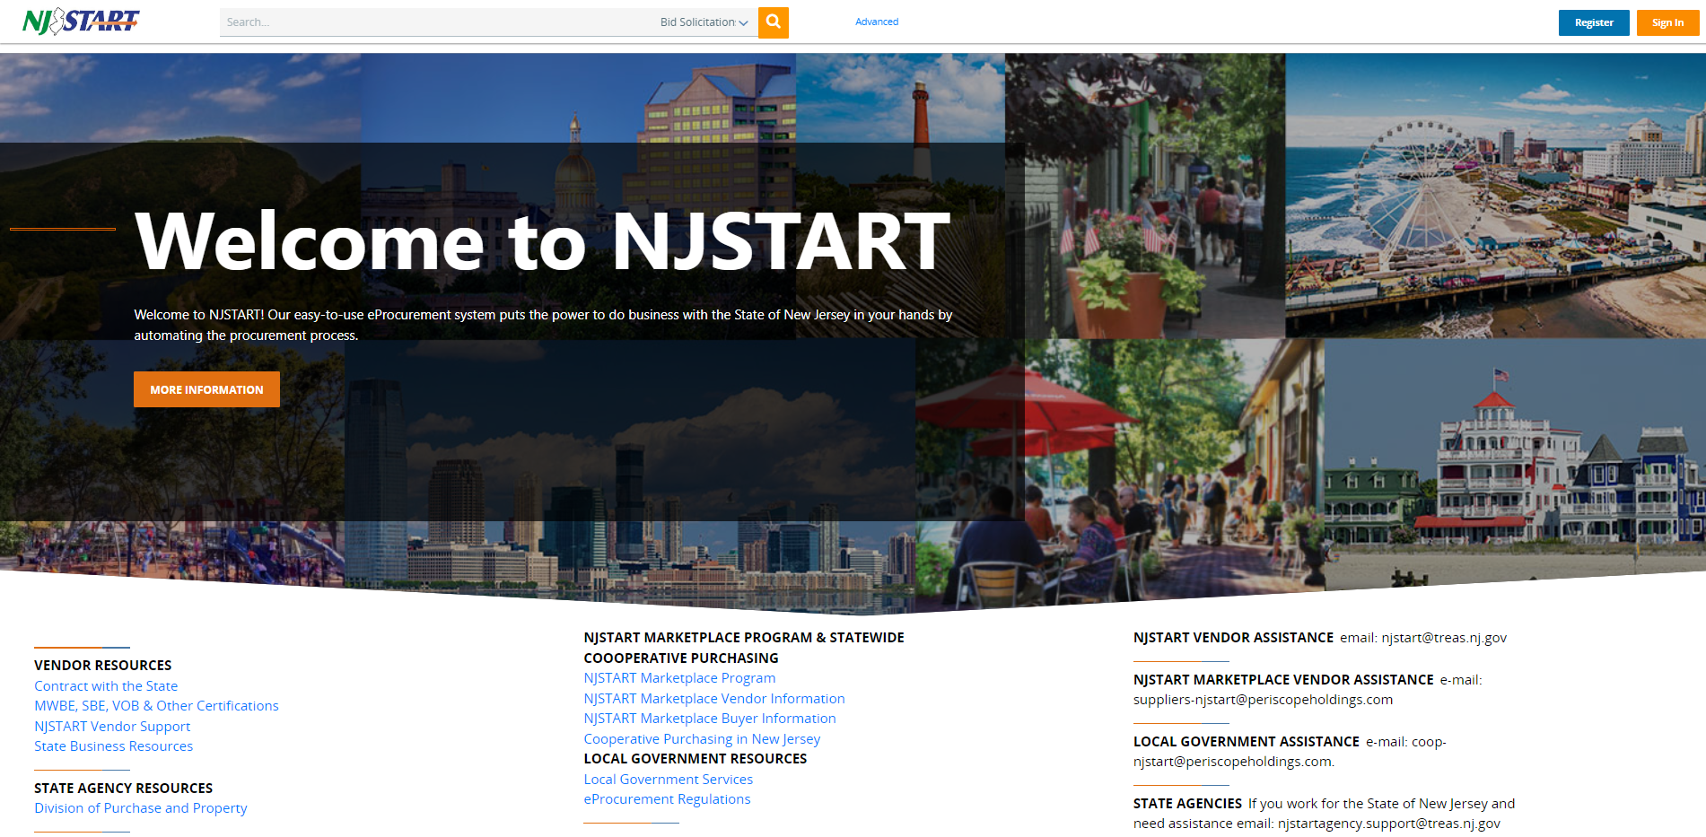

Slide 10
THANK YOU FOR ATTENDING
Q&A due by 2pm April 18, 2023
Quotes due by 2pm June 7, 2023

