Slide 1
Optional Pre-Quote Conference
T2560 Self Funded E-Goverment Applications and Services
23DPP00813
Q&a due by 2pm 8/22
Quotes due by 2pm 10/10
Notes:
Good morning. Welcome to the Pre-Quote Conference for T1776, Bid Solicitation 21DPP00639, Data Communications Network Services. Before we begin, please be sure you have the following available to you:
1)Bid Solicitation 21DPP00639;
2)The State-Supplied Pricing Configurations; and
3)The Optional Pre-Quote Conference PowerPoint Presentation.
Does anybody need assistance in accessing these files? [PAUSE]
**if yes, read below paragraph (If not move to the Paragraph saying “Let’s begin”)
**If you are not sure how to find these documents, please listen carefully. Go to NJSTART.gov – that is N-J-S-T-A-R-T-dot-G-O-V. Towards the bottom left corner, click “Open Bids”. Under Bid Number, click 21DPP00639. Click “Proceed”. In the File Attachments Section, open the Bid Solicitation file, the Price Sheet file, and the Optional Pre-Quote Conference PowerPoint file. We’ll give you a few moments to open the documents. If you are unable to open any of these files, you are still welcome to stay in this conference, but please know that you will need access to these files in order to submit a Quote.
Let’s begin today’s conference. Please keep your phones and microphones muted during this Pre-Quote Conference to avoid background noise. If you need to speak, you can unmute as needed. You should currently be looking at slide 1 of the PowerPoint presentation. As reflected in the Bid Solicitation, please be advised that your electronically submitted questions are due by 2pm on February 25, 2022and your Quotes are due by 2pm June 10, 2022. Please be sure that you have the Bid Solicitation and Pricing Configurations open as we will be reviewing it later in this conference. At this time, please move on to Slide 2.

Slide 2
WELCOME & INTRODUCTIONS
Please sign in by entering your name, company, and email in the Microsoft Teams chat window.
Please note that this conference is being recorded.
When asking a question, identify yourself and the firm you represent.
Make sure your company is registered in NJSTART, and that the contact information remains current.
  NJSTART Vendor email support: njstart@treas.nj.gov
  NJSTART Vendor phone support – (609) 341-3500 Staffed Monday to Friday 8:30 a.m. to 4:30 p.m.
  https://www.state.nj.us/treasury/purchase/vendor.shtml
Notes:
Allow me to introduce myself. My name is Angelica Morales, and I am the Procurement Specialist responsible for this Bid Solicitation. I am joined by Juliana Pastuzyn, our Lead in the IT Unit and Cory Kestner of our Bureau Counsel team. Now that we have introduced the present members of the Division of Purchase and Property, let’s take this opportunity to meet the representatives of the firms joining us during this conference. One at a time, please identify yourselves and the firm you represent in the chat box. For those calling in please state your name and the company your represent.
Is that everyone? [PAUSE] Great, thank you.
Please know that in order to submit a Quote, your firm will need to be registered on NJSTART. If your firm is already registered, please be sure that the contact information is up to date so you are notified when updates are posted to this Bid Solicitation. If you need any assistance with NJSTART, you can email our NJSTART Vendor Support team at NJSTART@treas.nj.gov. You can find additional helpful information, such as the Vendor Quick Reference Guide, at the link in Slide 2. At this time, please move on to Slide 3.

Slide 3
PURPOSE & GENERAL INFORMATION
The purpose of this conference is to address procedural questions regarding the Bid Solicitation and Quote submission requirements.
Questions relating to the specific Scope of Work or products required in the Bid Solicitation will not be addressed. Bidders should utilize the Q&A Tab of the Bid Solicitation in NJSTART to submit these questions electronically.
The Bid Solicitation will be reviewed section by section with procedural questions being entertained on that basis.
Notes:
The purpose of this conference is to discuss procedural and Quote submission requirements only. We will not be discussing or answering questions regarding the Scope of Work, which can be found in Bid Solicitation Section 3. Any questions related to the scope of work must be submitted through the Q&A Tab on NJSTART prior to the Q&A deadline. The majority of today’s presentation will reflect Sections 1, 2, 4, and 7. This Bid Solicitation will be reviewed section by section. We will not be reviewing every single part of the Bid Solicitation, but will try to review some of the most critical topics. Questions should be limited to procedure and Quote submission requirements only. At this time, please move on to Slide 4 and make sure you have the Bid Solicitation open.

Slide 4
BID SOLICITATION AT A GLANCE
Cover page: Submission dates and set-aside requirements
Section 1: Purpose and background information
Section 2: Pre-Quote Submission Information
Section 3: Quote Submission Requirements
Section 4: Scope of Work
Section 5: General Contract Terms
Section 6: Data Security Requirements – Contractor Responsibility
Section 7: Modifications to the NJ Standard Terms & Conditions
Section 8: Quote Evaluation and Award
Section 9: Glossary
Notes:
The Cover Sheet of the Bid Solicitation contains critical dates and deadlines, in addition to set-aside requirements. As a reminder, electronically submitted questions are due by 2pm on February 25, 2022 and your Quotes are due by 2pm on June 10, 2022. These dates are subject to change. If changed, it will be reflected in an Amendment posted to NJSTART. For this procurement, there is no set-aside requirement.
Read the rest of this section from paper

Slide 5
COMMON PRICE SHEET MISTAKES
Not completing all required price lines. Refer to Section 3.28 of the Bid Solicitation.
Making formatting changes to the Pricing Configurations. If the price line requires a dollar amount, do not change it to a percentage, or vice versa. If the price line includes 2 decimal places, do not change the settings to allow 4 decimals.
Adding additional language, assumptions, or fees to the Pricing Configurations document. Do not add language, assumptions, fees or remove any price lines.
Submitting the wrong version of the Price Sheet. Confirm the correct version of the Price Sheet has been completed; it may have been revised via Bid Amendment.
Notes:
Let’s take a moment to address some common Pricing pitfalls. Be sure to complete all required price lines on the Pricing Configurations, or the Quote may be deemed non-responsive. Indicate “no charge” if the cost is $0. Do not leave any price lines blank.
Do not make formatting changes to the Pricing Configurations. If the price line requires a dollar amount, don’t change it to a percentage, or vice versa. If the price line includes 2 decimal places, don’t change the settings to allow 4 decimals.
Do not add additional language, assumptions, or fees on the Pricing Configurations. Do not add or remove any price lines.
Confirm you have completed the latest to the version of the Pricing Configurations as it may have been revised via Bid Amendment. Review all posted amendments that may include changes to the Pricing Configurations and Bid Solicitation. These changes should be taken into account when completing price sheets.

Slide 6
HELPFUL TIPS & REMINDERS
  Review the Bid Solicitation in its entirety and submit any questions prior to the deadline including exceptions. Updated documents will be posted in NJSTART and should be reviewed as posted.
  Submit Quotes on time addressing all mandatory requirements including forms or the Quote may be deemed non-responsive. “Shall” denotes a mandatory requirement.
  Not submitting requested information designated as “should” could impact technical score evaluation.
  The Price Sheet must be completed in its entirety with no lines added or removed, or additional language or fees referenced. Do not leave any price lines blank. Indicated “no charge” if the cost is $0.
Notes:
Read Slide

Slide 7
DO NOT include language such as:
  Vendor accepts all terms and conditions of this Bid Solicitation with the following additional language: Section X - Agree, as it applies to changes that impact administrative fees as outlined in this provision, provided that Vendor reserves the right to modify Contracted Terms based on changes by the State.
  Vendor reserves the right to charge additional fees for services that require extensive time and effort.
  This Quote is a nonbinding expression of interest only and is not intended to create a binding commitment on either party unless and until a definitive agreement has been executed between the parties.
  This Quote may include statements regarding plans for future products and services, or future versions of existing products and services. Any such statements are provided solely for your general information and are not part of this Quote unless specifically stated in writing in this Quote.
Notes:
Read from slide

Slide 8
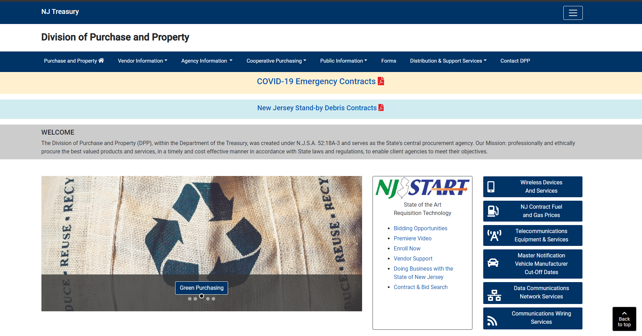
Notes:
At this time, please move on to Slide 9.
Slide 9 is a screenshot of the Division of Purchase and Property’s website. You can access this website by going to www.nj.gov/treasury/purchase, or by following the links throughout the Bid Solicitation. The website includes forms and other helpful information for Vendors.

Slide 9
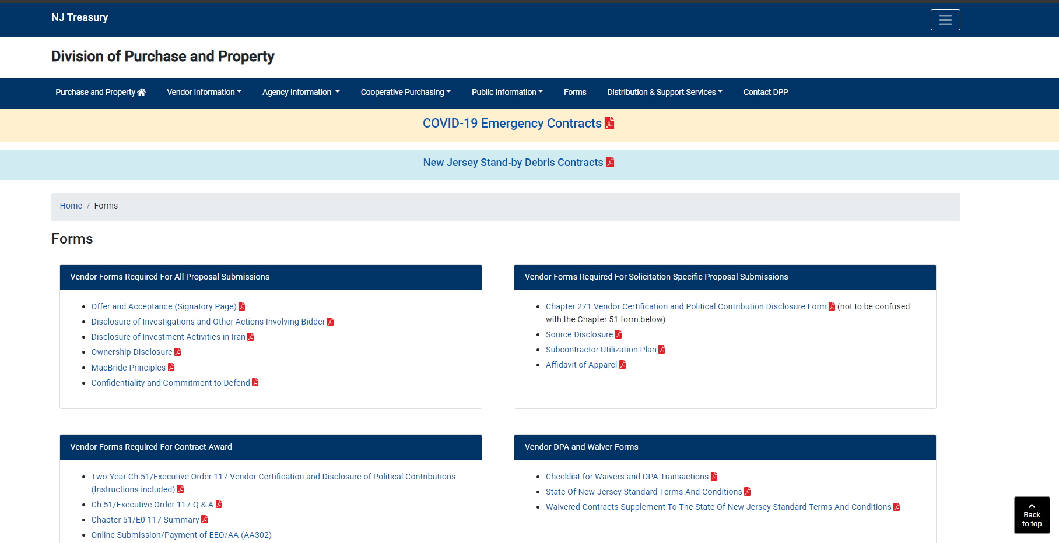
Notes:
Slide 10 is a screenshot of the Forms page on the Division of Purchase and Property’s website. The forms on this page are periodically updated, so it may not be an exact representation.

Slide 10
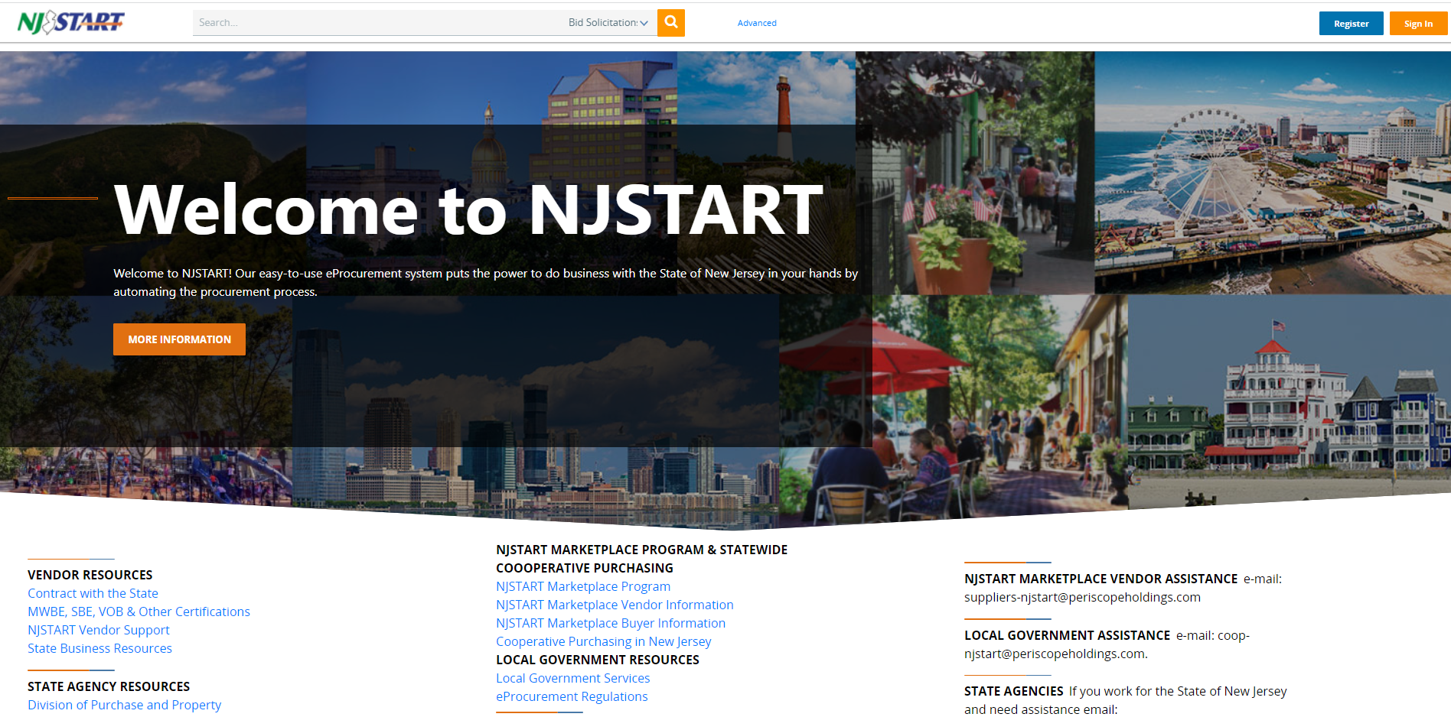
Notes:
Slide 11 is a screenshot of the State of New Jersey’s eProcurement website, NJSTART. This website can be found at njstart.gov.

Slide 11
THANK YOU FOR ATTENDING
Q&A due by 2pm 8/22
Quotes due by 2pm 10/10
Notes:
Thank you very much for joining us for today’s conference. One last reminder – electronic submission of your questions are due by 2pm on February 25, 2022 and your Quotes are due by 2pm on June 10, 2022.
This concludes today’s Pre-Quote Conference for T1176, Bid Solicitation 21DPP00639 Data Communications Network Services. Enjoy the rest of your day and good luck with your Quotes!

