Slide 1
Optional Pre-Quote Conference:
T1243 – Food Service for the NJ National Guard Training Center, Sea Girt
Bid Solicitation #20DPP00554
Q&a due by 2pm on November 12, 2020
Quotes due by 2pm on December 3, 2020

Slide 2
WELCOME & INTRODUCTIONS
Please identify yourself and the firm you represent when prompted during roll-call so that you are properly logged for attending the conference.
Please mute your phone at all times unless when speaking.
Please identify yourself and the firm you represent prior to asking a question.
Please make sure you are registered in NJSTART, and that your contact information remains current.
  NJSTART Vendor email support: njstart@treas.nj.gov
  https://www.state.nj.us/treasury/purchase/vendor.shtml

Slide 3
PURPOSE & GENERAL INFORMATION
The purpose of this conference is to address procedural questions only, regarding the Bid Solicitation and Quote submission requirements.
No questions relating to the Scope of Work or the services or products required in the Bid Solicitation will be addressed. Vendors should utilize the Q&A Tab of the Bid Solicitation in NJSTART to submit those questions electronically.
The Bid Solicitation will be reviewed section by section with procedural questions being entertained on that basis.

Slide 4
BID SOLICITATION AT A GLANCE
Cover page: Submission dates and set-aside requirements
Section 1: Purpose, background, Q&A and exceptions, Bid Amendments, Quote content, support
Section 2: Definitions
Section 3: Scope of Work
Section 4: Quote submission requirements including forms, schedules, firm experience, product literature, financial capability, and price sheet, as well as additional terms and prohibition on conflicting terms and conditions
Section 5: Contractual language including term, staff substitutions, ownership of materials, additional work, supplemental indemnification

Slide 5
BID SOLICITATION AT A GLANCE
Section 6: Evaluation criteria, clarifications, best and final offer
Section 7: Pre-award requirements
Section 8: State Contract Manager
Section 9: Standard Terms and Conditions
Reminders
  Review Bid Solicitation in its entirety and submit any questions prior to the deadline including exceptions. Updated documents will be posted in NJSTART and should be reviewed as posted.
  Submit Quotes on time addressing all mandatory requirements including forms, or Quote may be deemed non-responsive. “Shall” and “Must” denotes a mandatory requirement; however, not submitting requested information (“should”/”may”) could impact technical score
  Price Sheet must be completed in its entirety with no lines added or removed, or additional language or fees referenced

Slide 6
PRICE SHEET PITFALLS
Complete all required price lines on the Price Sheet, or Quote may be deemed non-responsive. Indicate “no charge” if the cost is $0. Do not leave any price lines blank.
Do not make formatting changes to the Price Sheet. If the price line requires a dollar amount, don’t change it to a percentage, or vice versa. If the price line includes 2 decimal places, don’t change the settings to allow 4 decimals.
Do not add additional language, assumptions, or fees on the Price Sheet. Do not add or remove any price lines.
Confirm you have completed the proper version of the Price Sheet; it may have been revised via Bid Amendment.

Slide 7
OTHER HELPFUL TIPS
Do NOT include language such as this:
  Vendor accepts all terms and conditions of this Bid Solicitation with the following additional language: Section X - Agree, as it applies to changes that impact administrative fees as outlined in this provision, provided that Vendor reserves the right to modify Contracted Terms based on changes by the State.
  Vendor reserves the right to charge additional fees for services that require extensive time and effort.
  This Quote is a nonbinding expression of interest only and is not intended to create a binding commitment on either party unless and until a definitive agreement has been executed between the parties.
  This Quote may include statements regarding plans for future products and services, or future versions of existing products and services. Any such statements are provided solely for your general information and are not part of this Quote unless specifically stated in writing in this Quote.

Slide 8


Slide 9


Slide 10


Slide 11
Vendor {Bidder} Checklist
PART #1: FORMS, REGISTRATIONS AND CERTIFICATIONS THAT MUST BE
SUBMITTED BY THE VENDOR WITH THE QUOTE
OFFER AND ACCEPTANCE PAGE (Bid Solicitation §4.4.1.1)
OWNERSHIP DISCLOSURE FORM (Bid Solicitation §4.4.1.2.1)
DISCLOSURE OF INVESTMENT ACTIVITIES IN IRAN FORM (Bid Solicitation §4.4.1.2.2)
SUBCONTRACTOR UTILIZATION PLAN (Bid Solicitation §4.4.1.3)
  If this Bid Solicitation has a Subcontracting Set-Aside Requirement, the Vendor MUST consult The Division of Revenue & Enterprise Services at (609) 292-2146 for information regarding registered Small Businesses and/or Disabled Veteran Businesses.
STATE-SUPPLIED PRICE SHEET

Slide 12
Vendor {Bidder} Checklist
PART #2: FORMS, REGISTRATIONS AND CERTIFICATIONS THAT SHOULD BE SUBMITTED BY THE VENDOR WITH THE QUOTE. THESE FORMS MUST BE SUBMITTED PRIOR TO THE AWARD OF THE MASTER BLANKET PURCHASE ORDER.
DISCLOSURE OF INVESTIGATIONS AND OTHER ACTIONS INVOLVING THE VENDOR {BIDDER} (Bid Solicitation Section §4.4.2.2)
PROOF OF REGISTRATION
  You may register your business HERE or obtain a copy of the Business Registration Certificate HERE
CERTIFICATE OF INSURANCE / ACCORD
TWO-YEAR CHAPTER 51/EXECUTIVE ORDER 117 VENDOR CERTIFICATION AND DISCLOSURE OF POLITICAL CONTRIBUTIONS (Bid Solicitation Section §7.1.1)
AFFIRMATIVE ACTION REQUIREMENTS COMPLIANCE (Bid Solicitation Section §7.1.3) - Submit one of the following:
  New Jersey Certification Of Employee Information
  Federal Letter Of Approval Verifying A Federally Approved OR Sanctioned Affirmative Action Program (Dated within 1 year of the Quote submission)
  Affirmative Action Employee Information Report (AA302 FORM)
SERVSAFE MANAGER CERTIFICATION AND FOOD HANDLER’S PERMIT (Bid Solicitation Section §4.4.3.4.1)
SOURCE DISCLOSURE FORM (Bid Solicitation Section §4.4.2.3 and 7.1.2)

Slide 13
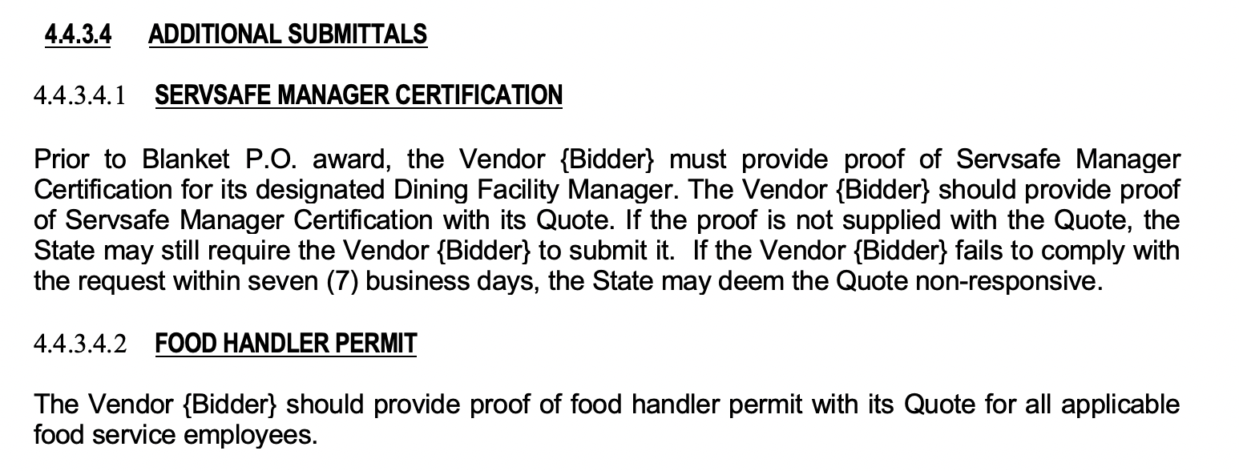
ServSafe Certification
T1243 – Food Service for NJ National Guard Training Center, Sea Girt
See Bid Solicitation Section 4.4.3.4 Additional Submittals
To all Vendors {Contractors}: Please make sure your firm has its ServSafe Certification before award.

Slide 14
State-Supplied Price Sheet
T1243 – Food Service for NJ National Guard Training Center, Sea Girt
See Price Sheet Instructions in Bid Solicitation Section 4.4.5.2., State–Supplied Price Sheet Instructions, for directions.
Total of Seventeen (17) Price Lines.

Slide 15
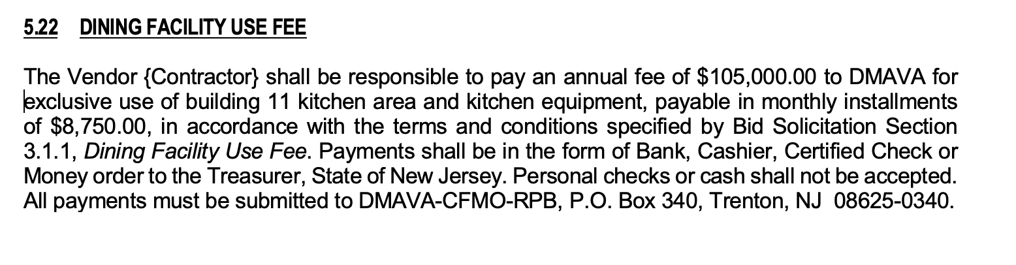
Dining Facility Use Agreement
T1243 – Food Service for NJ National Guard Training Center, Sea Girt
See Bid Solicitation Section 3.1.1 and Section 5.22 Dinning Facility Use Fee

Slide 16
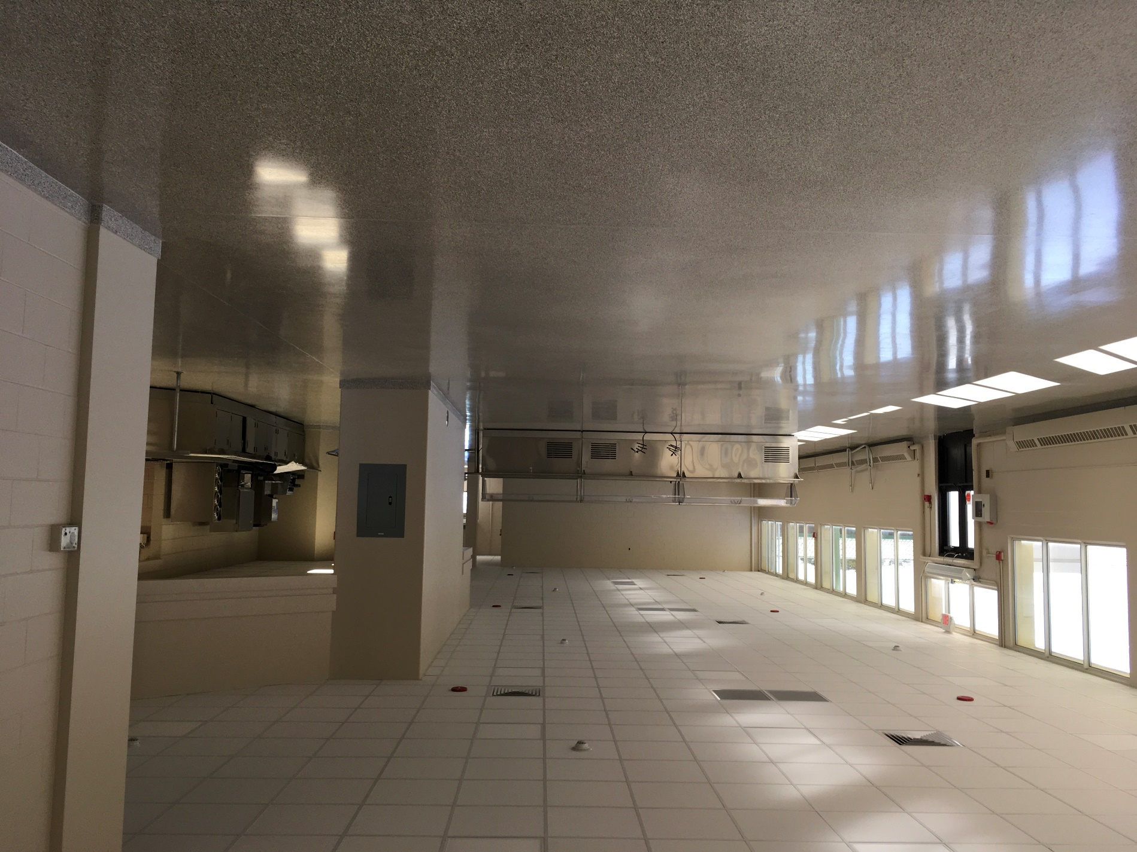
Dining Facility Pictures & Floor Plans

Slide 17
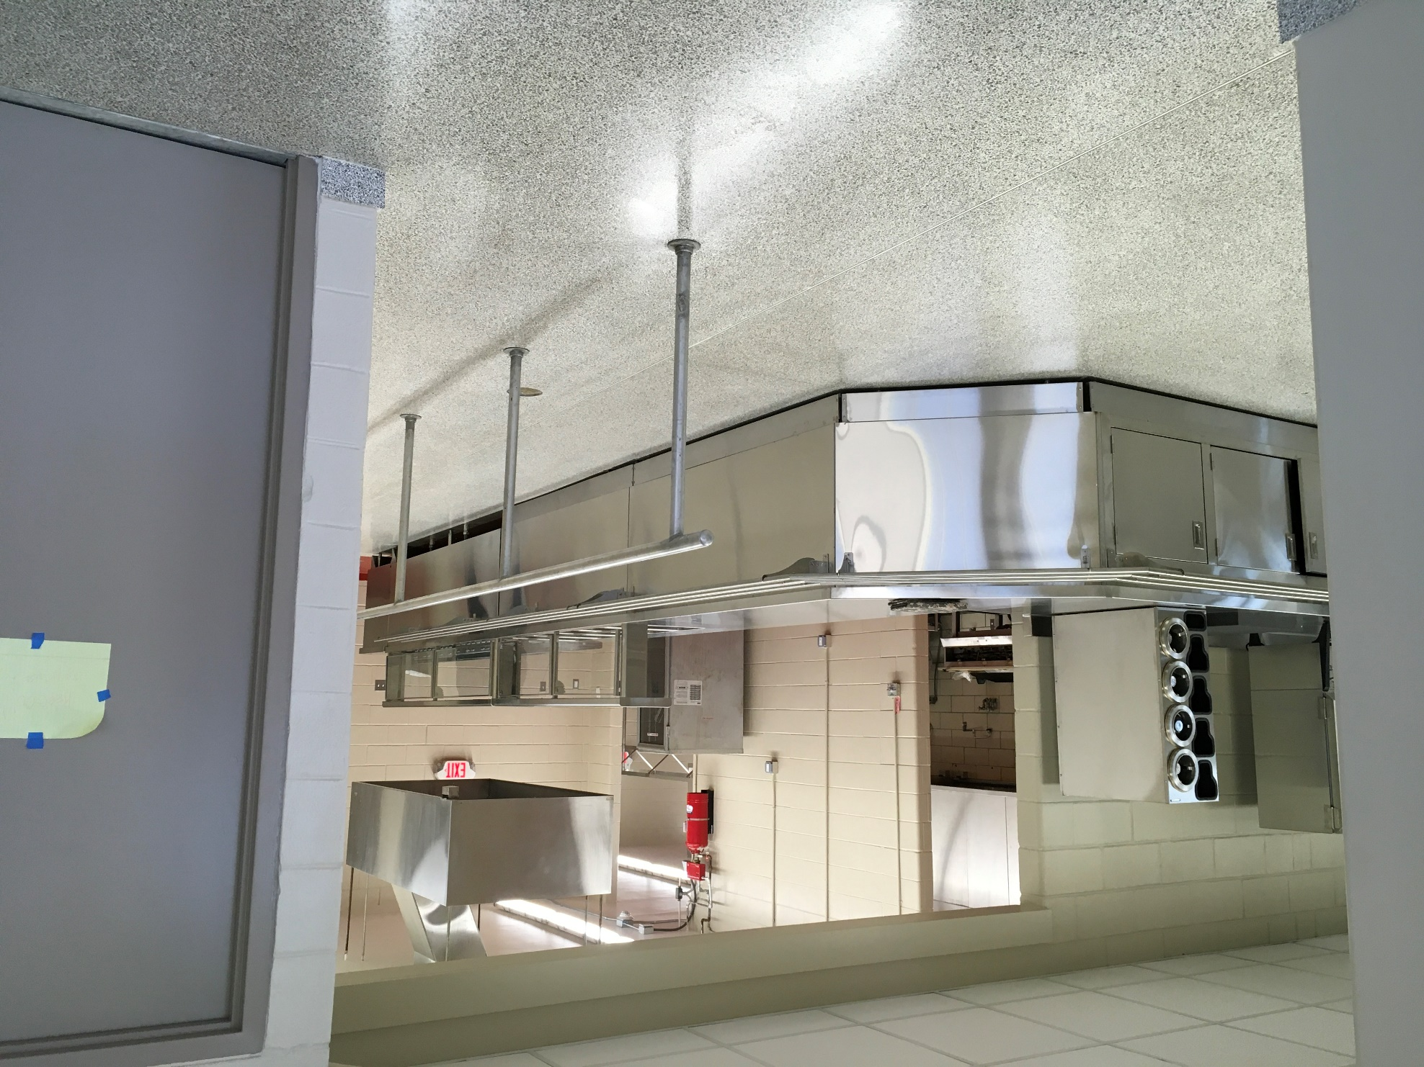
Dining Facility Pictures & Floor Plans

Slide 18
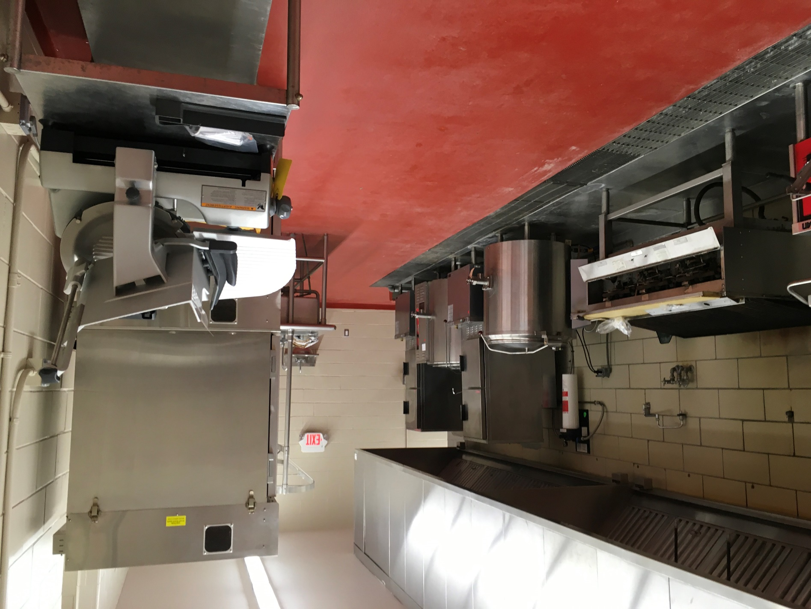
Dining Facility Pictures & Floor Plans

Slide 19
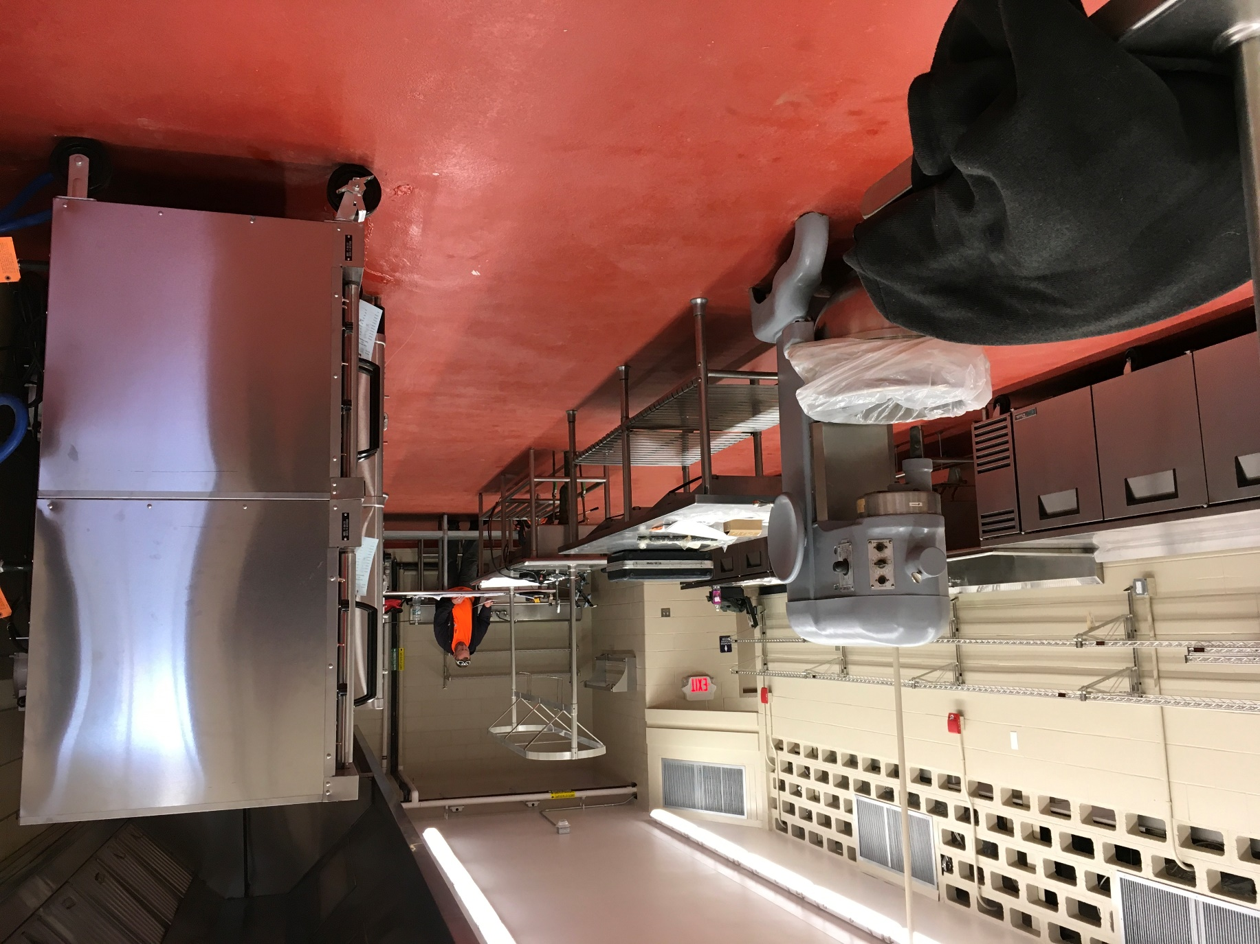
Dining Facility Pictures & Floor Plans

Slide 20
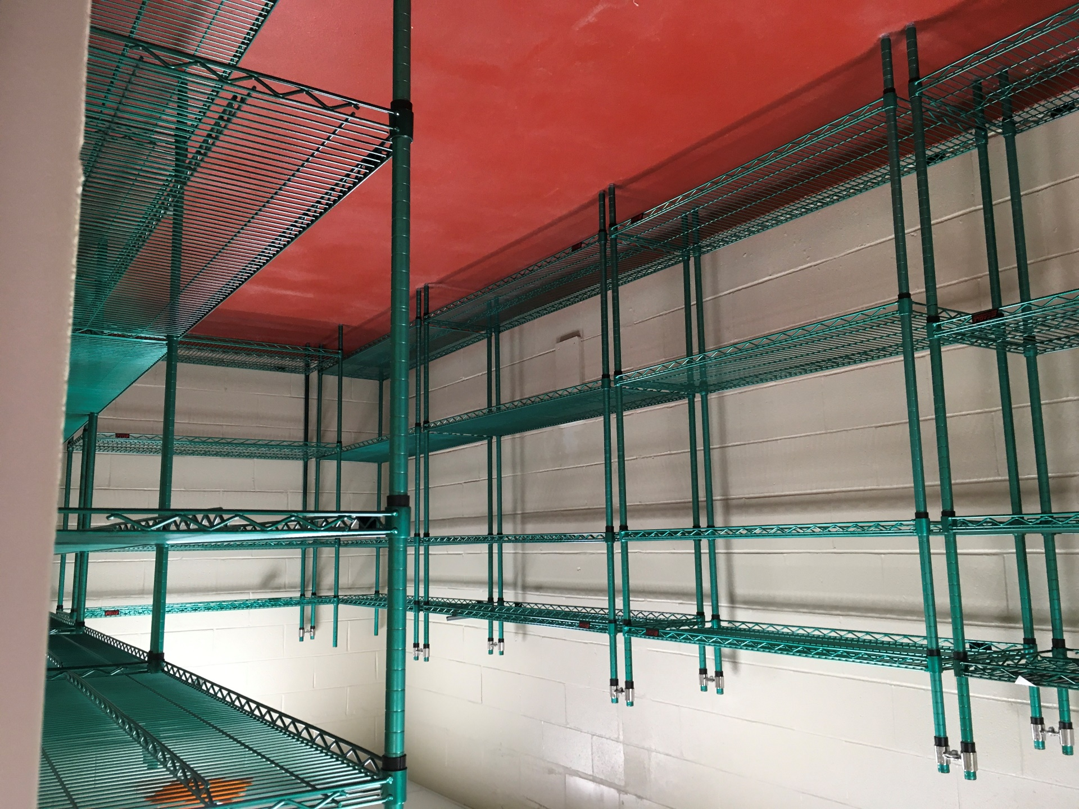
Dining Facility Pictures & Floor Plans

Slide 21
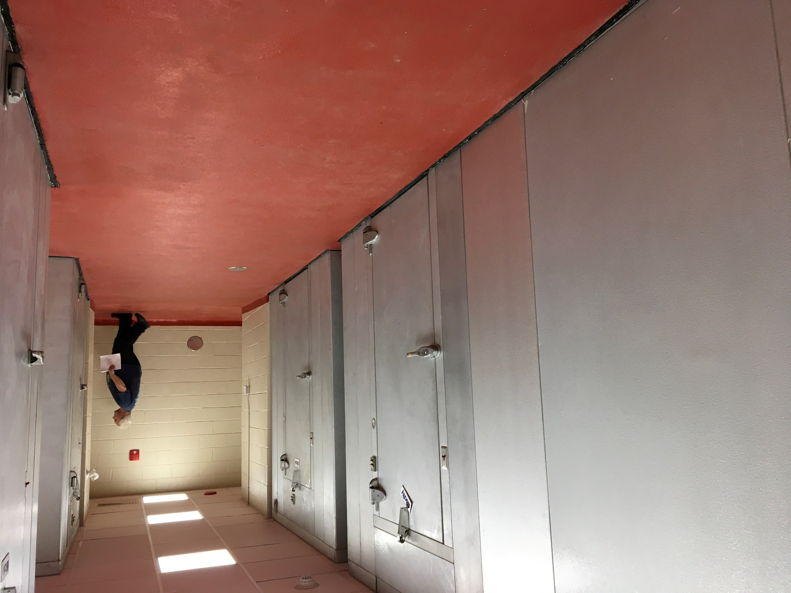
Dining Facility Pictures & Floor Plans

Slide 22
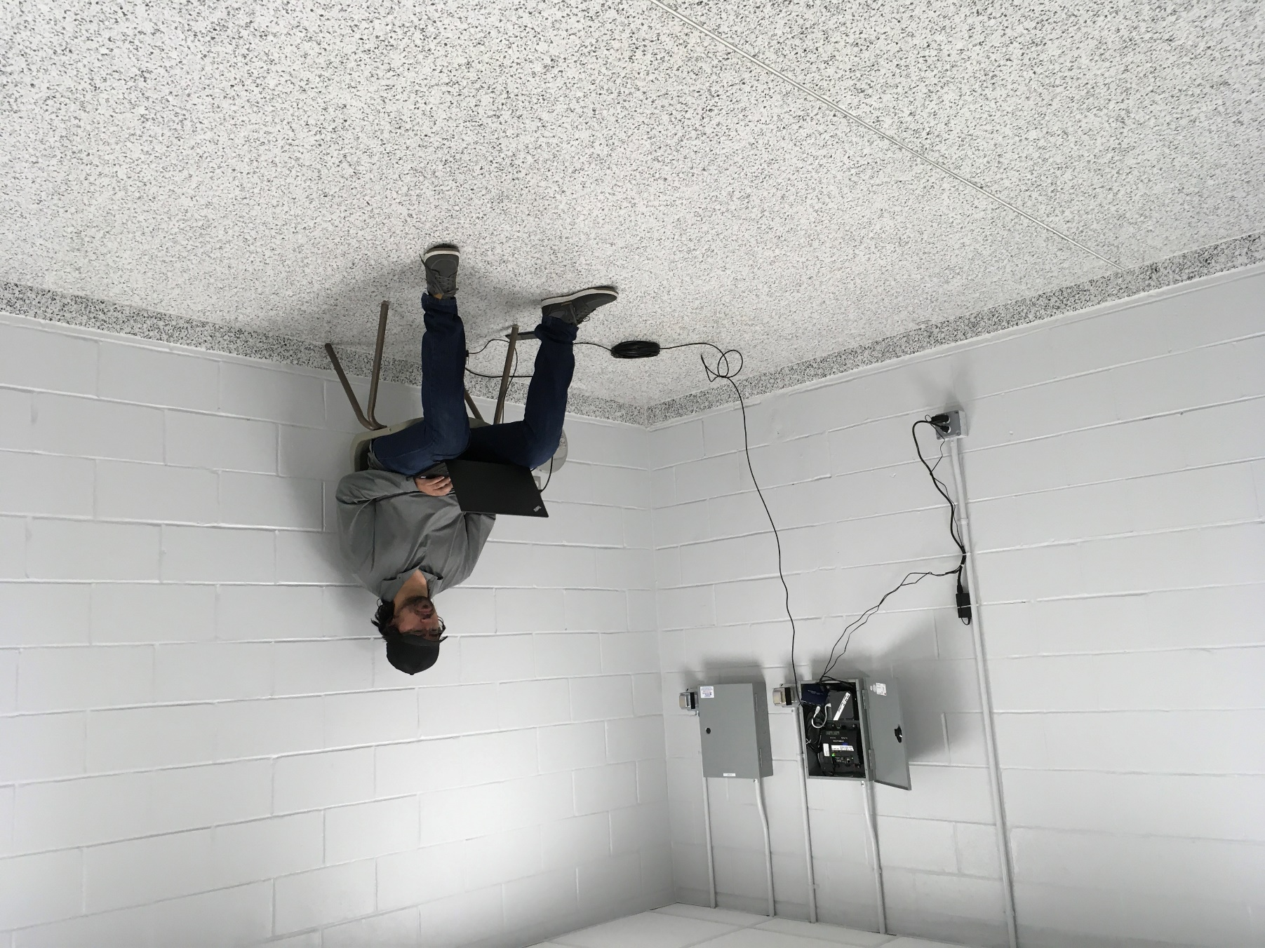
Dining Facility Pictures & Floor Plans

Slide 23
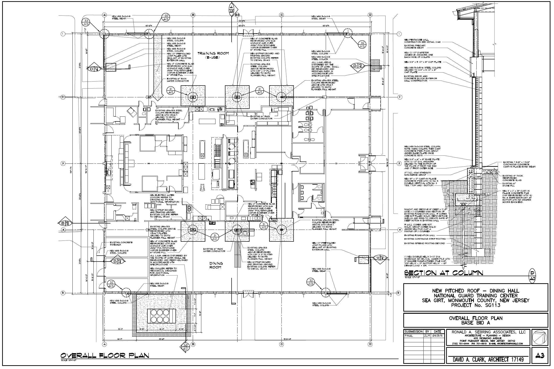

Slide 24
THANK YOU FOR ATTENDING
Q&A due by 2pm on November 12, 2020
Quotes due by 2pm on December 3, 2020

