Slide 1
Optional Pre-Quote Conference
T0777 – Snow Plowing and Spreading Services - NJDOT
20DPP00525
Q&a due by 2pm, April 30, 2020
Quotes due by 2pm, may 21, 2020

Slide 2
WELCOME & INTRODUCTIONS
Please make sure you are registered in NJSTART, and that your contact information remains current.
  NJSTART Vendor email support: njstart@treas.nj.gov
  NJSTART Vendor phone support – (609) 341-3500 Staffed Monday to Friday 8:30 a.m. to 4:30 p.m.
  NJSTART Vendor Support Page
    The Division’s Quick Reference Guides to assist Vendors with navigating NJSTART are available on the NJSTART Vendor Support Page. Vendors should refer to the Quick Reference Guide entitled “Submit a Quote” for information and instructions on how to submit a Quote through the NJSTART eProcurement site.
    NJSTART Vendor Support Page: https://www.state.nj.us/treasury/purchase/vendor.shtml

Slide 3
PURPOSE & GENERAL INFORMATION
The purpose of this conference is to address procedural questions regarding the Bid Solicitation and Quote submission requirements.
No questions relating to the Scope of Work or the services or products required in the Bid Solicitation will be addressed. Vendors shall utilize the Q&A Tab of the Bid Solicitation in NJSTART to submit those questions electronically.
The Bid Solicitation will be reviewed section by section with procedural questions being entertained on that basis.

Slide 4
BID SOLICITATION AT A GLANCE
Cover page: Submission dates and set-aside requirements (there are no set-aside requirements)
Section 1: Purpose, background, Q&A and exceptions, Bid Amendments, Quote content, support
Section 2: Definitions
Section 3: Scope of Work
Section 4: Quote submission requirements including:
  Forms;
  Attachment #1 – Experience of Vendor {Bidder};
  Financial capability;
  State-Supplied Price Sheet – Snow Plowing and Hauling Services;
  State-Supplied Price Sheet – Spreading Services; and
  Additional terms and prohibition on conflicting terms and conditions
  Quotes submitted in response to a Bid Solicitation MUST be submitted through the NJSTART eProcurement site.

Slide 5
BID SOLICITATION AT A GLANCE
Section 5: Contractual language including term, staff substitutions, ownership of materials, additional work, and supplemental indemnification
Section 6: Evaluation criteria, clarifications, best and final offer negotiations
Section 7: Pre-award requirements
Section 8: State Contract Manager
Section 9: Standard Terms and Conditions
Reminders
  Review the Bid Solicitation in its entirety and submit any questions and/or exceptions prior to the deadline. Updated documents will be posted in NJSTART and should be reviewed as posted.
  Submit Quotes on time addressing all mandatory requirements including forms, or the Quote will be deemed non-responsive. “Shall” denotes a mandatory requirement; however, not submitting requested information (“should”) could impact technical score.
  No lines shall be added and/or removed from the State-Supplied Price Sheets and no additional language or fees referenced shall be added to the State-Supplied Price Sheets.

Slide 6
STATE-SUPPLIED PRICE SHEET PITFALLS
Indicate “no charge” if the cost is $0 on a specific price line on the State-Supplied Price Sheet(s).
Do not make formatting changes to the State-Supplied Price Sheets. If the price line requires a dollar amount, don’t change it to a percentage, or vice versa. If the price line includes 2 decimal places, don’t change the settings to allow 4 decimals.
Confirm that you have completed all columns for all price lines that you are submitting pricing for in accordance with the State-Supplied Price Sheets directions.
Do not add additional language, assumptions, or fees on the State-Supplied Price Sheets. Do not add or remove any price lines.
Confirm that you have completed the proper version of the State-Supplied Price Sheets; it may have been revised via Bid Amendment.
Only provide unit pricing for the price lines that you are willing and fully able to provide, including all services specified by this Bid Solicitation, as applicable.

Slide 7
OTHER HELPFUL TIPS
Do NOT include language such as this:
  Vendor accepts all terms and conditions of this Bid Solicitation with the following additional language: Section X - Agree, as it applies to changes that impact administrative fees as outlined in this provision, provided that Vendor reserves the right to modify Contracted Terms based on changes by the State.
  Vendor reserves the right to charge additional fees for services that require extensive time and effort.
  This Quote is a nonbinding expression of interest only and is not intended to create a binding commitment on either party unless and until a definitive agreement has been executed between the parties.
  This Quote may include statements regarding plans for future products and services, or future versions of existing products and services. Any such statements are provided solely for your general information and are not part of this Quote unless specifically stated in writing in this Quote.

Slide 8


Slide 9


Slide 10


Slide 11
Vendor {Bidder} Checklist
PART #1: FORMS, REGISTRATIONS AND CERTIFICATIONS THAT MUST BE
SUBMITTED BY THE VENDOR WITH THE QUOTE
A. OFFER AND ACCEPTANCE PAGE (Bid Solicitation §4.4.1.1)
B. OWNERSHIP DISCLOSURE FORM (Bid Solicitation §4.4.1.2.1)
C. DISCLOSURE OF INVESTMENT ACTIVITIES IN IRAN FORM (Bid Solicitation §4.4.1.2.2)
D. SUBCONTRACTOR UTILIZATION PLAN (Bid Solicitation §4.4.1.3) IF THIS BID SOLICITATION HAS A SUBCONTRACTING SET-ASIDE REQUIREMENT, THE VENDOR MUST CONSULT THE DIVISION OF REVENUE & ENTERPRISE SERVICES AT 609-292-2146 FOR INFORMATION REGARDING REGISTERED SMALL BUSINESSES AND/OR DISABLED VETERAN BUSINESSES.
E. ATTACHMENT #1 – EXPERIENCE OF VENDOR {BIDDER} (Bid Solicitation §4.4.3)
F. STATE-SUPPLIED PRICE SHEETS (See Bid Solicitation Section §4.4.5)

Slide 12
Vendor {Bidder} Checklist
PART #2: FORMS, REGISTRATIONS AND CERTIFICATIONS THAT SHOULD BE SUBMITTED BY THE VENDOR WITH THE QUOTE. THESE FORMS MUST BE SUBMITTED PRIOR TO THE AWARDOF THE MASTER BLANKET PURCHASE ORDER.
A. DISCLOSURE OF INVESTIGATIONS AND OTHER ACTIONS INVOLVING VENDOR (Bid Solicitation §4.4.2.2)
B. PROOF OF BUSINESS REGISTRATION
C. CERTIFICATE OF INSURANCE / ACORD
D. TWO-YEAR CHAPTER 51/EXECUTIVE ORDER 117 VENDOR CERTIFICATION AND DISCLOSURE OF POLITICAL CONTRIBUTIONS (Bid Solicitation §7.1.1)
E. AFFIRMATIVE ACTION COMPLIANCE (Bid Solicitation §7.1.3) Submit one of the following:
 | NEW JERSEY CERTIFICATE OF EMPLOYEE INFORMATION REPORT
 | FEDERAL LETTER OF APPROVAL VERIFYING A FEDERALLY APPROVED OR SANCTIONED AFFIRMATIVE ACTION PROGRAM (Dated within 1 year of the Quote submission)
 | AFFIRMATIVE ACTION EMPLOYEE INFORMATION REPORT (FORM AA302)
F. SOURCE DISCLOSURE FORM (Bid Solicitation §§4.4.2.3 and 7.1.2)

Slide 13
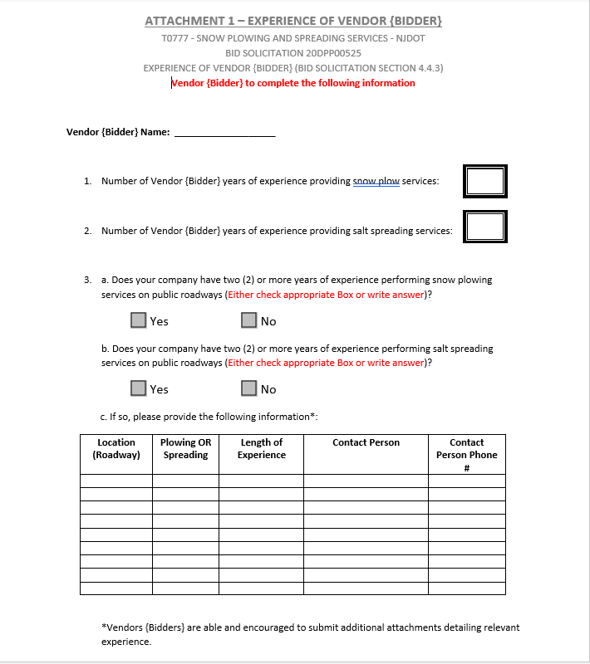
ATTACHMENT #1 – EXPERIENCE OF VENDOR {BIDDER} (Bid Solicitation §4.4.3)
See Bid Solicitation Section 4.4.3 Experience of Vendor {Bidder} for more information about this mandatory form.

Slide 14
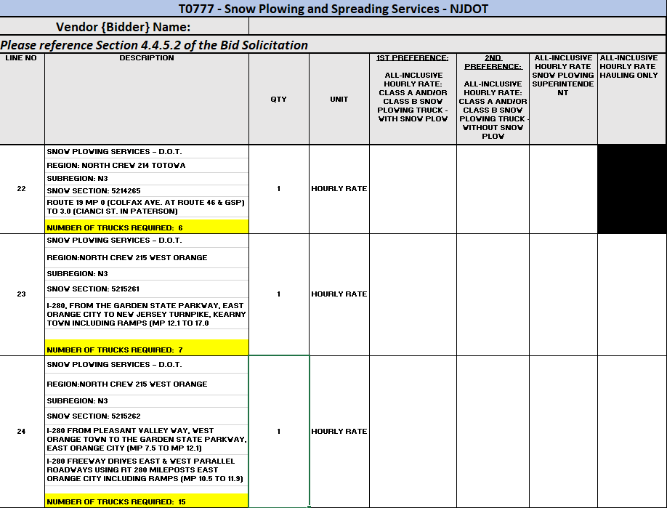
State-Supplied Price Sheet
Snow Plowing and Hauling Services
See Bid Solicitation Section 4.4.5.2.1 Snow Plowing and Hauling Services Price Sheet Instructions for directions.
Price lines 1 – 312.

Slide 15
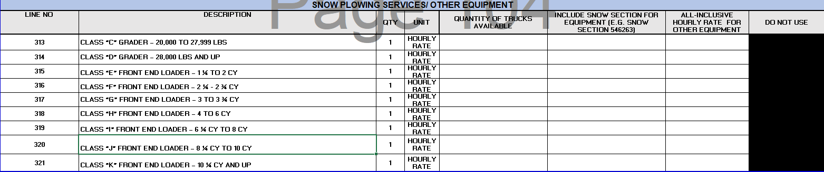
State-Supplied Price Sheet
Snow Plowing and Hauling Services (Other Equipment)
See Bid Solicitation Section 4.4.5.2.1 Snow Plowing and Hauling Services Price Sheet Instructions for directions.
Price lines 313 – 321.

Slide 16
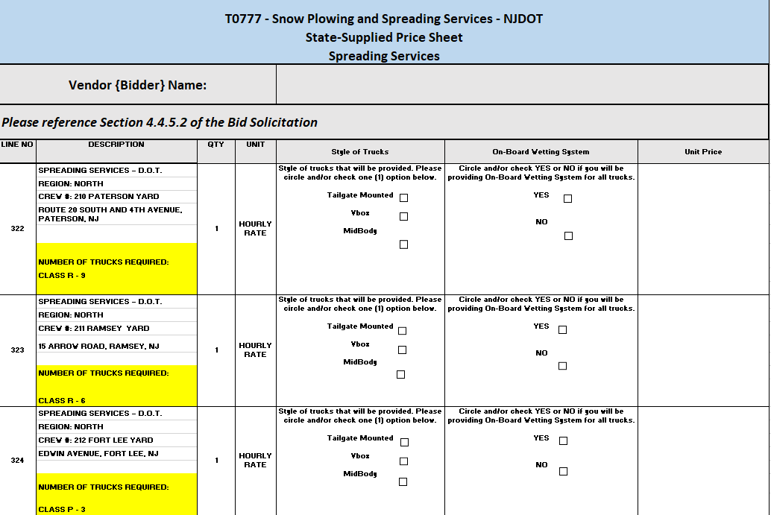
State-Supplied Price Sheet
Spreading Services
See Bid Solicitation Section 4.4.5.2.2 Spreading Services Price Sheet Instructions for directions.
Price lines 322 – 387.

Slide 17
THANK YOU FOR ATTENDING
Q&A due by 2pm, April 30, 2020
Quotes due by 2pm, May 21, 2020

