Slide 1
Optional Pre-Quote Conference
T1747 – Good Neighbor Planting Program for the New Jersey Department of Transportation (NJDOT)
20DPP00500
Q&a due by 2pm ON November 17, 2020
Quotes due by 2pm on December 22, 2020

Slide 2
WELCOME & INTRODUCTIONS
Please identify yourself and the firm you represent when prompted during roll-call so that you are properly logged for attending the conference.
Please mute your phone at all times unless speaking.
Please identify yourself and the firm you represent prior to asking a question.
Please make sure you are registered in NJSTART, and that your contact information remains current.
  NJSTART Vendor email support: njstart@treas.nj.gov
  https://www.state.nj.us/treasury/purchase/vendor.shtml

Slide 3
PURPOSE & GENERAL INFORMATION
The purpose of this conference is to address procedural questions only, regarding the Bid Solicitation and Quote submission requirements.
No questions relating to the Scope of Work or the services or products required in the Bid Solicitation will be addressed. Vendors should utilize the Q&A Tab of the Bid Solicitation in NJSTART to submit those questions electronically.
The Bid Solicitation will be reviewed section by section with procedural questions being entertained on that basis.

Slide 4
BID SOLICITATION AT A GLANCE
Cover page: Submission dates and set-aside requirements
Section 1: Purpose, background, Q&A and exceptions, Bid Amendments, Quote content, support
Section 2: Definitions
Section 3: Scope of Work
Section 4: Quote submission requirements including forms, schedules, firm experience, product literature, financial capability, and price sheet, as well as additional terms and prohibition on conflicting terms and conditions
Section 5: Contractual language including term, staff substitutions, ownership of materials, additional work, supplemental indemnification

Slide 5
BID SOLICITATION AT A GLANCE
Section 6: Evaluation criteria, clarifications, best and final offer
Section 7: Pre-award requirements
Section 8: State Contract Manager
Section 9: Standard Terms and Conditions
Reminders
  Review Bid Solicitation in its entirety and submit any questions prior to the deadline including exceptions. Updated documents will be posted in NJSTART and should be reviewed as posted.
  Submit Quotes on time addressing all mandatory requirements including forms, or Quote may be deemed non-responsive. “Shall” and “Must” denotes a mandatory requirement; however, not submitting requested information (“should”/”may”) could impact technical score.
  Price Sheet must be completed in its entirety with no lines added or removed, or additional language or fees referenced.

Slide 6
PRICE SHEET PITFALLS
Complete all required price lines on the Price Sheet, or Quote may be deemed non-responsive. Indicate “no charge” if the cost is $0. Do not leave any price lines blank.
Do not make formatting changes to the Price Sheet. If the price line requires a dollar amount, don’t change it to a percentage, or vice versa. If the price line includes 2 decimal places, don’t change the settings to allow 4 decimals.
Do not add additional language, assumptions, or fees on the Price Sheet. Do not add or remove any price lines.
Confirm you have completed the proper version of the Price Sheet; it may have been revised via Bid Amendment.

Slide 7
OTHER HELPFUL TIPS
Do NOT include language such as this:
  Vendor accepts all terms and conditions of this Bid Solicitation with the following additional language: Section X - Agree, as it applies to changes that impact administrative fees as outlined in this provision, provided that Vendor reserves the right to modify Contracted Terms based on changes by the State.
  Vendor reserves the right to charge additional fees for services that require extensive time and effort.
  This Quote is a nonbinding expression of interest only and is not intended to create a binding commitment on either party unless and until a definitive agreement has been executed between the parties.
  This Quote may include statements regarding plans for future products and services, or future versions of existing products and services. Any such statements are provided solely for your general information and are not part of this Quote unless specifically stated in writing in this Quote.

Slide 8


Slide 9


Slide 10


Slide 11
Vendor {Bidder} Checklist
PART #1: FORMS, REGISTRATIONS AND CERTIFICATIONS THAT MUST BE
SUBMITTED BY THE VENDOR WITH THE QUOTE
OFFER AND ACCEPTANCE PAGE (Bid Solicitation §4.4.1.1)
OWNERSHIP DISCLOSURE FORM (Bid Solicitation §4.4.1.2.1)
DISCLOSURE OF INVESTMENT ACTIVITIES IN IRAN FORM (Bid Solicitation §4.4.1.2.2)
SUBCONTRACTOR UTILIZATION PLAN (Bid Solicitation §4.4.1.3) IF THIS BID SOLICITATION HAS A SUBCONTRACTING SET-ASIDE REQUIREMENT, THE VENDOR MUST CONSULT THE DIVISION OF REVENUE & ENTERPRISE SERVICES AT 609-292-2146 FOR INFORMATION REGARDING REGISTERED SMALL BUSINESSES AND/OR DISABLED VETERAN BUSINESSES.
STATE-SUPPLIED PRICE SHEET
SMALL BUSINESS REGISTRATION FOR SET-ASIDE BLANKET P.O. (See Bid Solicitation Section §4.4.1.4)
PUBLIC WORKS CONTRACTOR REGISTRATION (See Bid Solicitation Section §4.4.1.6)

Slide 12
Vendor {Bidder} Checklist
PART #2: FORMS, REGISTRATIONS AND CERTIFICATIONS THAT SHOULD BE SUBMITTED BY THE VENDOR WITH THE QUOTE. THESE FORMS MUST BE SUBMITTED PRIOR TO THE AWARDOF THE MASTER BLANKET PURCHASE ORDER.
DISCLOSURE OF INVESTIGATIONS AND OTHER ACTIONS INVOLVING VENDOR (Bid Solicitation §4.4.2.2)
PROOF OF BUSINESS REGISTRATION You may register your business HERE or obtain a copy of the Business Registration Certificate HERE.
CERTIFICATE OF INSURANCE / ACORD
TWO-YEAR CHAPTER 51/EXECUTIVE ORDER 117 VENDOR CERTIFICATION AND DISCLOSURE OF POLITICAL CONTRIBUTIONS (Bid Solicitation §7.1.1)
AFFIRMATIVE ACTION COMPLIANCE (Bid Solicitation §7.1.3) Submit one of the following:
NEW JERSEY CERTIFICATE OF EMPLOYEE INFORMATION REPORT
FEDERAL LETTER OF APPROVAL VERIFYING A FEDERALLY APPROVED OR SANCTIONED AFFIRMATIVE ACTION PROGRAM (Dated within 1 year of the Quote submission)
AFFIRMATIVE ACTION EMPLOYEE INFORMATION REPORT (FORM AA302)
SOURCE DISCLOSURE FORM (Bid Solicitation §§4.4.2.3 and 7.1.2)
COOPERATIVE PURCHASING FORM (Bid Solicitation §4.4.6)

Slide 13
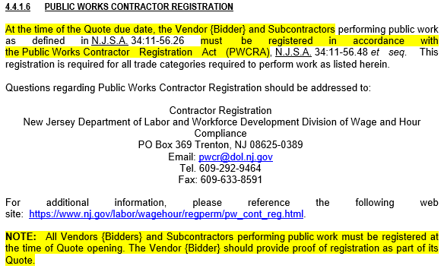
Public Works Contractor Registration
T1747 – Good Neighbor Planting Program for the New Jersey Department of Transportation (NJDOT)
See Bid Solicitation Section 4.4.1.6, Public Works Contractor Registration.
To all Vendors {Contractors}: Please make sure your firm has its Public Works Contractor Registration at the time of Quote due date, as well as any Subcontractor(s) that may be engaged to perform public work on your firm’s behalf.

Slide 14
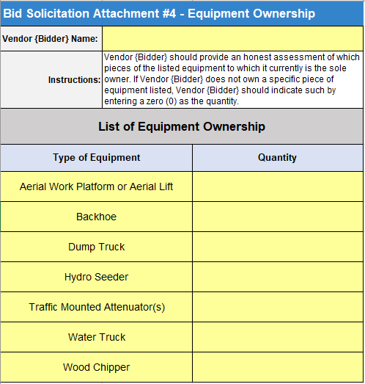
Bid Solicitation Attachment #4 - Equipment Ownership
T1747 – Good Neighbor Planting Program for the New Jersey Department of Transportation (NJDOT)
See Bid Solicitation Section 4.4.3.3.2, List of Equipment Ownership.
Vendors {Bidders} that are submitting Quotes should submit this attachment as part of the Quote.
Vendors {Bidders} should provide an honest assessment of which pieces of the listed equipment to which it currently is the sole owner. Indicate a zero (0) if a piece of equipment is not owned.

Slide 15
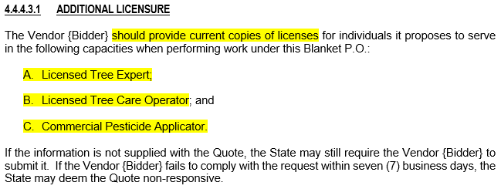
Additional Licensure
T1747 – Good Neighbor Planting Program for the New Jersey Department of Transportation (NJDOT)
See Bid Solicitation Section 4.4.4.3.1, Additional Licensure.
If Vendors {Bidders} do not supply proof of licensure, the State may still require it. If so, Vendors {Bidders} will have seven (7) days to furnish proof of licensure or risk being deemed non-responsive.

Slide 16
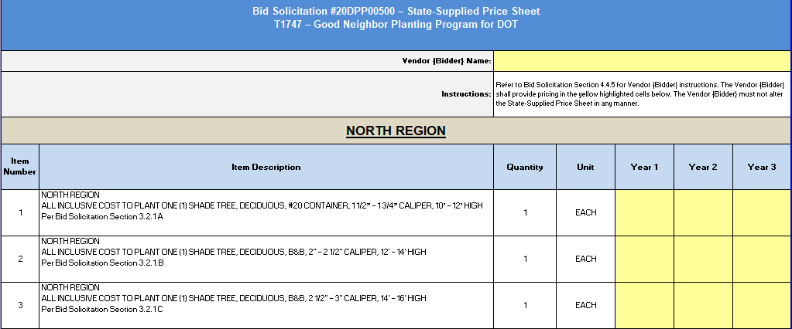
State-Supplied Price Sheet
T1747 – Good Neighbor Planting Program for the New Jersey Department of Transportation (NJDOT)
See Price Sheet Instructions in Bid Solicitation Section 4.4.5.2, for directions.
Pricing must be submitted for all price lines within a Region. Failure to submit pricing for all price lines within a selected Region will result in the Quote being deemed non-responsive for that entire respective Region.

Slide 17
THANK YOU FOR ATTENDING
Q&A due by 2pm on NOVEMBER 17, 2020
Quotes due by 2pm on DECEMBER 22, 2020

