Slide 1
Optional Pre-Quote Conference
T-#0084: Automotive Glass Parts and Windshield Repair/Replacement
Bid Solicitation #20DPP00496
Q&a due by 2pm, November 30, 2020
Quotes due by 2pm, December 30, 2020

Slide 2
WELCOME & INTRODUCTIONS
Please identify yourself and the firm you represent when prompted during roll-call so that you are properly logged for attending the conference.
Please mute your phone at all times unless speaking.
Please identify yourself and the firm you represent prior to asking a question.
Please make sure you are registered in NJSTART, and that your contact information remains current.
  NJSTART Vendor email support: njstart@treas.nj.gov
  https://www.state.nj.us/treasury/purchase/vendor.shtml

Slide 3
PURPOSE & GENERAL INFORMATION
The purpose of this conference is to address procedural questions only, regarding the Bid Solicitation and Quote submission requirements.
No questions relating to the Scope of Work or the services or products required in the Bid Solicitation will be addressed. Vendors should utilize the Q&A Tab of the Bid Solicitation in NJSTART to submit those questions electronically.
This is also an opportunity for potential Vendors to partner with other potentials Vendors and/or meet small, woman-owned, minority-owned, veteran-owned, and disabled veteran-owned businesses.
The Bid Solicitation will be reviewed section by section with procedural questions being entertained on that basis.

Slide 4
BID SOLICITATION AT A GLANCE
Cover page: Submission dates and set-aside requirements
Section 1: Purpose, background, Q&A and exceptions, Bid Amendments, Quote content, support
Section 2: Definitions
Section 3: Scope of Work, security requirements
Section 4: Quote submission requirements including forms, technical approach, schedules, draft plans, resumes, firm experience, financial capability, and price sheet, as well as additional terms and prohibition on conflicting terms and conditions
Section 5: Contractual language including term, staff substitutions, ownership of materials, additional work, supplemental indemnification

Slide 5
BID SOLICITATION AT A GLANCE
Section 6: Evaluation criteria, clarifications, best and final offer
Section 7: Pre-award requirements
Section 8: State Contract Manager
Section 9: Standard Terms and Conditions
Reminders
  Review Bid Solicitation in its entirety and submit any questions prior to the deadline including exceptions. Updated documents will be posted in NJSTART and should be reviewed as posted.
  Submit Quotes on time addressing all mandatory requirements including forms, or Quote may be deemed non-responsive. “Shall” denotes a mandatory requirement; however, not submitting requested information (“should”) could impact technical score
  Price Sheet must be completed in its entirety with no lines added or removed, or additional language or fees referenced

Slide 6
PRICE SHEET PITFALLS
Complete all required price lines on the Price Sheet, or Quote may be deemed non-responsive. Indicate “no charge” if the cost is $0. Do not leave any price lines blank.
Do not make formatting changes to the Price Sheet. If the price line requires a dollar amount, don’t change it to a percentage, or vice versa. If the price line includes 2 decimal places, don’t change the settings to allow 4 decimals.
Confirm that you have completed all tabs on the Price Sheet.
Do not add additional language, assumptions, or fees on the Price Sheet. Do not add or remove any price lines.
Confirm you have completed the proper version of the Price Sheet; it may have been revised via Bid Amendment.

Slide 7
OTHER HELPFUL TIPS
Do NOT include language such as this:
  Vendor accepts all terms and conditions of this Bid Solicitation with the following additional language: Section X - Agree, as it applies to changes that impact administrative fees as outlined in this provision, provided that Vendor reserves the right to modify Contracted Terms based on changes by the State.
  Vendor reserves the right to charge additional fees for services that require extensive time and effort.
  This Quote is a nonbinding expression of interest only and is not intended to create a binding commitment on either party unless and until a definitive agreement has been executed between the parties.
  This Quote may include statements regarding plans for future products and services, or future versions of existing products and services. Any such statements are provided solely for your general information and are not part of this Quote unless specifically stated in writing in this Quote.

Slide 8
Bid Solicitation Checklist
PART #1: FORMS, REGISTRATIONS AND CERTIFICATIONS THAT MUST BE
SUBMITTED BY THE VENDOR WITH THE QUOTE
OFFER AND ACCEPTANCE PAGE (Bid Solicitation §4.4.1.1)
OWNERSHIP DISCLOSURE FORM (Bid Solicitation §4.4.1.2.1)
DISCLOSURE OF INVESTMENT ACTIVITIES IN IRAN FORM (Bid Solicitation §4.4.1.2.2)
SUBCONTRACTOR UTILIZATION PLAN (Bid Solicitation §4.4.1.3)
SMALL BUSINESS REGISTRATION FOR SET-ASIDE BLANKET P.O. (Bid Solicitation §4.4.1.4)
STATE-SUPPLIED PRICE SHEETS (5)

Slide 9
Bid Solicitation Checklist
PART #2: FORMS, REGISTRATIONS AND CERTIFICATIONS THAT SHOULD BE SUBMITTED BY THE VENDOR WITH THE QUOTE BUT MUST BE SUBMITTED PRIOR TO THE AWARD OF THE MASTER BLANKET PURCHASE ORDER.
DISCLOSURE OF INVESTIGATIONS AND OTHER ACTIONS INVOLVING VENDOR (Bid Solicitation §4.4.2.2)
PROOF OF BUSINESS REGISTRATION You may register your business HERE or obtain a copy of the Business Registration Certificate HERE.
CERTIFICATE OF INSURANCE / ACORD
TWO-YEAR CHAPTER 51/EXECUTIVE ORDER 117 VENDOR CERTIFICATION AND DISCLOSURE OF POLITICAL CONTRIBUTIONS (Bid Solicitation §7.1.1)
AFFIRMATIVE ACTION COMPLIANCE (Bid Solicitation §7.1.3) Submit one of the following:
NEW JERSEY CERTIFICATE OF EMPLOYEE INFORMATION REPORT
FEDERAL LETTER OF APPROVAL VERIFYING A FEDERALLY APPROVED OR SANCTIONED AFFIRMATIVE ACTION PROGRAM (Dated within 1 year of the Quote submission)
AFFIRMATIVE ACTION EMPLOYEE INFORMATION REPORT (FORM AA302)
SOURCE DISCLOSURE FORM (Bid Solicitation §§4.4.2.3 and 7.1.2)
COOPERATIVE PURCHASING FORM (Bid Solicitation §4.4.6)

Slide 10
Small Business Registration for Set-Aside Blanket P.O.
Section 4.4.1.4
      Section 4.4.1.4 - SMALL BUSINESS SET-ASIDE BLANKET P.O.
Pursuant to the provisions of N.J.S.A. 52:32-17 and N.J.A.C. 17:13 this is a full Set-Aside Blanket P.O. for Category I, II, or III for Small Businesses.
The Vendor {Bidder} must be registered as a qualifying small business with the Division of Revenue and Enterprise Services, Small Business Registration and M/WBE Certification Services Unit by the date the Quote is received and opened. Evidence that the Vendor {Bidder} has registered as a small business should be submitted with the Quote. Vendors {Bidders} should verify its Small, Minority, Veteran, and Women Owned Business Certification status on the “Maintain Terms and Categories” Tab within its profile in NJSTART. In the event of an issue with a Vendor’s {Bidder’s} Small, Minority, Veteran, and Women Owned Business Certification status, NJSTART provides a link to take corrective action.
The Vendor {Bidder} should provide, as part of its response to this Bid Solicitation, proof of its current registration as a qualifying small business with the New Jersey Division of Revenue and Enterprise Services, Small Business Registration and M/WBE Certification Services Unit. Information, registration requirements and application are available by contacting the agency at:

Slide 11
Small Business Registration for Set-Aside Blanket P.O.
Section 4.4.1.4 - Continued
New Jersey Department of the Treasury
Division of Revenue and Enterprise Services
Small Business Registration and M/WBE Certification Services Unit
PO Box 026
Trenton, NJ 08625-0026
https://www.nj.gov/njbusiness/contracting/sbsa/
On-line application is available at:
https://www.njportal.com/DOR/SBERegistry/
** IF THE VENDOR {BIDDER/CONTRACTOR} HAS PREVIOUSLY REGISTERED OR BEEN CERTIFIED AS A SMALL BUSINESS ENTERPRISE, THE VENDOR {BIDDER} SHOULD ENSURE IT IS REGISTERED AND THAT ITS REGISTRATION IS ACTIVE WITH THE DIVISION OF REVENUE AND ENTERPRISE SERVICES, SMALL BUSINESS REGISTRATION AND M/WBE CERTIFICATION SERVICES UNIT, PRIOR TO THE QUOTE OPENING DATE, TO BE ELIGIBLE FOR AWARD.

Slide 12
State-Supplied Price Sheets
T0084 – Automotive Glass Parts and Windshield Repair/Replacement
There are five (5) separate price sheets for this Bid Solicitation. They are as follows:
  Central Region;
  North Region;
  South Region;
  Central Motor Pool (CMP); and
  New Jersey State Police (NJSP).
Vendors {Bidders} may submit Quotes and be eligible for any combination of Regions/Agencies.

Slide 13
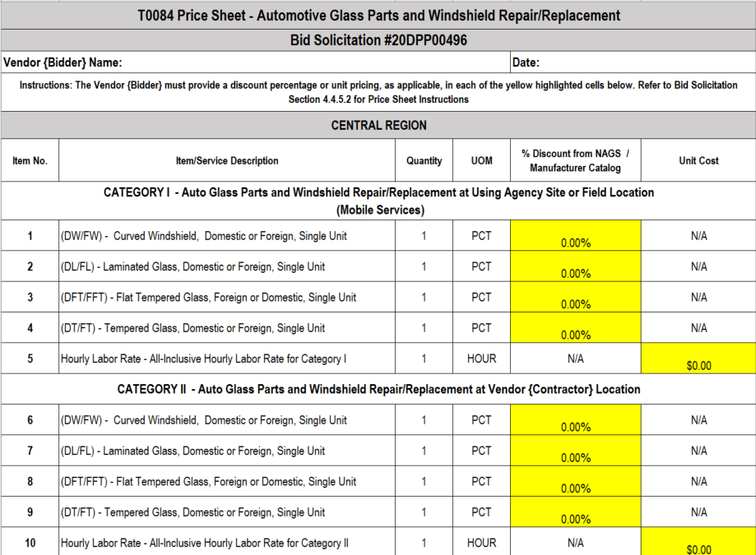
State-Supplied Price Sheet
T-0084 – Automotive Glass Parts and Windshield Repair/Replacement Central Region

Slide 14
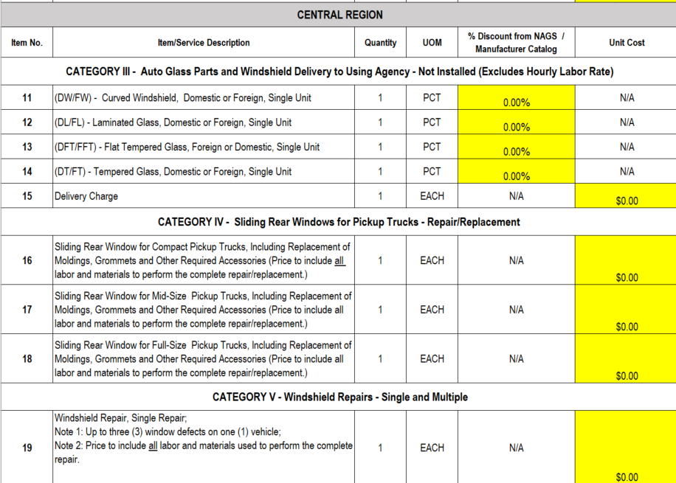
State-Supplied Price Sheet
T0084 – Automotive Glass Parts and Windshield Repair/Replacement
Central Region - Continued

Slide 15
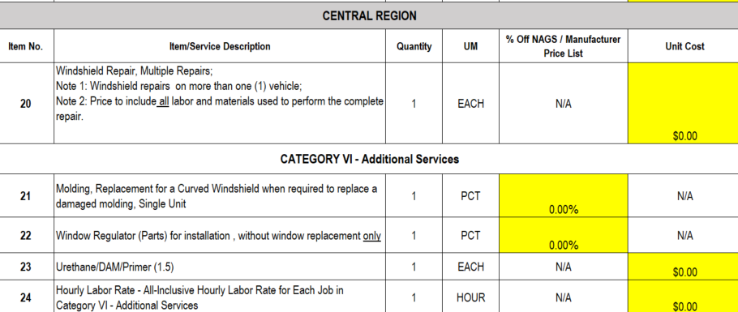
State-Supplied Price Sheet
T-0084 Automotive Glass Parts and Windshield Repair/Replacement
Central Region - Continued

Slide 16


Slide 17


Slide 18


Slide 19
THANK YOU FOR ATTENDING
Q&A due by 2pm, NOVEMBER 30, 2020
Quotes due by 2pm, DECEMBER 30, 2020

