Slide 1
SIROMS Overview
BID SOLICITATION #18DPP00226
Sandy Integrated Recovery Operations and Management System (SIROMS)
Maintenance and Hosting
Attachment 05
01.30.2018

Slide 2
SIROMS : Overall Solution
Grant Management
Program Administration
Policy Change Management
Financial Management
Funds Disbursement
Federal Reporting
Program Reporting
System Integration

Slide 3
SIROMS Functions and Components – Cont…
SIROMS - Business Process Management
Program Setup Module (Action Plan setup)
Funds Request Module
Quarterly Performance Reporting (QPR) Module
Program Federal Reporting Module
SIROMS - Integration Hub
SIROMS Grants Management (SGM):
RREM Integration with CBI&Shaw and Gilbane
SAGE Integration
Escrow Integration - Bank of America
Department of Environmental Protection (DEP) Integration
Treasury Integration - NJCFS
LRRP Integration with Gilbane
RREM Module
LRRP Module
Essential Government Services (ESGA) Module
Local Planning Services (LPS) Module
User Access Module
LMI Module

Slide 4
SIROMS Functions and Components – Cont…
SIROMS - Transparency site www.newjerseyrebuild.org
Map Reporting by Jurisdiction:
SIROMS - Data Warehouse/ Data Feeds
Document management Module
Reporting and Analytics
Statewide
State Senate and Assembly District
Congressional District
Municipality
County
Program Progress (Awarded and Disbursements Data)
Data Warehouse- GORR Data from the partners
Data Warehouse- SIROMS Grants Management (SGM):
Data Warehouse- Fund Request Data
RREM Data
LRRP Data
ESGA Data
LPS Data
Data Warehouse- QPR Data
Data Warehouse- Landlord Incentive Program/ Neighborhood Enhancement Program Data from SAGE
Data Warehouse- DOB Data (FEMA, NFIP and SBA)
LMI Data
Data migration mapping tool
Data staging tools

Slide 5
SIROMS Portal Overview
SIROMS

Slide 6
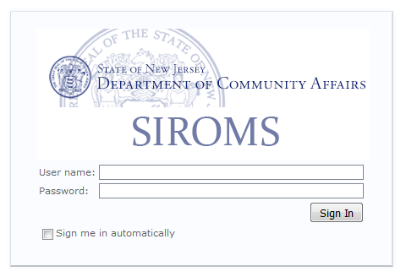
Logging into SIROMS
SIROMS web content and modules can be accessed by the following URL: https://www.siroms.com
Once the page loads, users will be required to login with their SIROMS credentials:

Slide 7
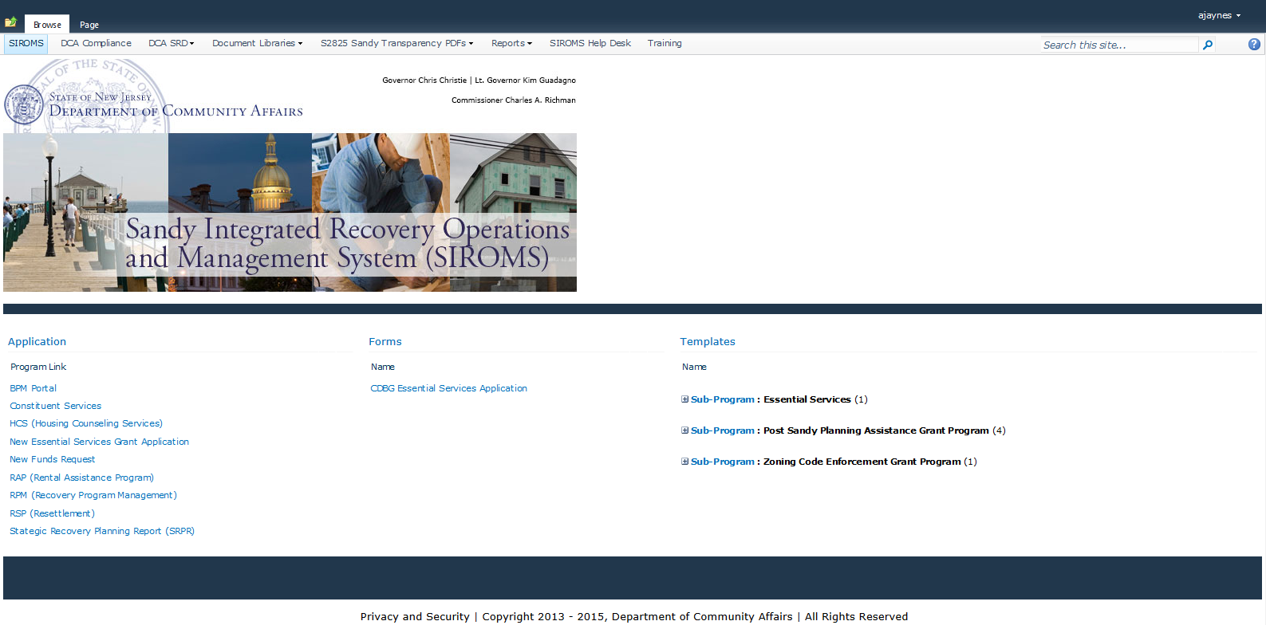
SIROMS Portal

Slide 8
SIROMS Portal
The SIROMS Portal serves as a central location where Sandy-related modules and documentation can be accessed by all SIROMS users.
SIROMS Applications
  BPM Portal
  Constituent Services
  HCS (Housing Counseling Services)
  New Essential Services Grant Application
  New Funds Request
  RAP (Rental Assistance Program)
  GRT (Grant Resource Tool)
  RSP (Resettlement)
  Strategic Recovery Planning Report (SRPR)
SIROMS SharePoint
  DCA Compliance
  DCA IT PMO
  DCA SRD
    Policy Change Request (PCR)
    Policy Library
  SIROMS Helpdesk
  Training
SharePoint Document Libraries
  FHE Document Library
  FHRR Document Library
  RREM Document Library
  LRRP Document Library
  LMI Document Library
  NJ Sandy Document Library
  SRD Operational Document Library
  SRPAG Document Library
SIROMS Reports
  Constituent Services Reports
  Federal Reports
  Finance Management Reports
  Forecasting Reports
  Funds Request Reports
  HRP Reports
  Interface Reports
  LMI Reports
  LRRP Reports
  RSP Reports
  RREM Reports
S2825 Sandy Transparency PDFs

Slide 9
What is the PCR module?
The Policy Change Request (PCR) module is a system used for maintaining policy related documentation. In order to publish these policies to the Policy Library, users utilize the PCR module to obtain all appropriate reviews and approvals.
The PCR module provides:
  A solution for Sandy Policy Library content managers the ability to edit, approve, and publish finalized policy documents to the Sandy Policy Library
  An electronic solution for storing published Sandy Policy documents
  PCR Process Map
Reviewer 2
Admin Review
Policy Author
Reviewer 1
Reviewer 3
Reviewer 4

Slide 10
SIROMS Applications
SIROMS

Slide 11
What is the CS Module?
The Constituent Services (CS) module is a ticketing system used to document information regarding constituent inquires and their resolution
The CS module captures:
  General Information about the constituent (name, address, phone, etc.)
  Details regarding the constituent’s issue including the reason for contact, priority, assignee, due date and notes
  Key documentation germane to the issue and/or its resolution
  Information on when the ticket was closed
This module integrates with SGM so that:
  Tickets created in the CS module are viewable within individual applicant records for the RREM, LMI, LRRP, FHE and USD programs
  Applicant Interactions initiated in RREM, LMI, LRRP, FHE and USD create tickets in the CS module

Slide 12
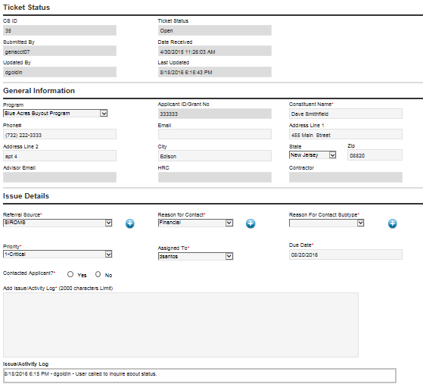
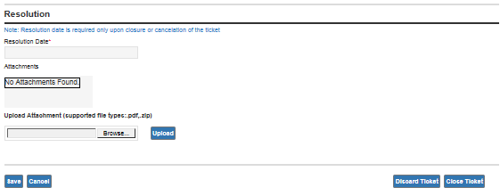
Open CS Ticket

Slide 13
What is the HCS Module?
The Housing Counseling Services (HCS) module enables external agencies to document assistance provided to Sandy affected individuals
Agencies use the HCS module to:
  Create and maintain intake forms containing general information about the applicant (name, address, damaged property, etc.)
  Document which CDBG programs and/or HCS services the individual is interested in learning about
  Document which CDBG program(s) the individual is already involved with
  Document all interactions the agency has with the individual
This module integrates with SGM so that CDBG interactions documented in the HCS module are viewable within individual applicant records for the RREM, LMI, LRRP, FHE and USD programs
HCS also integrates with the CS module so that CDBG interactions for RREM, LMI, LRRP, FHE and USD applicants create records in the central ticketing system for follow-up and reporting purposes

Slide 14
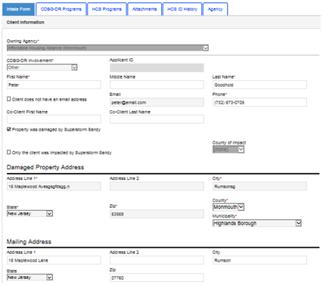
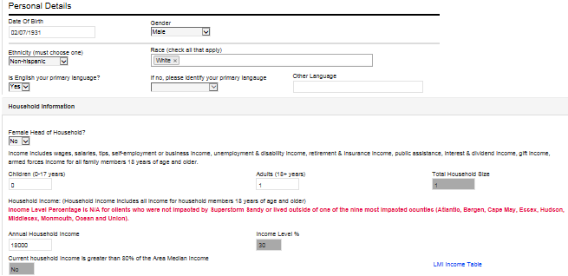
HCS Intake Form

Slide 15
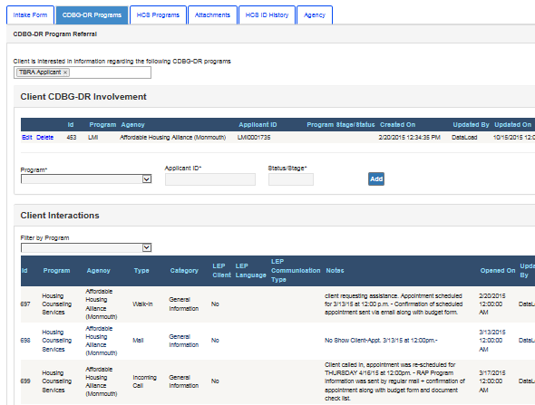
HCS CDBG-DR Programs Tab

Slide 16
What is the RSP Module?
  The Resettlement Program (RSP) Archive was developed to provide a view into the historical Resettlement data for the users.
  This module was developed after the retirement of the eGrants system.
  The RSP module provides an ability to update a small set of data attributes required to confirm applicant’s ongoing compliance with the requirements of the program.
  The RSP module also provides a document upload functionality to support the ongoing compliance check for the applicants.

Slide 17
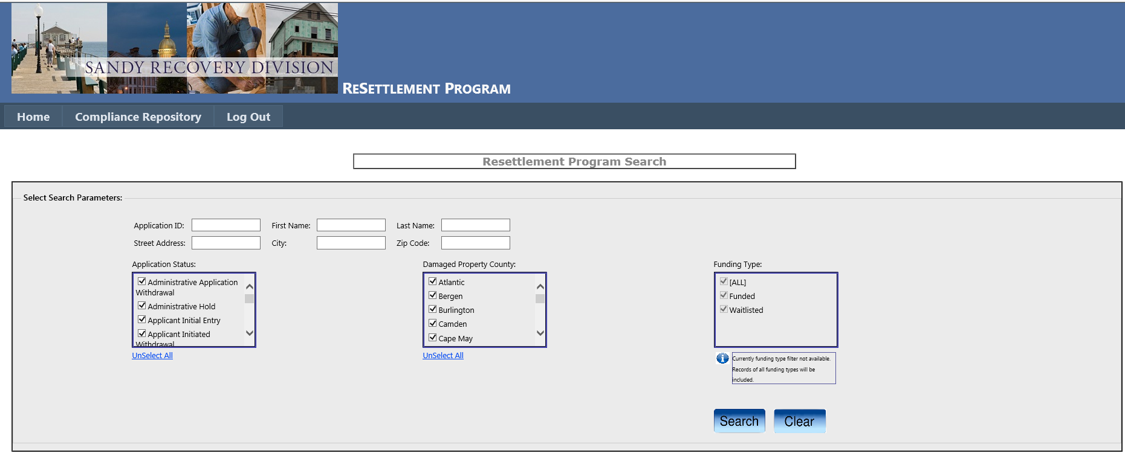
RSP Module

Slide 18
What is the Grant Resource Tool?
The Grant Resource Tool (GRT) provides detailed information about each partnering agency affiliated with the Department of Community Affairs as the grantee of HUD CDBG-DR funds.
The Grant Resource Tool (GRT) module provides an all-encompassing view into information about each program and their sub-recipients including:
  Program and Sub-Recipient Information
  Budgets and Payments Information
  Performance Measures (Forecasted and QPR)
  Notes and Interactions

Slide 19
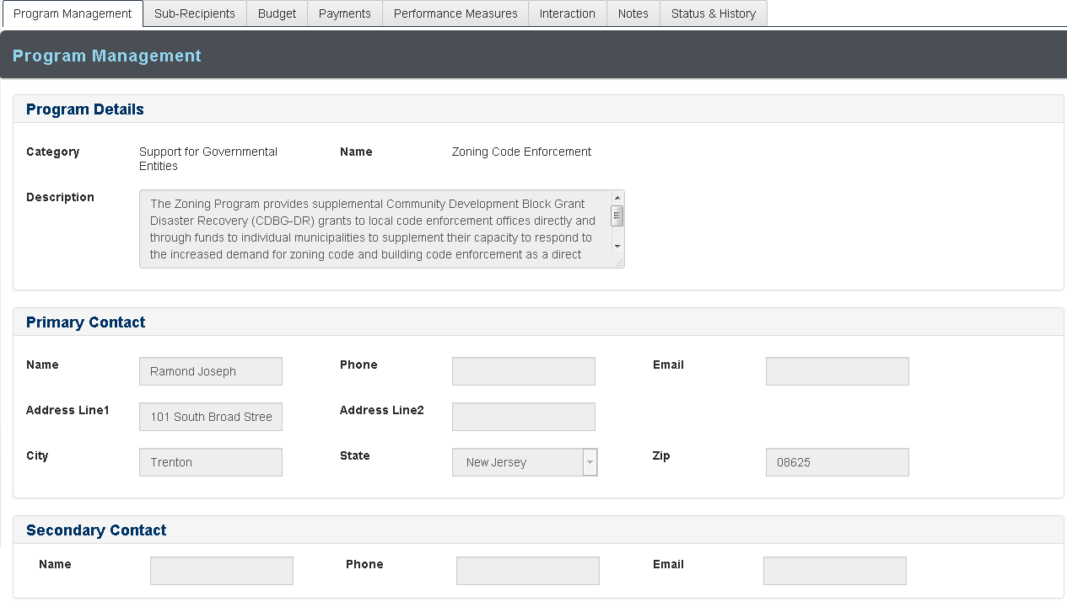
Grant Resource Tool (GRT)

Slide 20
BPM Overview
Business Process Management (BPM)

Slide 21
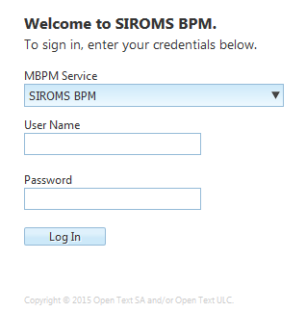
Logging into BPM Portal
Users can access BPM by clicking the BPM Portal link from the SIROMS Home Page
Once the page loads, users will be required to login with their SIROMS credentials

Slide 22
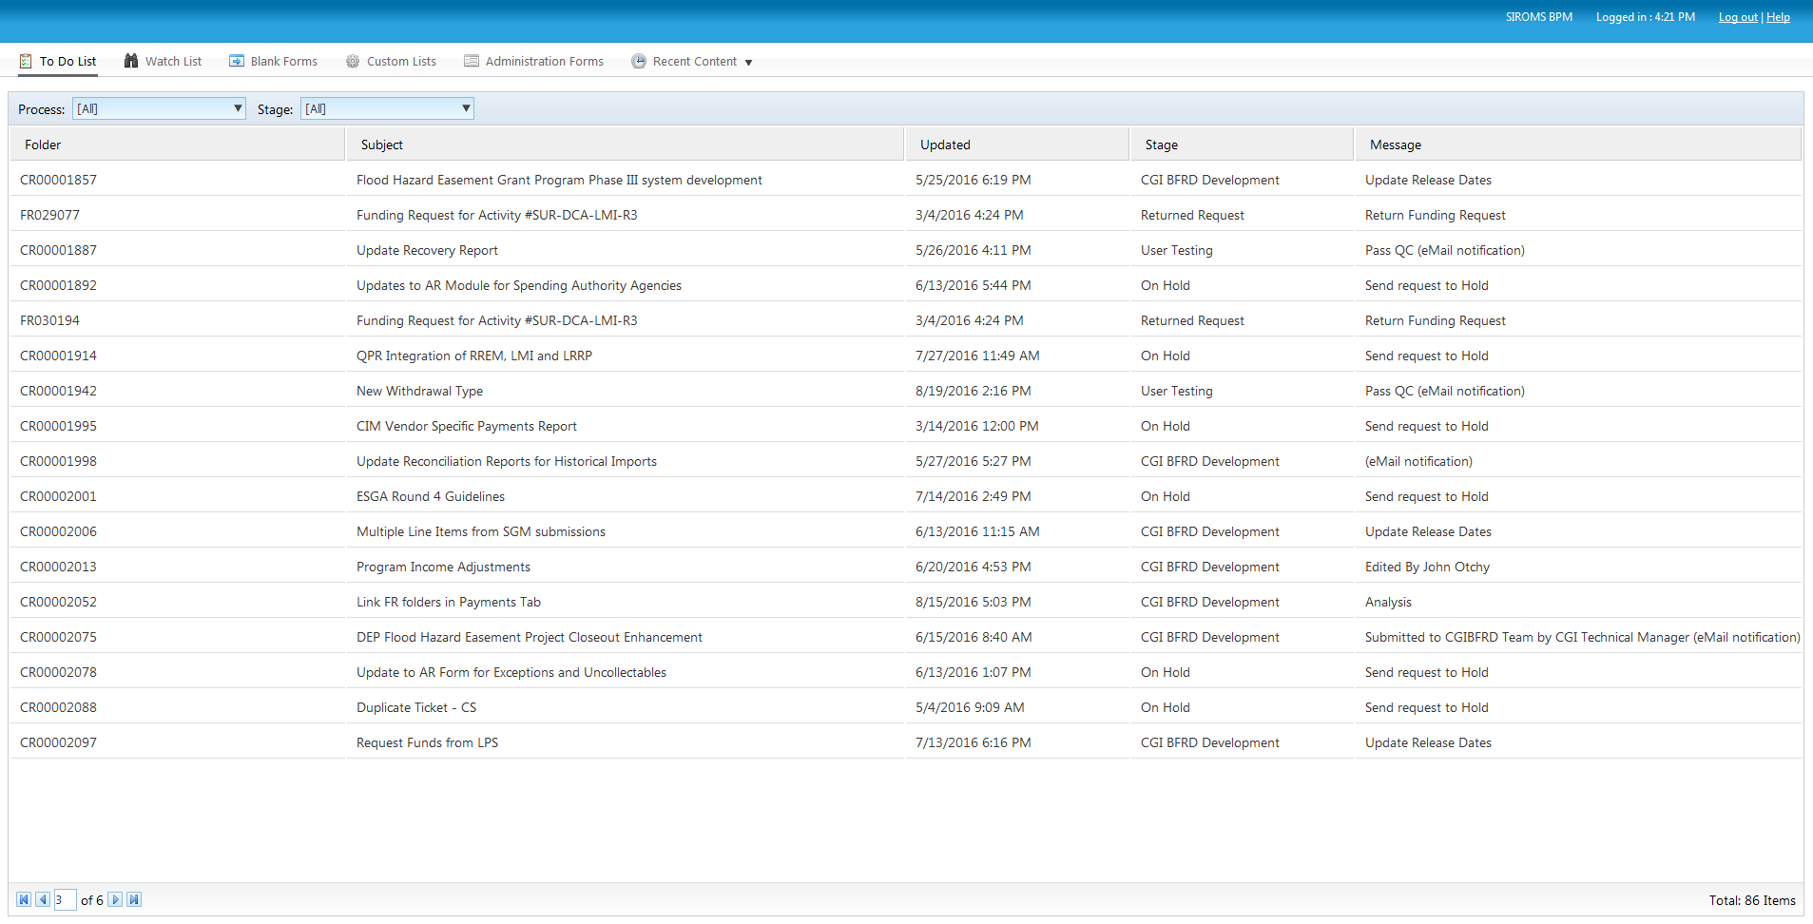
SIROMS To Do List
Users are able to see all records currently available to their role for processing
The To Do List allows users to specify a certain stage for processing, view the record’s current stage, and when it was last updated

Slide 23
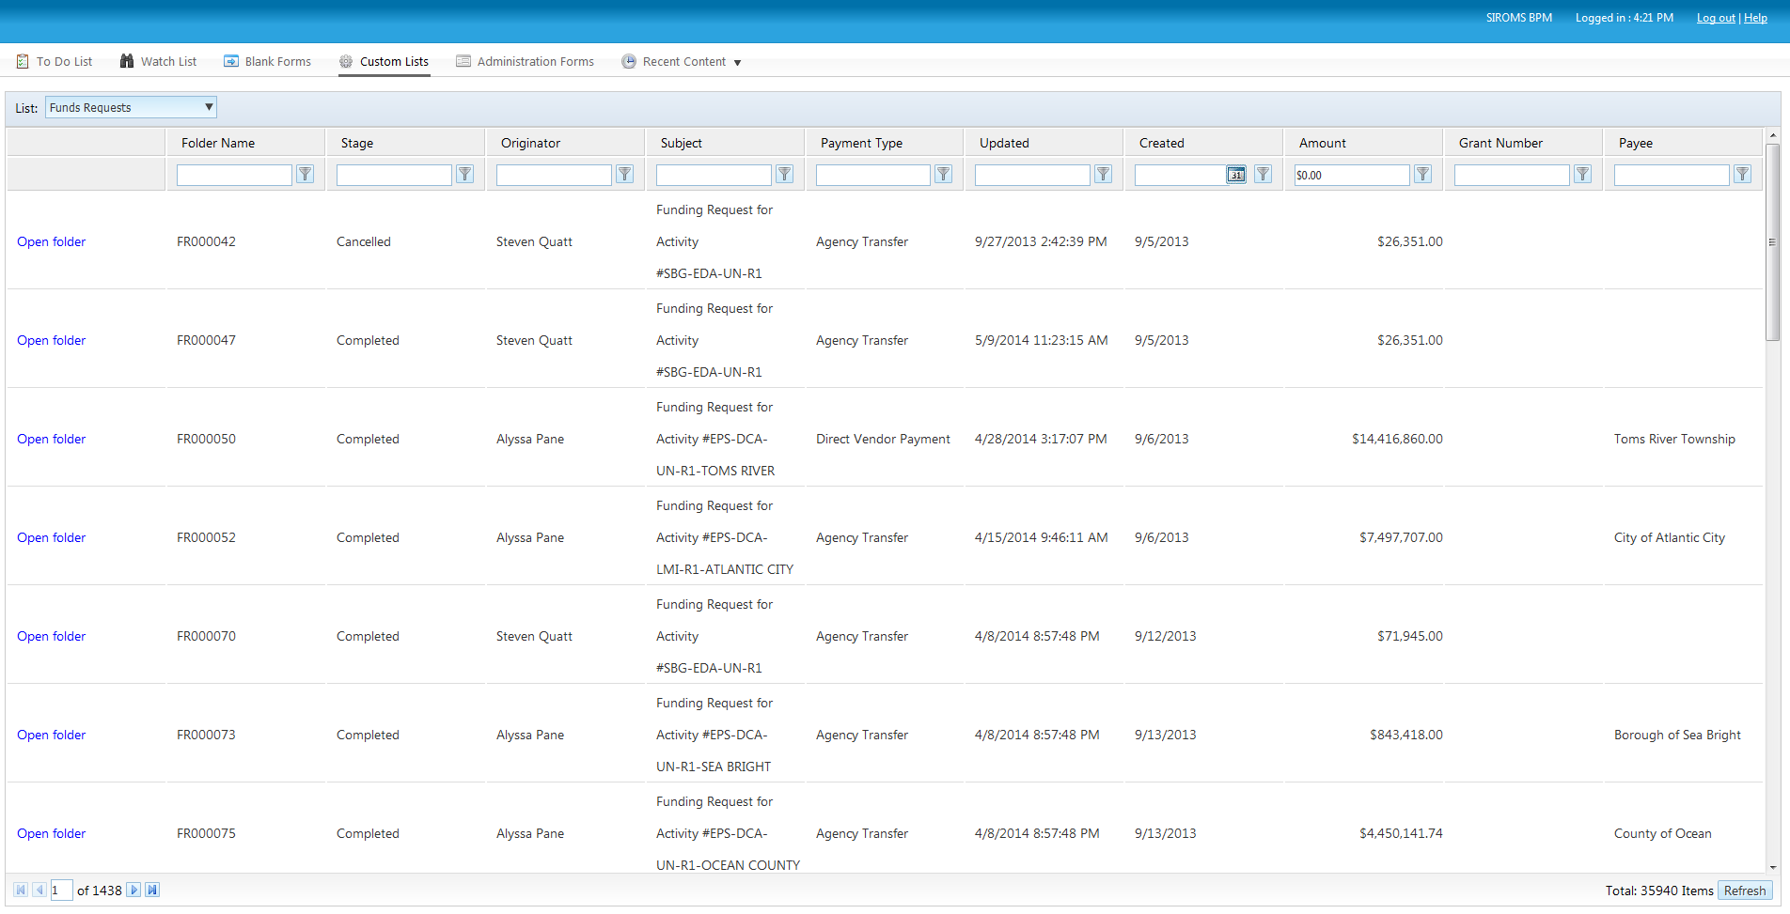
SIROMS Custom Lists (Search)
Users are able to select Custom Lists on the homepage of the BPM application and execute desired search criteria

Slide 24
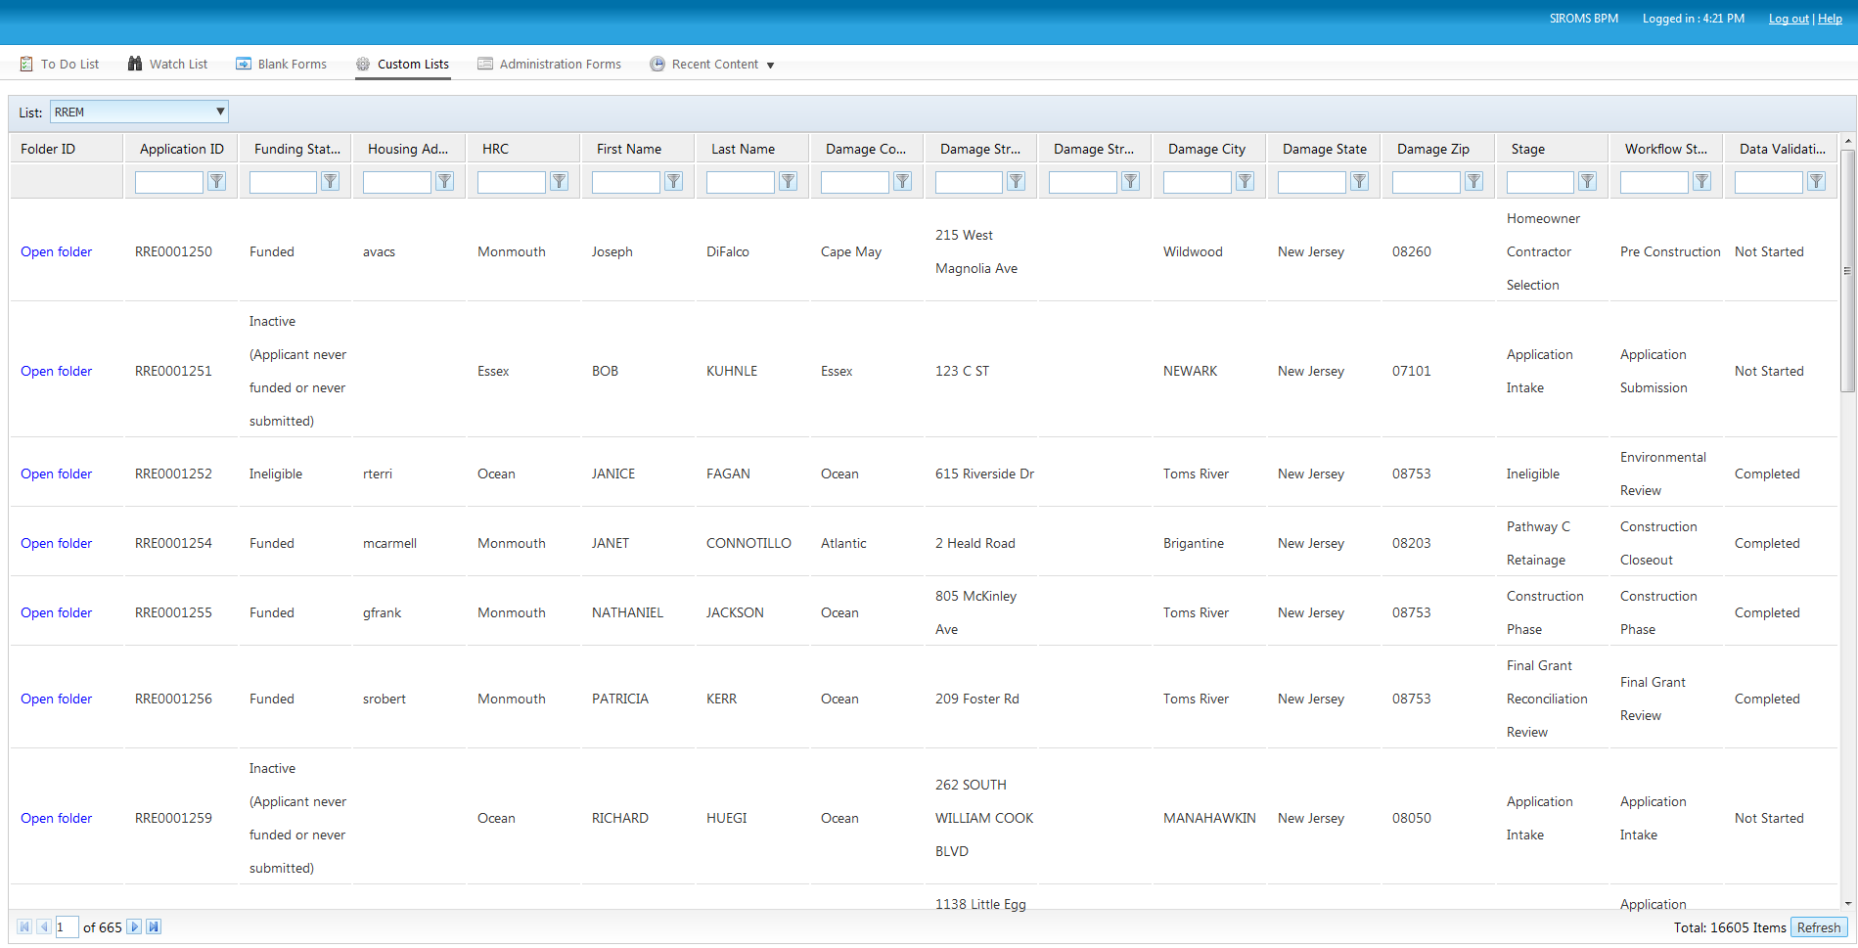
Custom Lists Filter Options
Users are able to filter utilizing desired filter criteria by selecting the funnel icon or by entering text into the text field and selecting a filter type. The Custom Lists filter options differ by program.

Slide 25
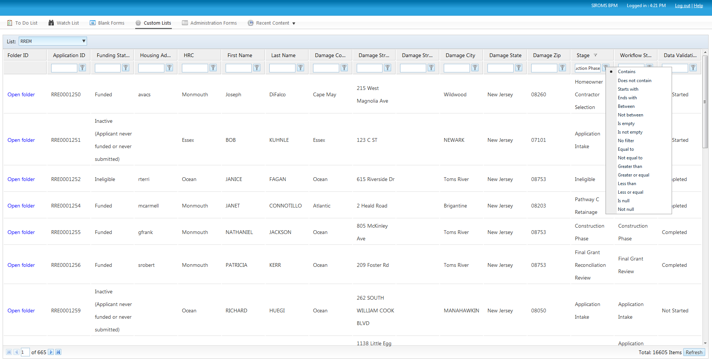
Custom Lists Filter Options
For example, if a user wishes to view all applications that reside within a certain stage, simply type in the name of the stage in the text box, select the funnel icon, and then select ‘Equal to.’ All files that reside within that stage will be displayed. To refresh filter options, users can select the ‘Refresh’ button located at the bottom right of the page.

Slide 26
Financial Management
Business Process Management (BPM)

Slide 27
Funds Distribution

Slide 28
What is the Budget/Activation Tracking module?
    The SIROMS Funds Distribution Module provides the budget tracking of CDBG-DR & Program Income Funds for the funds allotted to New Jersey for Superstorm Sandy Recovery. Funds Distribution provides this tracking at the following budget levels:
      Tranche/Grant Activated Funds
      Round
      Project/Program
      Activity
        Within each Round/Activation, there is a deadline to exhaust all CDBG and PI within two years of inception
    The Funds Distribution Management form provides DCA Sandy Recovery Division (SRD) to modify activated dollars at each of the aforementioned budget levels
    The Funds Allocation form provides the allocations across all Superstorm Sandy programs and allows SRD to track these changes as amendments are done to the overall Action Plan

Slide 29
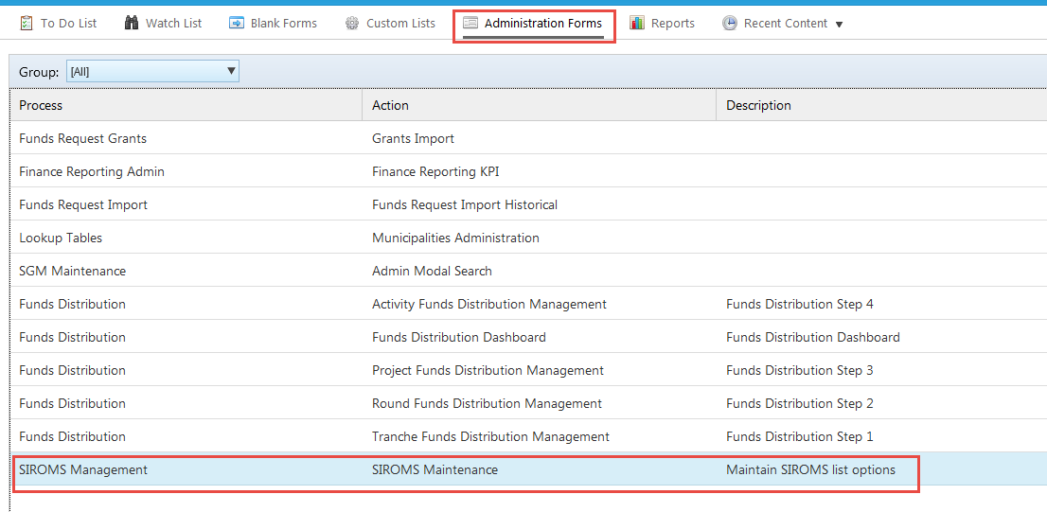
SIROMS Management

Slide 30
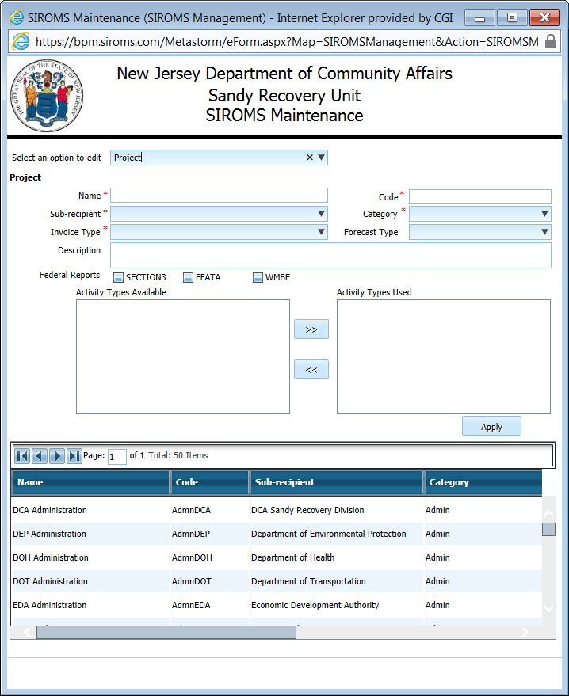
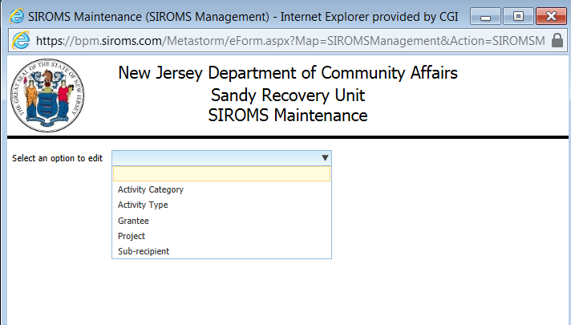
SIROMS Management
    By accessing the SIROMS Maintenance Action the user can begin Budget/Activation updates with the following data:
      Activity Category
      Activity Type
      Grantee
      Project
      Sub-recipient

Slide 31
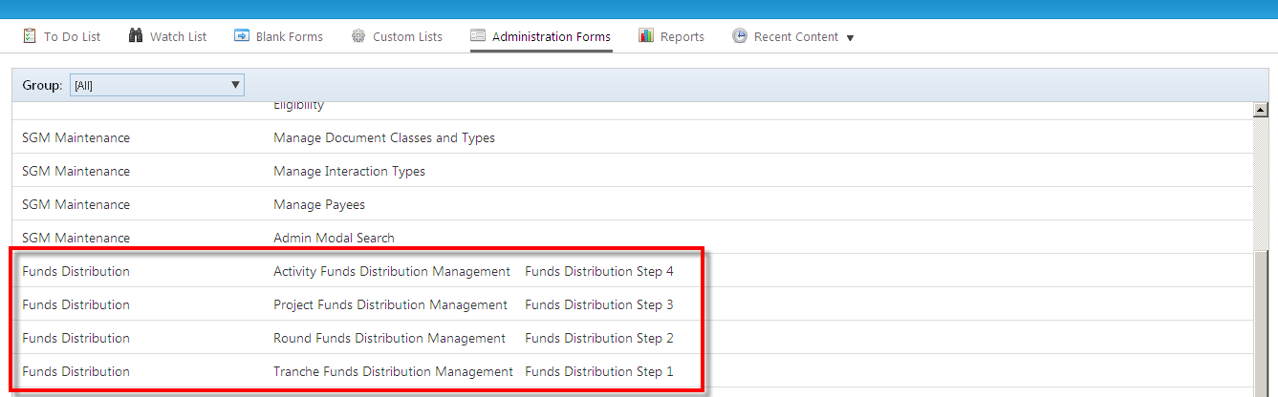
Funds Distribution
    There are 4 different Funds Distribution pages. Each Fund Distribution represents a different Level:
      1.Tranche Funds Distribution Management Funds Distribution Step 1
      2.Round Funds Distribution Management Funds Distribution Step 2
      3.Project Funds Distribution Management Funds Distribution Step 3
      4.Activity Funds Distribution Management Funds Distribution Step 4

Slide 32
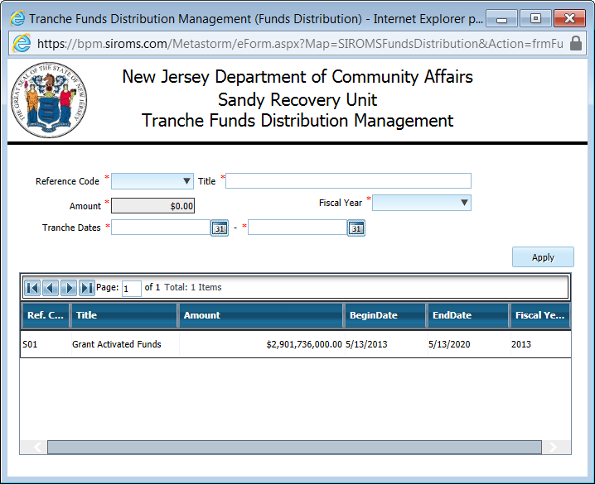
Funds Distribution – Tranche Funds
    Tranche funds are the main funds that tie to an allocation in the Action Plan. All of the allocated grant funding comes from the Tranche funds. These can also be referred to as Grant Activated Funds.

Slide 33
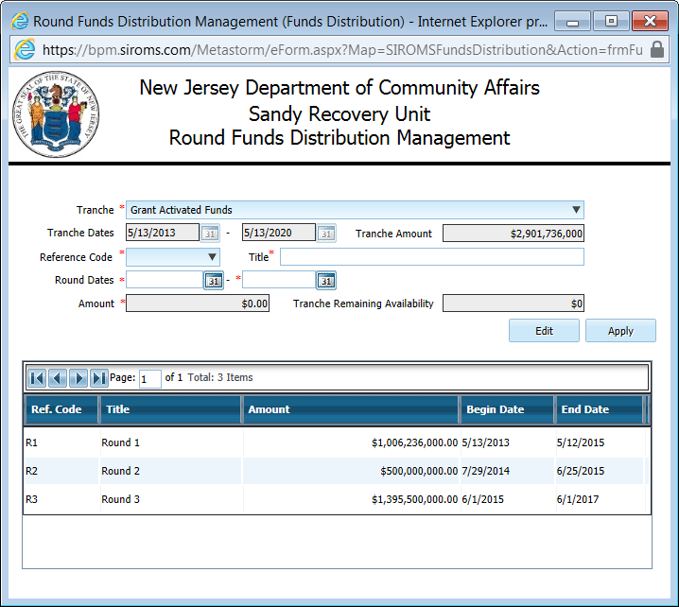
Funds Distribution – Round Funds
    Each Round is tied to a specific activation of funds established in an action plan amendment and has a certain timetable and amount of money. All of the money within that Round must be used within that timetable.

Slide 34
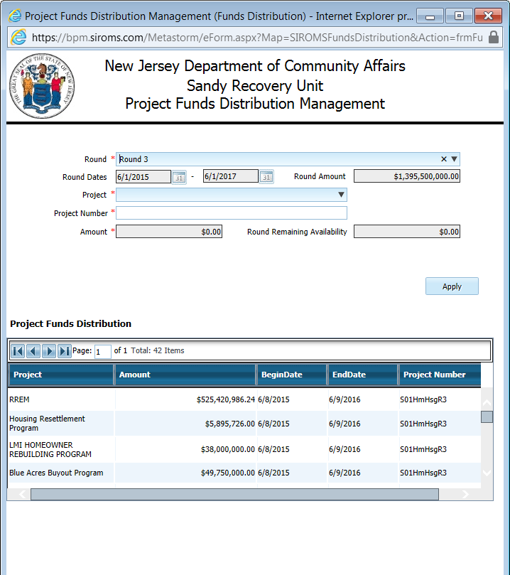
Funds Distribution – Project Funds
    Within each Round are different projects such as, RREM, LRRP, HMGP, and etc. Each Project has a certain amount of money allocated to it. These can also be referred to as Programs.

Slide 35
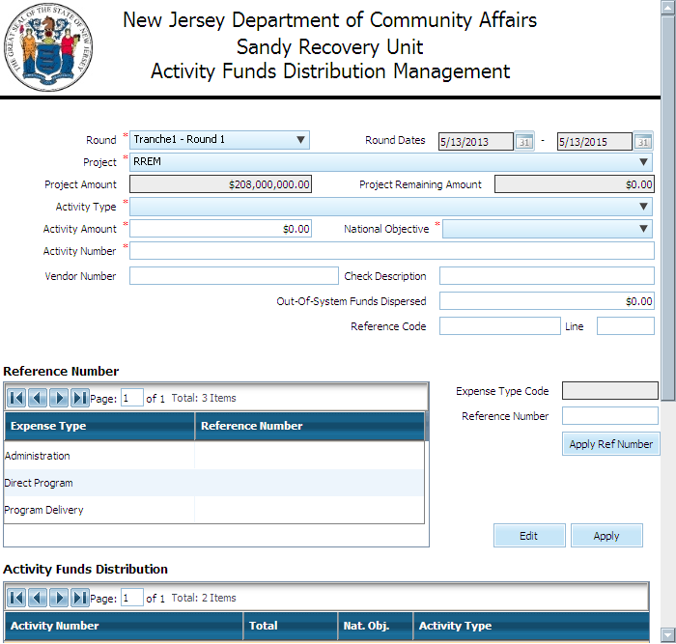
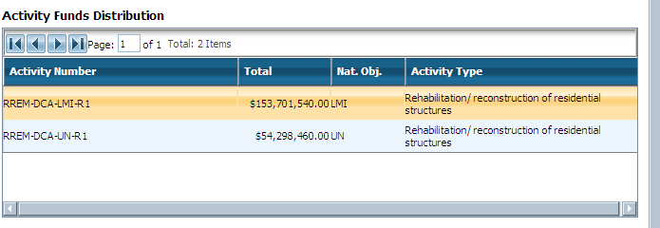
Funds Distribution – Activity Funds
    Each project will have a set of activity numbers assigned depending on the activities that are set up in DRGR; there are currently 644 activities in the system.

Slide 36
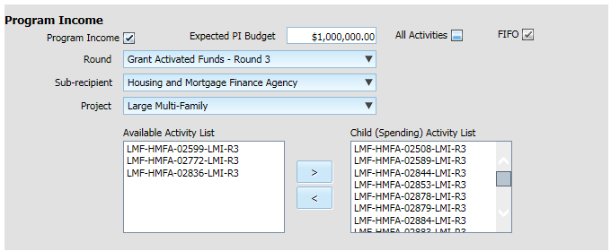
Funds Distribution – Program Income
The Program Income section of Activity Funds Distribution Management captures whether or not the activity will be receiving Program Income and, if so, the expected PI budget.
The relationship between which activities receive Program Income and which activities spend that Program Income are established here.

Slide 37
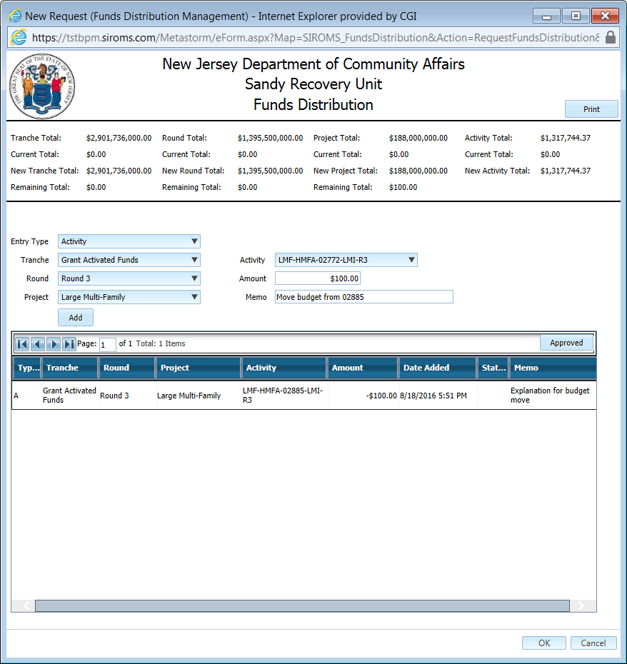
Funds Distribution Management Form
The Funds Distribution Management form tracks adjustments made at Trance, Round, Project, and Activity levels

Slide 38
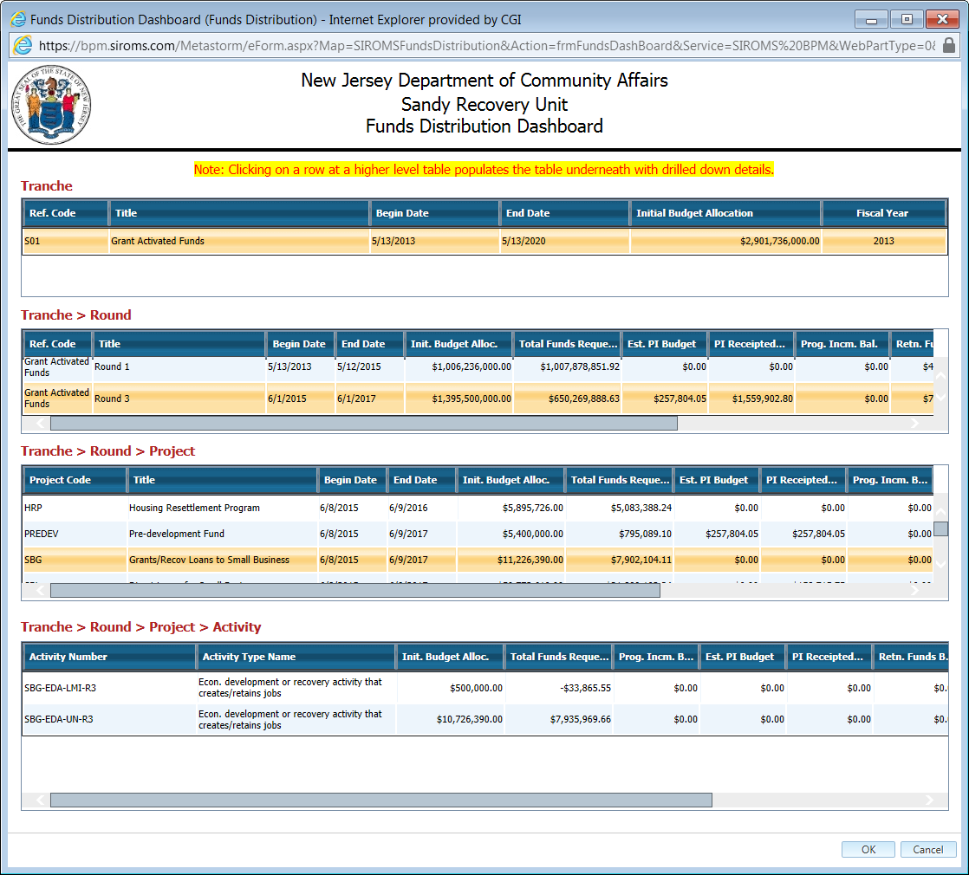
Funds Distribution - Dashboard
    The Funds Distribution Dashboard allows the user with the appropriate role to see all Tranche funds, Round funds, Program funds and Activity funds on one page

Slide 39
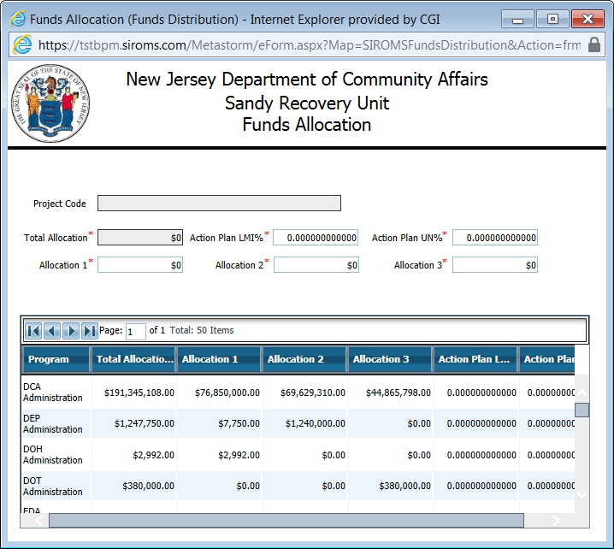
Funds Distribution - Dashboard
Allocations per latest Action Plan are captured here

Slide 40
Funds Request

Slide 41
What is the Funds Request Module?
    The Funds Request (FR) module enables grantees to submit a request for funds, associated with a specific program activity and funding round for disbursement to a specific payee.
    The FR allows DCA Fiscal and Sandy Recovery Division (SRD) to review and approve the grantee request to ensure completeness and accuracy.
    Funds Requests will move through a specific workflow process depending on the program and type of funds being requested
    Funds Request will capture specific information, such as:
      Sub-Recipient
      Project
      Request Type
      Activity
      National Objective
      Supporting Documentation
      Source of Funding

Slide 42
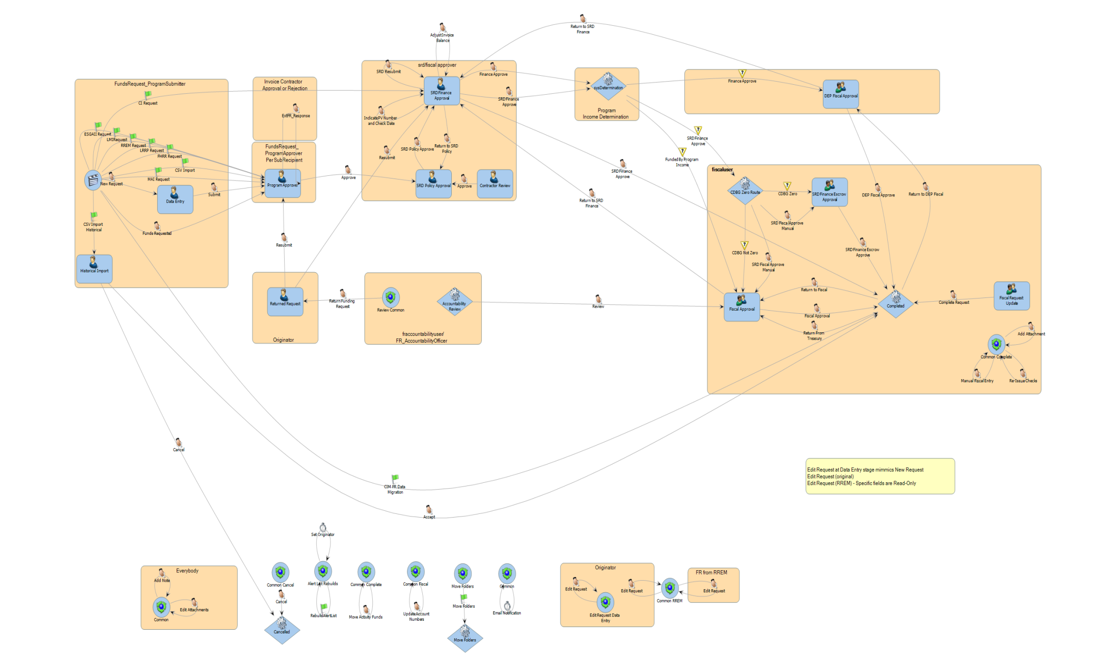
Funds Request BPM Process Flow

Slide 43
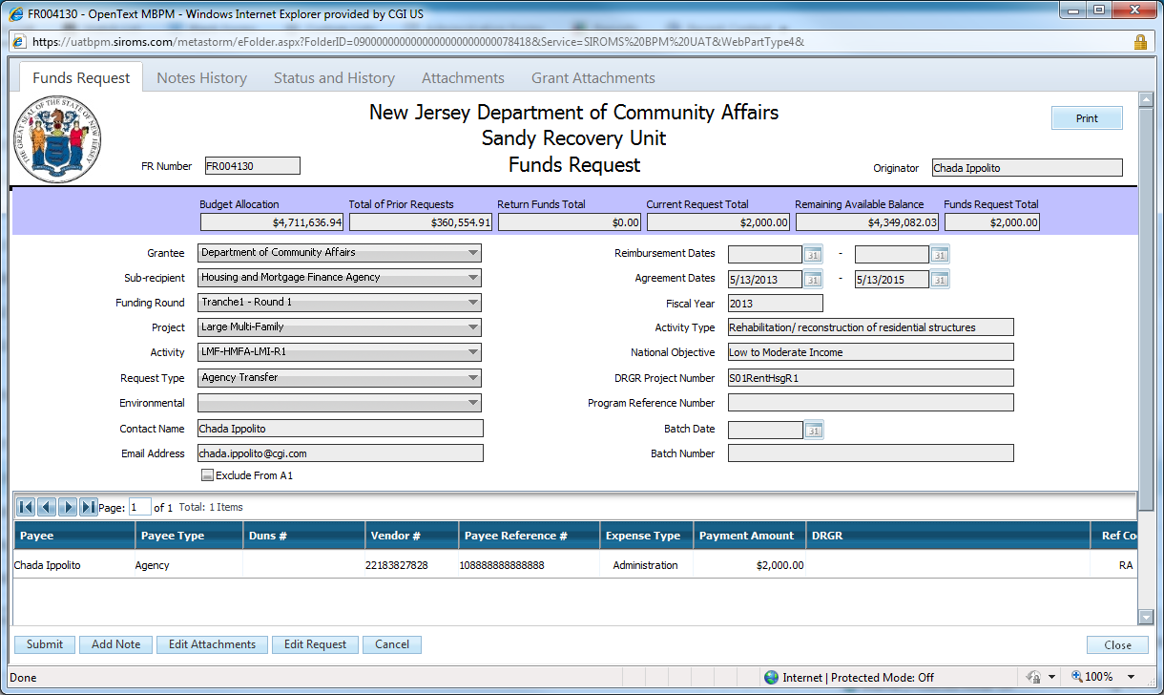
Funds Request
  Users are able to open a record from their To Do List or Custom List
  Users, based on their role and stage, are able to perform multiple actions throughout the process as applicable

Slide 44
Historical Imports
Transactions processed in NJCFS which do not get processed through a SIROMS Funds Request will be recognized through an import tool
SIROMS will map expenditures from NJCFS and conform them to the DRGR activity level
After mapping the expenditures, CSV files are uploaded through the Funds Request Historical Import form where it will create Funds Requests at the Historical Import stage for approval to reconcile expenses back to NJCFS and DRGR

Slide 45
ACH Processing

Slide 46
Accounts Receivable (AR)
Return Funds (RF)

Slide 47
What is the Accounts Receivable/Return Funds Module?
  Accounts Receivable allows SRD to set up and track funds owed back from applicants within each program
  Return Funds allows SRD to recognize funds returned back from applicants within each program against each AR established
  After an Accounts Receivable is established, the status of the AR will update as Return Funds are submitted against it
  Returned Funds will be applied to the latest Round/Activation in the program from which the funds were originally disbursed. Funds that were disbursed from a closed round will be returned to the open round

Slide 48
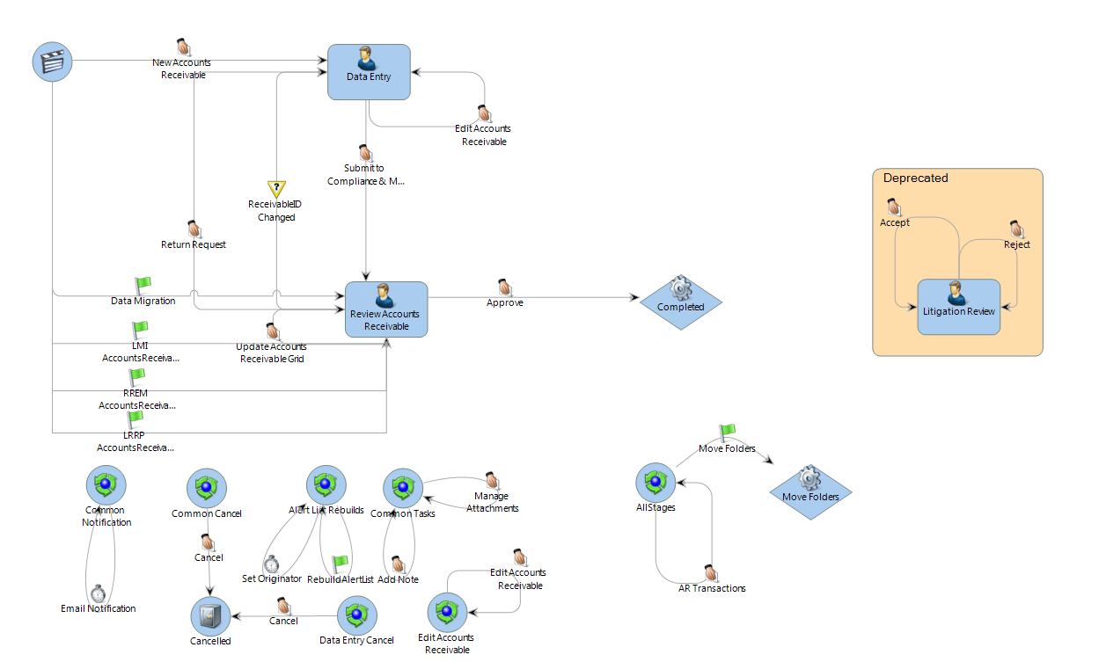
Accounts Receivable BPM Process Map

Slide 49
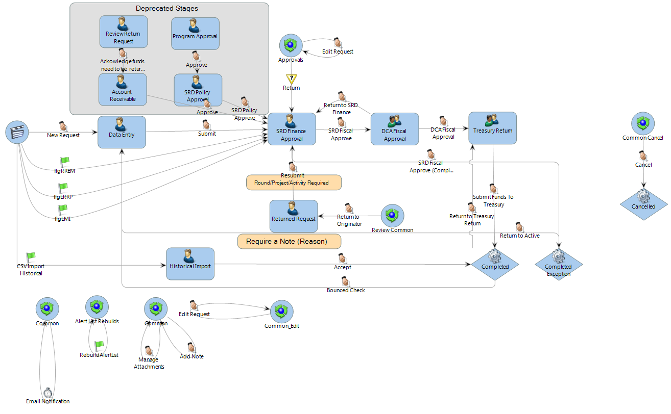
Return Funds BPM Process Map

Slide 50
Program Income Receipt

Slide 51
What is the Program Income Receipt Module?
Program Income (PI) is gross income, received by a recipient or sub-recipient of CDBG-DR funds, which was generated from a repayment
The workflow-driven Program Income Receipt module supports the receipt and approval of PI
Approved PI is available to be spent by one or more activities based on relationships established in Activity Funds Distribution Management
Activities that spend PI do so using the first-in first-out (FIFO) methodology; PI is expended before any other source of funding
Funds are expended through the processing of a Funds Request

Slide 52
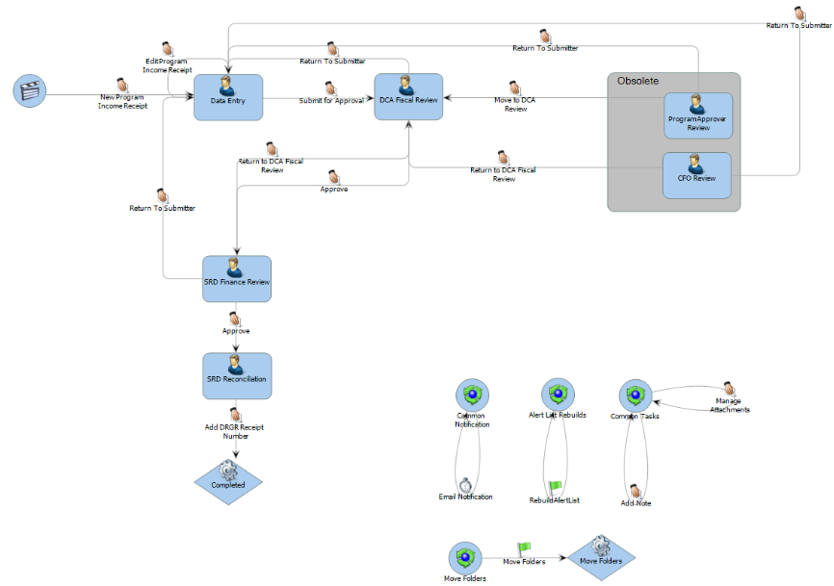
Program Income Receipt BPM Process Map

Slide 53
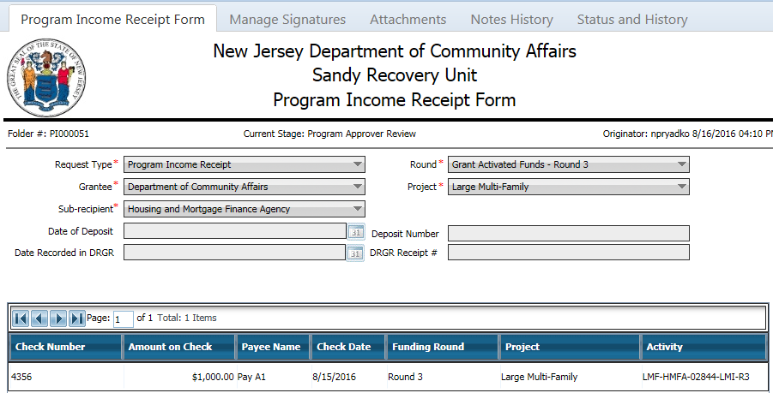
Program Income Receipt

Slide 54
Contractor Invoicing Management (CIM)

Slide 55
What is the CIM Module?
  The Contractor Invoicing Management (CIM) module has been developed to track changes within a Contract and Task Orders within a Contract, Purchase Order Requests for each contractor, Invoices submitted by contractors, and payments (FRs) against each Invoice
  The CIM module involves the following processes:
    Contractor Profile Management
    Purchase Order Request
    Invoicing
    Funds Requests (from Invoices)
  CIM allows SRD to monitor and track invoices submitted against the Task Orders established within the contract
  Also provides SRD the ability to track encumbrances at a DRGR activity level

Slide 56
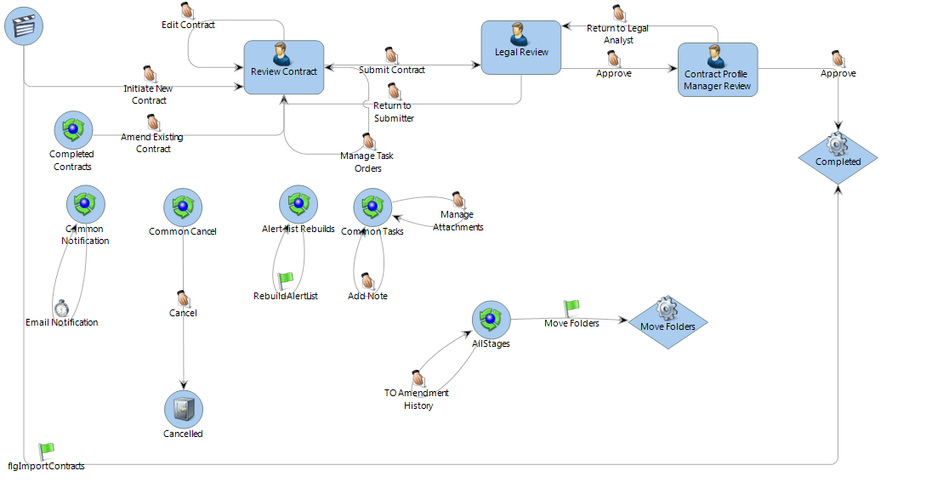
Contractor Profile Management BPM Process Map

Slide 57
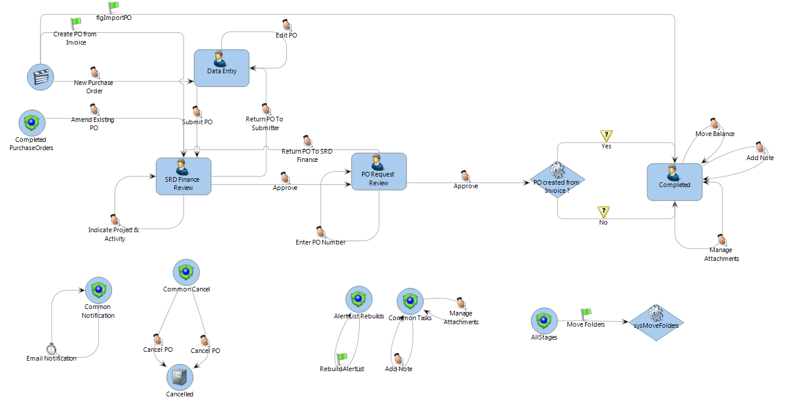
Purchase Order Request BPM Process Map

Slide 58
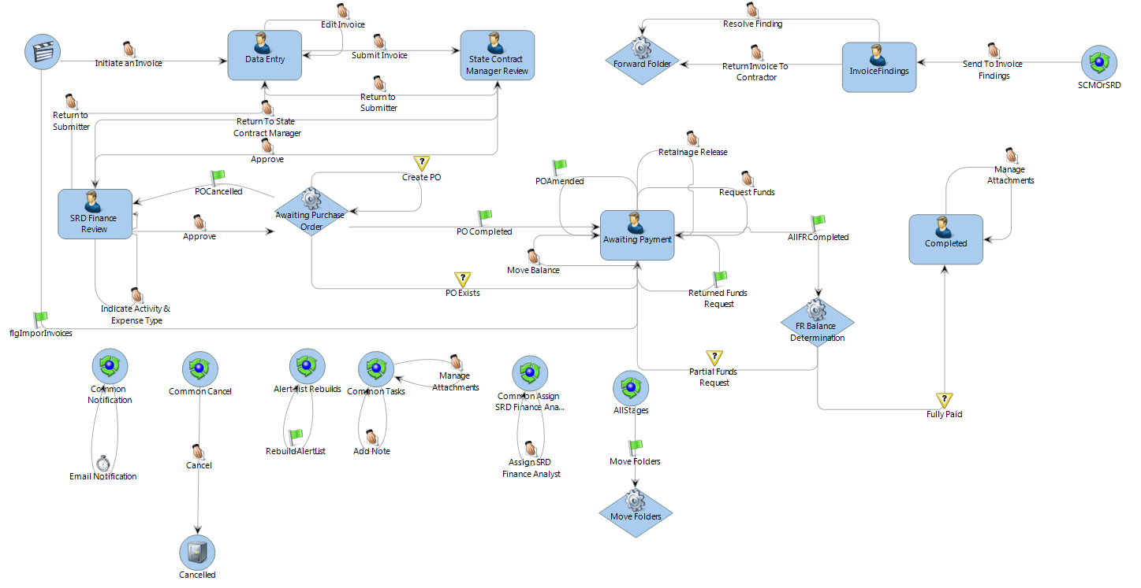
Invoicing BPM Process Map

Slide 59
Multi-Applicant Invoice (MAI)

Slide 60
What is the MAI Module?
  The Multi-Applicant Invoice (MAI) module has been developed to allow streamlined processing of bulk invoices which must be attributed to program delivery costs for specific grant applicants.
  Specifically for use with the FHE module, this module tracks the funds reimbursed for obtaining each individual easement when an invoice is received for services delivered to a municipality.
  The MAI module also provides an interface to the SharePoint Document Library system to move the supporting documents for the invoices.
  This module also allows the user to edit/update the invoices, add the attachments and notes during the invoice review process.

Slide 61
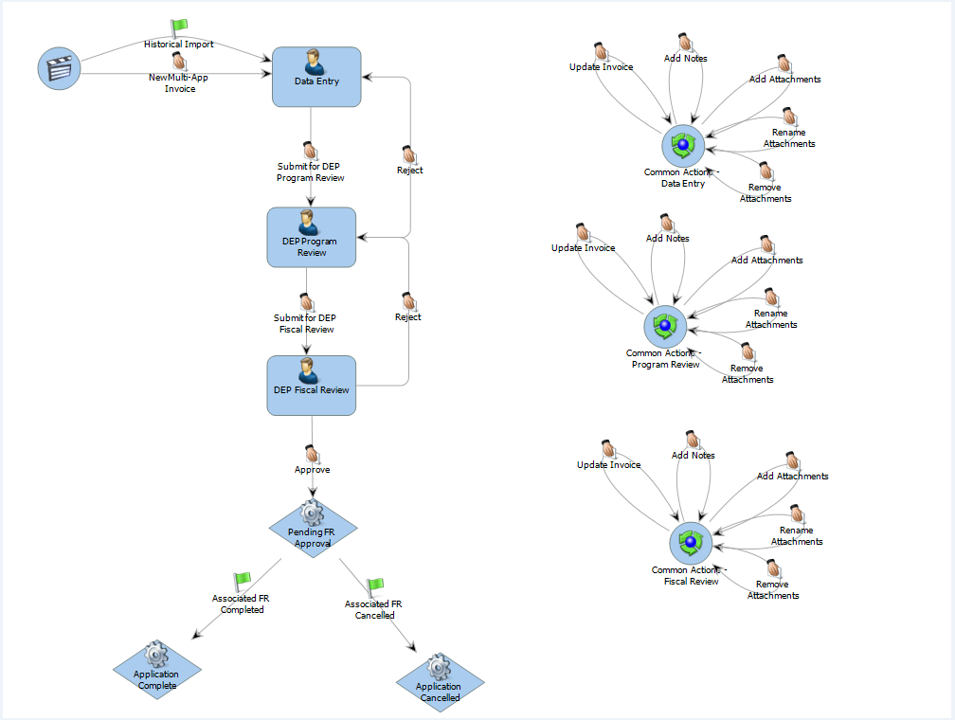
MAI BPM Process Map

Slide 62
Forecasting

Slide 63
What is the SIROMS Forecast Module?
  The SIROMS Forecast Module provides detailed financial and metric collection and reporting functionality
  This information is used to generate comprehensive forecast reports that are submitted to HUD, and are used by the agency to make financial decisions around moving funds.
  Each of the partner agencies submits detailed line item forecasts to show line item projected expenditures for:
    Administration
    Program Delivery
    Direct Program
    Program Income
  The Forecast Module allows:
    Track spending against forecasted values.
    Track key performance indicators (KPI) against projected progress.

Slide 64
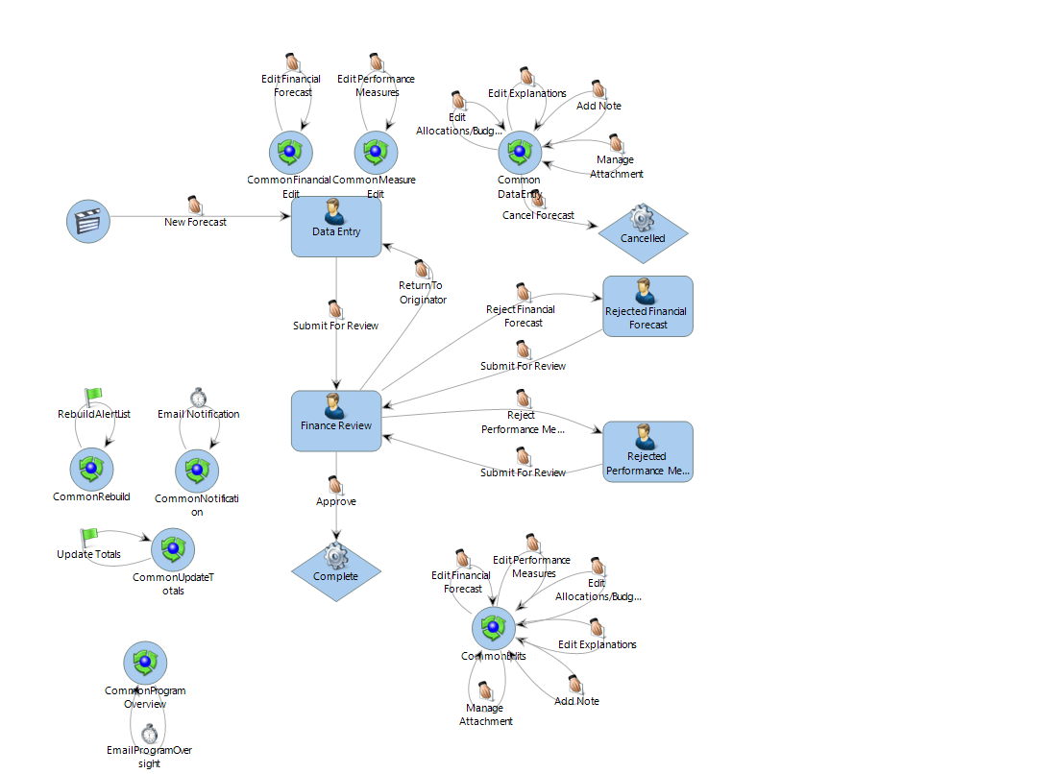
Forecasting BPM Process Map

Slide 65
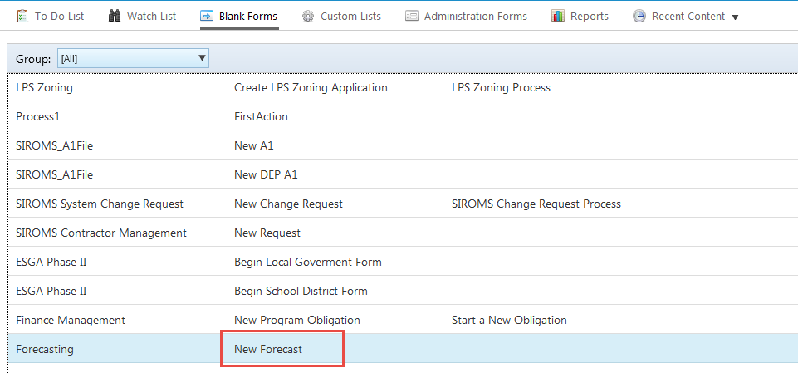
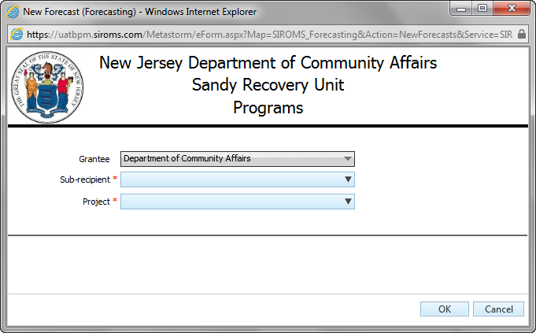
New Forecast
To create a New Forecast, select the action from Blank Forms
Select a Sub-recipient and Program (Project)

Slide 66
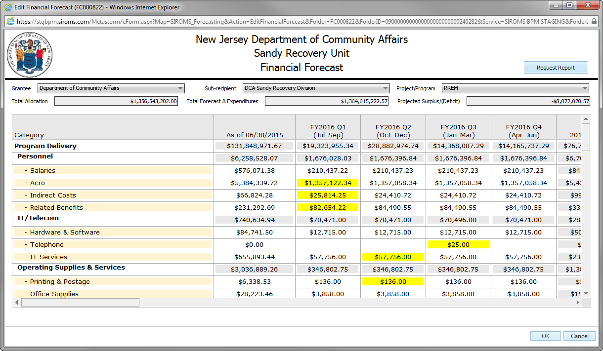
Financial Forecasting
Data entry at forecast line level per quarter
Each line item edit will be highlighted to show changes

Slide 67
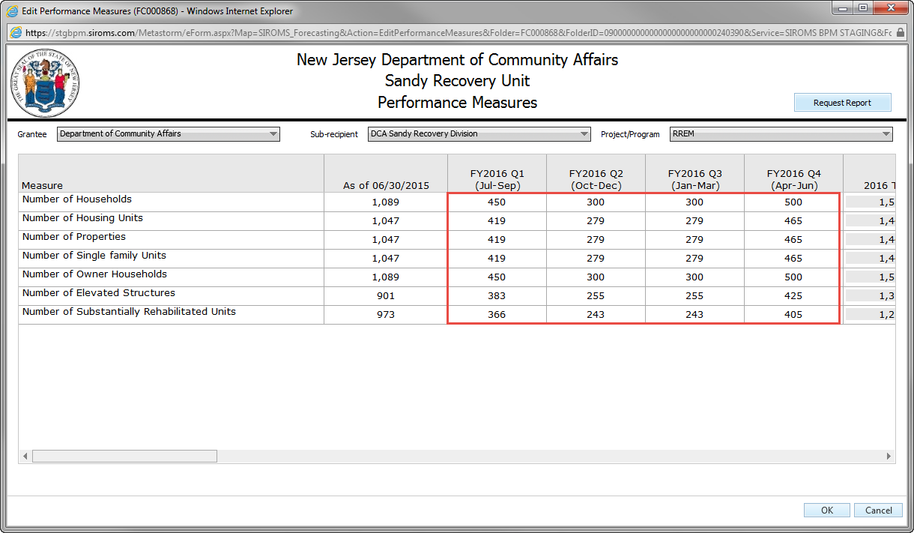
Performance Measure Forecasting
Select Edit Performance Metrics to forecast program KPIs
Enter data for current and future reporting periods

Slide 68
Reporting
Business Process Management (BPM)

Slide 69
Quarterly Performance Reporting

Slide 70
What is the QPR Module?
The Quarterly Performance Report (QPR) enables grantees to submit financial data, performance data, and a progress narrative for their program activities.
The QPR provides information to HUD of the progress of the grantee and to ensure the activities are compliant.
Grantees will typically report the following information:
      Activity Beneficiaries Assisted
      Performance Accomplishments
      Expenditures
For financial and performance data, DRGR calculates information about the current quarter and also the total cumulative data based on all quarters up through the period.
Unless otherwise specified by an appropriation, QPRs are due within thirty days of the end of the quarter.

Slide 71
What is reported in the QPR Module?
Grantees will report the progress of their project /activity on three levels:
    Performance Accomplishments & Beneficiaries Assisted – by reporting on metric measures per national objective
        Examples: #Of Households, #Of Building Inspections, Race and Ethnic Data, etc.
    Financial Progress – by reporting on specific financial data for the project: Total Funds Expended, Match Contributed. Prior to grantee submission, current and cumulative Expenditures, Drawdowns and Program Income data is populated in the module.
    Narrative – by explaining, in narrative form, how the program is progressing.

Slide 72
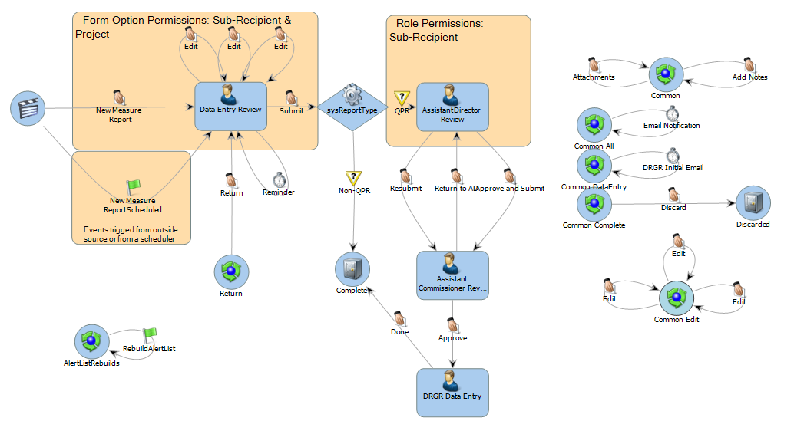
QPR BPM Process Flow

Slide 73
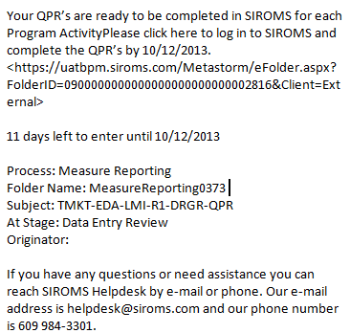
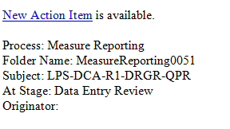
Accessing the QPR Editor
Grantees an access the QPR from the To Do List or Customer list of BPM. Alternatively to accessing QPRs through the BPM portal, grantees can access the available QPRs through the links provided in the notification emails sent at the beginning of the submission period
Initial Email
Reminder Email

Slide 74
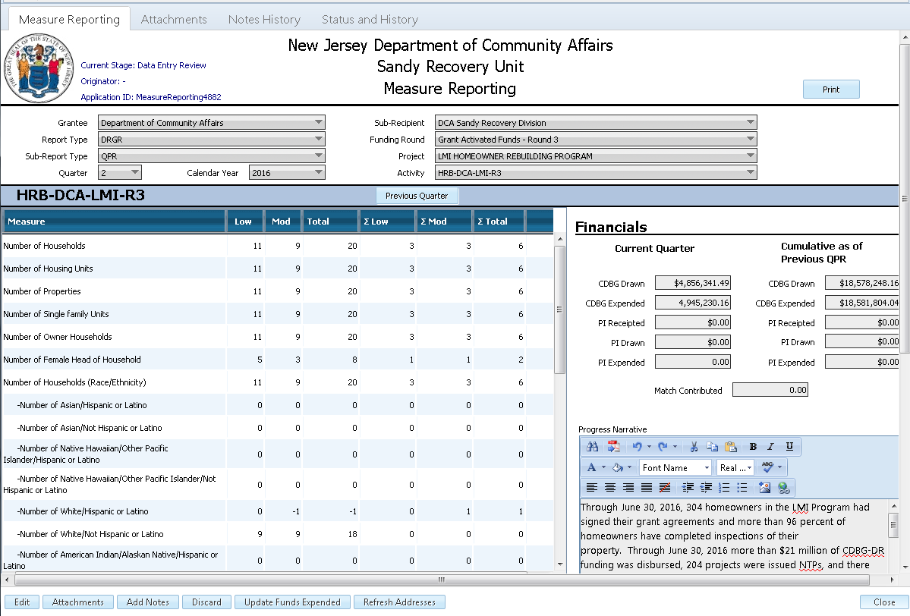
Measure Reporting Tab
After accessing your activities’ QPR, you will be brought to the QPR editor screen
  If an “Edit” button is available on this screen, click it to begin entering data.

Slide 75
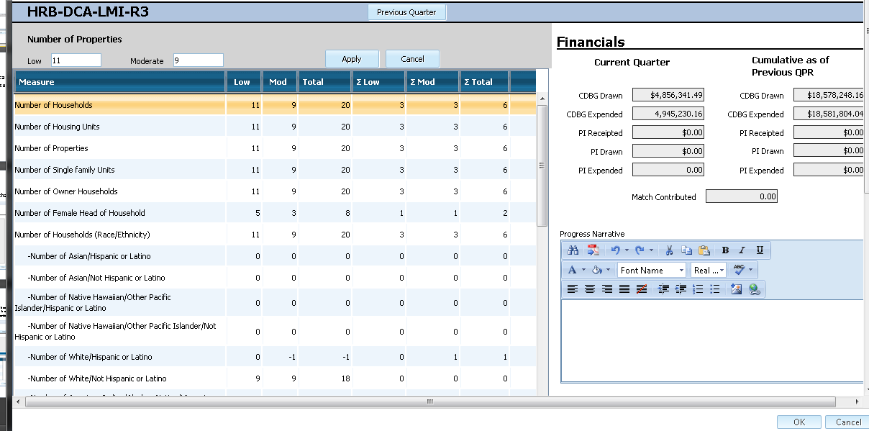
QPR Editor
Grantees will enter their metrics and the progress narrative for their activity on this page.

Slide 76
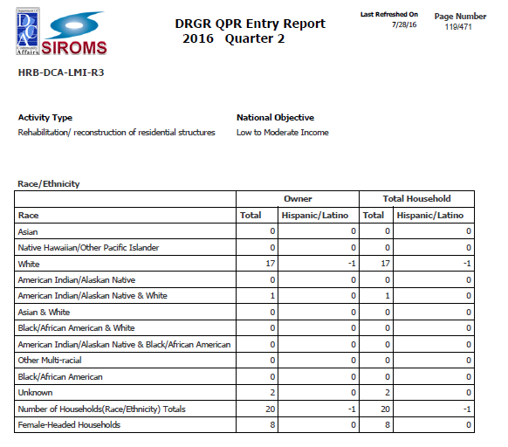
DRGR Entry Report
The DRGR Entry Report is a Business Objects report provided to the Sandy Recovery Division detailing information to be submitted into DRGR

Slide 77
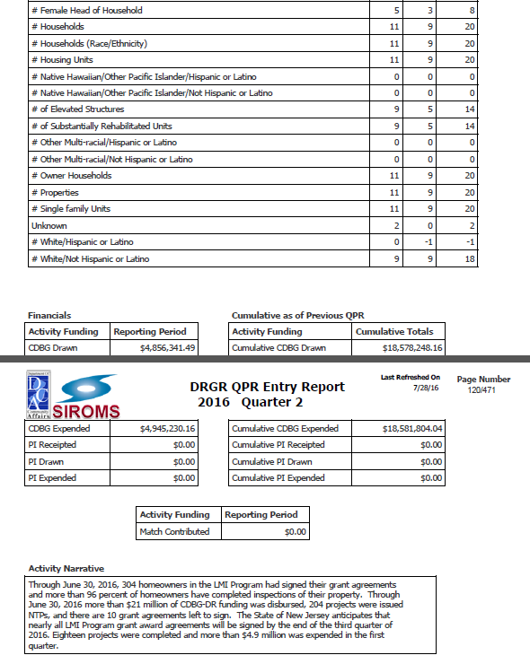
DRGR Entry Report

Slide 78
Voluntary Compliance Agreement

Slide 79
What is the VCA Module?
The VCA is the Voluntary Compliance Agreement entered into between DCA and HUD with the goal of ensuring:
    Access to Sandy Recovery Programs for minority and other underserved communities
    Availability of language assistance to Program applicants, when requested
  The VCA/LEP Module allows each sub recipient to report on their activities’ progress for the quarter associated with:
  Units and Projects (A3)
  LEP Services and Requests (B)
  Households Served by FRM/FRM-PHA/SSNHF (C2)
  LMI Benefit by Municipality (C3)
  The information reported in the SIROMS VCA/LEP Quarterly Reporting Data Entry Module is then used to generate a report to fulfill the reporting requirements outlined by HUD within the VCA

Slide 80
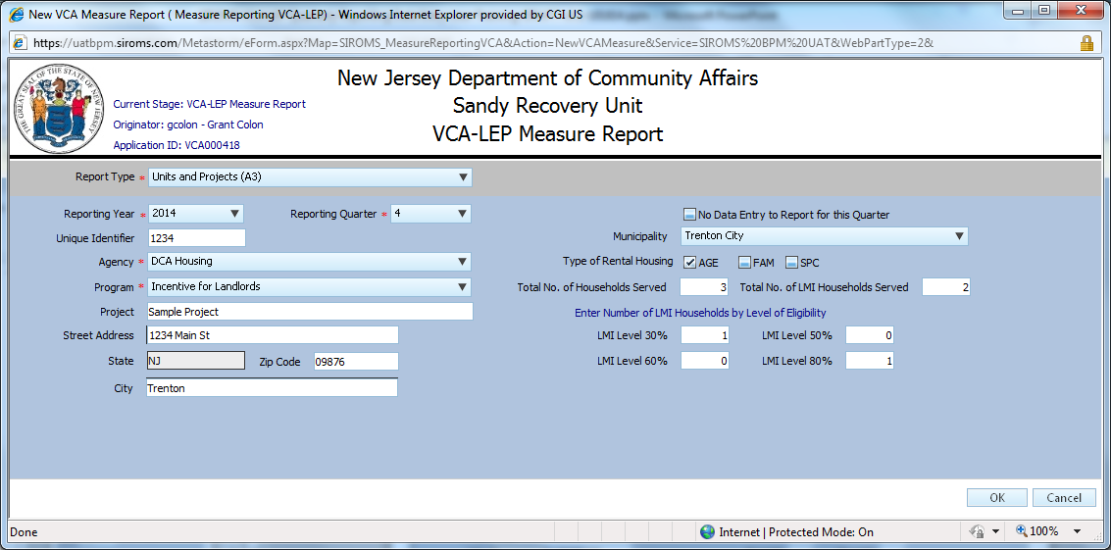
Units and Projects (A3)
Captures LMI Level of Eligibility for Units within applicable Projects
The number of LMI Households by Level of Eligibility must equal the Total Number of Households Served

Slide 81

LEP Requests and Services (B)
Captures individual LEP Requests which have been fulfilled

Slide 82

Households Served by FRM/FRM-PHA/SSNHF (C2)
Captures Race/Ethnicity, LEP Status, Language, and LMI Levels of households served by FRM, FRM-PHA, and SSNHF

Slide 83

LMI Benefit by Municipality (C3)
Captures the National Objectives fulfilled by each Program at the Municipality level
Project Type only applicable to Supportive Services

Slide 84
Federal Reports

Slide 85
What is the Federal Report Module?
    Section 3:
      HUD funded CDBG-DR Program for Super storm Sandy is subject to Section 3. The Section 3 program requires that recipients of HUD CDBG-DR funds, provide (a) employment and training and (b) contracting opportunities for low- or very-low income residents in connection with construction projects in their neighborhoods.
      Each sub-recipient or contractor is required to provide a quarterly submission of their accomplishments related to Section 3.
    WMBE:
      The purpose of this report is to ensure that small and disadvantaged businesses, minority firms, and women-owned businesses can compete for and win a fair share of the contracts that are awarded by the Department of Community Affairs, its sub-recipients and contractors receiving funding under the CDBG-DR program.
    FFATA:
      Prime grant recipients awarded a new Federal grant greater than or equal to $25,000 as of October 1, 2010 are subject to FFATA sub-award reporting requirements as outlined in the Office of Management and Budget guidance issued August 27, 2010. The prime awardee is required to file a FFATA sub-award report by the end of the month following the month in which the prime recipient awards any sub-grant greater than or equal to $25,000.

Slide 86

Federal Reporting BPM Process Flow

Slide 87

Section 3 Reporting

Slide 88

WMBE Reporting

Slide 89

FFATA Reporting

Slide 90
Technical Assistance Monitoring

Slide 91
What is the TAM Module?
The Technical Assistance and Monitoring (TAM) module captures all Technical Assistance, Technical Assistance with Monitoring and Monitoring events that have been provided within a given quarter.
TAM efforts can be provided by the Department of Community Affairs to partnering agencies as well as partnering agencies to their sub-recipients

Slide 92

Technical Assistance

Slide 93

Monitoring

Slide 94
Dashboard Reports

Slide 95

RREM Executive Financial Dashboard
The RREM Executive Financial Dashboard provides the overview of the financials by obligations and disbursements by phases.

Slide 96

RREM Program Management Dashboard
The RREM Program Management Dashboard provides overview on the application processing by phases.

Slide 97

RREM Daily Dashboard
The RREM Daily Dashboard provides overview on the application processing by phases at a granular level.

Slide 98
Other RREM Reports
Aging Reports
  RREM Accounts Receivable aging report
  RREM Compliance and Monitoring Report
  RREM Deficiency Report
  RREM Funds Request Aging Report
Contractor Reports
  RREM CBI Funds Request Report
  RREM Gilbane Funds Request Report
  RREM Gilbane Constituent Services
Other Reports
  RREM Average Grant Size by Phases
  RREM Funding status Report
  RREM Homeowner Private Funds Report
  RREM Construction Extension Report
  RREM Project Closeout Report

Slide 99
GORR

Slide 100
GORR Report
The GORR report is a monthly report that provides transparency of the dollars obligated and disbursed across all Sandy Recovery programs
Data will be pulled from SIROMS Grant Management and SIROMS Funds Request/Return Funds for the programs which are currently managed and tracked within SGM
The Housing and Mortgage Finance Agency (HMFA), Economic Development Authority (EDA), and New Jersey Redevelopment Authority (NJRA) provide data for their respective programs to meet the transparency reporting requirements from the GORR
The GORR report is transmitted to OIT to update the NJ Comptroller and is also utilized the update the New Jersey Rebuild and ReNewJersey Stronger web portals

Slide 101

GORR Report
Summary level output

Slide 102
Grant management / SGM
Business Process Management (BPM)

Slide 103
What is the SIROMS Grant Management (SGM) Module?
SGM is a comprehensive management system designed to provide custom grant/program workflow functionality specifically targeting disaster recovery programs.
SGM Provides full end-to-end program workflow tracking and management functionality including:
  Application Intake
  Eligibility
  Duplication of Benefits Analysis
  Award Calculation
  Award Agreement
  Disbursements

Slide 104
Grant Management / SGM
Program Type | SIROMS Grant Management- Q1 2017 Forecast | Agency | Total Records | Active Records
Budget Tracking | Program Income Receipting | Multiple | 15 | 5
Easement Acquisition | Flood Hazard Risk Reduction Program - Acquisition | DEP | 3,613 | 3,613
Financial Management | CIM - Contracts | DCA | 5 | 5
Financial Management | CIM - Invoices | DCA | 2,036 | 152
Financial Management | CIM - Purchase Orders | DCA | 1,614 | 152
Financial Management | Finance Management | Multiple | 209 | -
Financial Management | Funds Requests | Multiple | 35,647 | 1,184
Financial Management | Return Funds | Multiple | 1,401 | 73
Housing Construction | LMI Homeowners Rebuilding Program | DCA | 1,007 | 312
Housing Construction | RREM | DCA | 16,605 | 7,690
Housing Construction | Unsafe Structure Demolition | DCA | 891 | 129
Housing Residency | Housing Resettlement Program | DCA | 23,994 | 18,547
Municipal | Essential Public Services | DCA | 33 | 33
Municipal | Local Planning Services | DCA | 33 | 33
Municipal | Zoning Program | DCA | 33 | 21
Municipal | Flood Hazard Risk Reduction Program - Infrastructure | DEP | 69 | 14
Policy Retention | Policy Library | Multiple | 267 | 267
Rental Construction | Small Rental Properties (LRRP) | DCA | 2,585 | 514
Reporting | FFATA Federal Reporting | Multiple | 150 | 150
Reporting | Forecast Reporting | DCA | 304 | 38
Reporting | QPR Reporting | DCA | 3,258 | 528
Reporting | Section 3 Federal Reporting | Multiple | 452 | 66
Reporting | Technical Assistance and Monitoring | Multiple | 133 | 133
Reporting | VCA - LEP Reporting | Multiple | 2,592 | 357
Reporting | WMBE Federal Reporting | Multiple | 300 | 53
Resident Support | Constituent Services | DCA | 148,104 | 540
Resident Support | Housing Counseling | DCA | 3,242 | 134
SIROMS Change Mgmt. | SIROMS Change Management | DCA | 876 | 73

Slide 105
Housing
Business Process Management (BPM)

Slide 106
What is RREM?
The RREM Program provides grant awards to the primary residences of homeowners for activities necessary to restore their storm-damaged homes, including reconstruction, rehabilitation, elevation and/or other mitigation activities.
A SGM RREM module is designed to provide a custom workflow to process applications in the RREM Program.
SGM RREM Module consists of
  Application, Grant Details, Award Calculation, Payments, Recoupment along with other supporting features.
  Interfaces that allow transmission of data and documents between RREM Contractors, DEP and DCA.

Slide 107

RREM BPM Process Map

Slide 108

Workflow Status Tab
The Workflow Status tab shows a high-level overview of the applicant’s progression through the RREM program.

Slide 109

Requirements Review Tab
The Requirements Review tab displays the current requirements applicable to self-certify completion of a specific stage.
Any applicable, uploaded, documents will also be displayed.

Slide 110

Application Tab
The Application tab is a exact display of the applicant’s application into the RREM program.

Slide 111

Grant Details Tab
The Grant Details tab captures applicable information specific to the applicant’s initial site inspection, environmental review, construction, etc under different sections.

Slide 112

Grant Details Tab: Step 2 Meeting and Initial Site Inspection sections
Step 2 Meeting section captures the information related to the Step 2 meeting
Initial Site Inspection section contains the information related to the Initial Site Inspection

Slide 113

Grant Details Tab: Environment Review, Step 5 Meeting and Pre-Construction sections
Environment Review section contains information related to the Environment Review.
Step 5 Meeting section contains information related to the Step 5 Meeting.
Pre-Construction section contains the builder related information.

Slide 114

Grant Details Tab: Pre-Construction Pathway C only and Construction Phase sections
Pre-Construction –Pathway C only section contains information related to the Pathway C pre-construction.
Construction Phase – Construction Phase contains information related to the Construction status of the project.

Slide 115

Grant Details Tab: Construction Progress, Final Closeout Information and Appeals sections
Construction Progress – Construction progress section contains information related to the construction progress of the project.
Final Closeout Information – Final contains information section contains the reason for reconciliation reason.
Appeals – Appeals section contains information related to the appeals.

Slide 116

Grant Details Tab: Uniform Relocation Act section
Uniform Relocation Act – URA section contains the tenant information.

Slide 117

Award Calculation Tab
The Award Calculation tab allows the user to capture detail financial values associated with the applicant’s construction. The values are applicable to funds available for disbursement.

Slide 118
Award Calculator Versions
There are different versions of the Award Calculators based the Application type.
The Award Calculator is classified by:
  Project Type – Reconstruction vs Rehabilitation
  RREM Pathway – The RREM Pathway chosen by the applicant
  Retainage – Pre vs Post Retainage
  Closeout – Pre vs Post Closeout
  Stage – Step 5 vs Step 8
There are total of 16 different calculator types defined in the system.
The award calculator versions are created at different steps in the RREM Workflow mainly at Step 5, Step 8 and Amendment.

Slide 119

Payments Tab
The Payments tab displays all funds requests associated with the applicant.

Slide 120

Eligibility Tab
The Eligibility tab captures the criteria associated with determining an applicant’s Eligibility with in the program.

Slide 121

Applicant Interaction Tab
The Applicant Interaction tab captures all interactions between the Program and the Applicant including meeting scheduled and completion dates, phone calls and email. The Application interaction is integrated with Constituent Services and HCS.

Slide 122

Case Log Tab
The Case Log tab captures applicable notes associated with the application process.

Slide 123

Attachments Tab
The Attachments tab displays all documents associated with the application. Users are able to manually upload or scan in documents to the RREM application. The documents can be uploaded through interfaces. The document validation checks for certain documents to be present for some stage moves.

Slide 124

Status & History Tab
The Status and History tab displays event history associated with the applicant’s progression through the program.
Based on stage roles, the To Do List/Watch will display specific users(s)

Slide 125
LMI

Slide 126
What is the Low to Moderate Income (LMI) Module?
The LMI module allowed users to manage an applicant record from initial Intake, an online application process, through eligibility, grant signing, construction, final grant reconciliation and closeout.
The LMI modules allows users to initiate a Funds Request, Return of Funds, Accounts Receivable and process applicants through Recoupment, Ineligibility and Withdrawal.
The LMI Module also allows users to capture and view detailed information about the applicant record through the following:
  Applicant Information
  Grant Details
  Payments
  Applicant Interactions
  Case Notes
  Attachments

Slide 127

LMI BPM Process Map

Slide 128
What is the Landlord Rental Repair Program Module (LRRP)?
  The Landlord Rental & Repair Program (LRRP) enables users to process a landlord’s application through the program.
  The LRRP module captures specific details associated about the damaged and undamaged units of the property.
  The LRRP module captures important dates for Initial Occupancy, Closeout, and Historical Property Information.
  The LRRP module allows the user to capture individual values associated with the award calculation. SGM calculates a cumulative value.

Slide 129


LRRP BPM Process Map

Slide 130
Municipal/Local
Business Process Management (BPM)

Slide 131
Unsafe Structure Demolition

Slide 132
What is the Unsafe Structure Demolition (USD) Module?
  The Unsafe Structure Demolition Program (USD) enables users to process a nomination of buildings that have been determined as eligible for demolition.
  The USD modules allows the program to document the following information:
      Eligibility Inspections
      Title Search
      Contractor Bids
      Demolition

Slide 133

Nomination
Information about the property (Damaged Address, Owners/Lien Holders) as captured by the nominating municipality.

Slide 134

Structure Details
Information about the inspections, title search, demolition, etc.

Slide 135
ESGA

Slide 136
What is the ESGA Module?
The ESGA module allows users to submit an Essential Services Grant Application for both Local Government and School Districts through various rounds of funding/policies.
The ESGA module allows the user to track the application through the process as well as initiate a request for funds upon grant approval and capture applicable notes.

Slide 137

ESGA BPM Process Map

Slide 138

ESGA – Local Government

Slide 139

ESGA – School District

Slide 140
What is the SRPR Module?
The Strategic Recovery Planning Report (SRPR) module supports the submission and management of SRPR grant applications
The SRPR module:
  Allows municipalities to electronically submit applications for funding
  Supports the review and approval (or rejection) of applications
    Approved applications result in the electronic signature of sub-recipient agreements
  Captures the submission of invoices and reports by funded municipalities and enables the review and approval (or rejection) of invoices and reports

Slide 141

SRPR BPM Process Map

Slide 142
What is the LPS Phase II Module?
The Local Planning Services (LPS Phase II) module supports the submission and management of LPS Phase II grant applications
  NOTE: municipalities are only eligible to receive an LPS Phase II grant if they were previously awarded an SRPR grant
The LPS Phase II module:
  Allows municipalities to electronically submit applications for funding
  Supports the review and approval (or rejection) of applications
    Approved applications result in the electronic signature of sub-recipient agreements
Captures the submission of invoices and reports by funded municipalities and enables the review and approval (or rejection) of invoices and reports

Slide 143

LPS Phase II BPM Process Map

Slide 144
What is the Zoning Module?
The Zoning module supports the submission and management of Zoning applications
The Zoning module:
  Allows municipalities to electronically submit applications for funding
  Supports the review and approval (or rejection) of applications
    Approved applications result in the electronic signature of sub-recipient agreements
Captures the submission of invoices and reports by funded municipalities and enables the review and approval (or rejection) of invoices and reports

Slide 145

Zoning BPM Process Map

Slide 146
Partner Programs
Business Process Management (BPM)

Slide 147
What is the FHRRR Module?
  The FHRRR module was developed to track the workflow process of the applications which were submitted by the municipalities through an online web based system seeking reimbursement for the projects associated with the Flood Hazard Risk Reduction and Resiliency projects as a part of the State’s post-Superstorm Sandy reconstruction efforts.
  The FHRRR module provides an interface to the SharePoint Document Library system to move the supporting documents needed to reimburse the grants funded by the municipalities.
  This module allows the user to edit/update and score the applications, add the attachments, enter the applicant’s interactions, and case logs during the application approval and tracking process.

Slide 148

FHRRR BPM Process Map

Slide 149
What is the FHE module?
  The Flood Hazard Easements (FHE) module provides an ability to track the fund reimbursement for acquiring of easements for the beach erosion, shore damage reduction and flood control projects in partnership with the U.S. Army Corp of Engineers and New Jersey Department of Environment Protection.
  The FHE module provides the DEP with an ability to review the applications, manage the workflow process and track the funds reimbursed on evaluation (Survey & Title verifications, Legal details, and Appraisals) of the projects till the easement is obtained.
  This module allows the user to edit/update the applications, initiate the funds requests, enter the applicant’s interactions and case logs during the acquisition of easements.

Slide 150

FHE BPM Process Map

Slide 151
Change Management
Business Process Management (BPM)

Slide 152
What is the Change Request module?
  The Change Request module streamlines business process for requesting changes that alter the previously agreed upon scope of a particular deliverable.
  The CR module tracks the workflow and approval process needed to design, develop, and deploy the requested system or reporting change.
  The CR module also allows the user to edit/update the requested change details, add attachments, remove attachments and add notes.

Slide 153

CR BPM Process Map

Slide 154
Integration
SIROMS

Slide 155
Solution Background

Slide 156

SIROMS : Overall Solution

Slide 157
SIROMS Solution : Integration
SIROMS Components
SIROMS - Integration Layer:
Treasury Integration – NJCFS
Sage Integration – Weekly LIP Funds Requests, QPR
RREM Integration – Web Services (I1, I7, I8, iDone) Gilbane, Cbi Shaw
LRRP Integration – Web Services (I1, I7, iDone) Gilbane
LMI Integration – Web Services (I1/I71, I7, iDone) Cbi Shaw
Escrow Integration (ACH) – Bank of America
EDA Integration – Document Transfers (FTP)
DEP Integration – Document Transfers (S3) RREM, LRRP, LMI, USD, FHRP, FHE, …
Common Functions – Bulk Document Transfers (scanned, auto-generated)
Common Functions – Bulk E-mail Notifications ACH, CEN, CSD, LMI…

Slide 158
SIROMS Integration - NJCFS
Download OPVLD, WRECD Files from NJCFS Server 6:30 AM M-F
Trigger SIROMS Process to Import Files Into SIROMS Database
SIROMS Process Generates A1 Transaction Files
Upload A1 Transaction File to NJCFS 5:30 PM M-F

Slide 159
SIROMS Integration - SAGE
Funds Request
  Query SAGE Database for new Funds Request at 3:00 PM Friday
  Generate Funds Request CSV File
  Save SAGE Data into LIP tables in SIROMSINT database
  Generate Supporting DTL, MNC PDF Attachments for Funds Request
  Trigger SIROMS Process to Create Funds Request Using Generated CSV File
  Send E-mail Alert on Funds Request Creation Status
  Send E-mail Alert (mid-week) on Funds Request Processing Status
QPR (Quarterly)
  Download Monthly Information from SAGE Database for each Month in Quarter
  Create Export File (.xlsx) – manual process.

Slide 160
SIROMS Integration – RREM Web Services
Incoming (ad-hoc) – I7, I8, iDone
  CBI/Gilbane Upload Supporting Documentation to SIROMS Integration via SIROMS Int. Web Service
  CBI/Gilbane Upload Applicant Information to SIROMS Integration via Another SIROMS Int. Web Service:
    I7 – Feasibility Report
    I8 – TDC Report
    iDone – Closeout Information
  CBI/Gilbane Receive Transaction Acknowledgement from SIROMS Integration
  SIROMS Integration Triggers SIROMS Process To Update Applicant Information in SIROMS Application.
Outgoing (ad-hoc) – I1 / I71
  SIROMS User Submits Records to SIROMS Integration Database For Transmittal to CBI/Gilbane
  SIROMS Integration Periodically Polls Database For New Records to Transmit
  Transmit New Records (data + attachments) to CBI/Gilbane via Web Services (hosted at Contractor’s site)

Slide 161
SIROMS Integration – LRRP Web Services
Incoming (ad-hoc) – I7, iDone
  Gilbane Uploads Supporting Documentation to SIROMS Integration via SIROMS Int. Web Service
  Gilbane Uploads Applicant Information to SIROMS Integration via Another SIROMS Int. Web Service:
    I7 – Feasibility Report
    iDone – Closeout Information
  Gilbane Receives Transaction Acknowledgement from SIROMS Integration
  SIROMS Integration Triggers SIROMS Process To Update Applicant Information in SIROMS Application.
Outgoing (ad-hoc) – I1 / I71
  SIROMS User Submits Records to SIROMS Integration Database For Transmittal to Gilbane
  SIROMS Integration Periodically Polls Database For New Records to Transmit
  Transmit New Records (data + attachments) to Gilbane via Web Services (hosted at Contractor’s site)

Slide 162
SIROMS Integration – LMI Web Services
Incoming (ad-hoc) – I7, iDone
  CB&I Uploads Supporting Documentation to SIROMS Integration via SIROMS Int. Web Service
  CB&I Uploads Applicant Information to SIROMS Integration via Another SIROMS Int. Web Service:
    I7 – Feasibility Report
    iDone – Closeout Information
  CB&I Receives Transaction Acknowledgement from SIROMS Integration
  SIROMS Integration Triggers SIROMS Process To Update Applicant Information in SIROMS Application.
Outgoing (ad-hoc) – I1 / I71
  SIROMS User Submits Records to SIROMS Integration Database For Transmittal to CB&I
  SIROMS Integration Periodically Polls Database For New Records to Transmit
  Transmit New Records (data + attachments) to CB&I via Web Services (hosted at Contractor’s site)

Slide 163
ESCROW Integration (ACH) – Bank of America
Applies to Following Fund Request Types:
  DAP – Pathway C Design Advance Payment (CDBG)
  DFP – Pathway C Design Final Payment (CDBG)
  PC – Pathway C Payment (CDBG and/or Escrow)
Mechanism to Pay Participating Builders
  DCA Approves a Funds Request
  Latest Available Balances (CDBG, Escrow) Downloaded from BOFA and Uploaded to SIROMS Integration Tables (daily, manual process)
  SIROMS Integration Generates ACH File (.csv) at 4:30 PM M-F
  ACH File Uploaded to BOFA (manual process)
  Summary of Payments Sent to DCA (manual process)
  E-mail Notification Sent to Builders Next Day at 11:30 AM M-F
  Builder Acknowledges Receipt of Funds (50/50 chance)
Mechanism to Refund Escrow Overpayment By Applicants
  In Development

Slide 164
DEP Integration – RREM, USD, LHRP, LMI, LRRP…
Most Common Interface
Two Components:
  Submit For Environmental Review - Outbound
  Environmental Review Results (a.k.a TierII Review) - Inbound
DEP Outbound Process:
  DCA Submits Records for DEP Review (manual/automated)
    ROE Attachment Mandatory for Successful Submission
  Early DEP Report Generated And E-mailed To DCA/DEP 4:00 PM M-F
  Verify DEP Record Contents (Remove Duplicates, Fix Data) – Visual Process
  DEP Outbound Nightly Process Begins 5:00 PM – 7:30 PM M-F
  DEP Report (Actual Submissions) Generated & E-mailed to DCA/DEP 8:00 PM M-F

Slide 165
DEP Integration – Contd.
DEP Inbound Process:
  Download DEP Record Information from DEP ERMS Repository 5:30 AM M-Sat
  Send E-mail Alert to SIROMS Support with DEP Outbound Processing Results
  Upload .ZIP Files to SIROMS (<APPID>_TII_<timestamp>.zip
  Update TierII Review Results in SIROMS (SIROMS Web Service):
    Pass
    Fail
    Findings Cannot be Made

Slide 166
Common Functions – Bulk Document Transfers
Bulk Scanning of Documents to ECM
  Field Offices Scan Documents
  Documents Automatically Uploaded to SIROMS FTP Server
  Camel Downloads Files from FTP Locations
  Camel Uploads File to SIROMS

Slide 167
Reporting
SIROMS

Slide 168
Reports by Program
Program | Report Count
DCA Local Planning Services | 1
EDA Administration | 2
Housing Counseling Services | 2
Housing Resettlement Program | 6
LMI Homeowner Rebuild Program | 24
LRRP | 24
RREM | 64
Finance Management Reports | 12
Forecasting Reports | 10
QPR Reports | 6
Other Reports | 5

Slide 169
Reporting Ad-hoc Requests Per Month
The SIROMS reporting team receives close to 30 ad-hoc requests per month.
During Forecasting and QPR seasons, the number of ad-hoc requests for reporting peaks up.
The average number of high priority requests per month for reporting requests is approximately 10

Slide 170
Reporting from DRGR
Following reports from DRGR are used to reconcile financial data between SIROMS and DRGR
  7a Report from DRGR
  9b Report From DRGR
The 7a Report from DRGR is sourced in daily and stored into a database in SIROMS. This data is in turn used to create reconciliation reports in SIROMS Business Objects.
ETL jobs are used to extract and load this data into the SIROMS database.
The 9b Report is a quarterly report, sourced in and stored in the SIROMS database for every QPR season. The data from 9b Report serves as a base for data entry and reconciliation in QPR.
Reports for HUD audits are generated with the help of this reconciliation.

Slide 171
Reporting from NJCFS
Following Reports from the NJCFS system are used to reconcile financial data between SIROMS and NJCFS
  FBLT Cumulative Report
  Reporting Cat By Activity
Both the reports mentioned above are sourced in daily from NJCFS as excel files. These excel files are then saved in the SIROMS database using import jobs.
SIROMS database also maintains complex mappings which connect the Activities in SIROMS to Reporting Category, Activity Code and FBLT description in NJCFS.
ETL Jobs are used to transform and load data from the CFS reports to the SIROMS data warehouse.
Various reconciliation reports are created from the data that is loaded into the data warehouse.

Slide 172

Three System Reconciliation Report
The Three System Reconciliation report is a very important tool which combines information from SIROMS. DRGR and NJCFS systems to compare the financial data across these systems.

Slide 173
Historical Imports ETL Process
The historical import process helps in importing transactions that happened outside the SIROMS system. An example for such a transaction is check that is directly issued by the treasury without an approved Funds Request.
The transactions are imported from the Reporting Cat By Activity File from NJCFS.
Using the ETL mappings the transactions from NJCFS are then converted into a Funds Requests in SIROMS.
The Historical Import ETL is a daily job, that helps the SIROMS and CFS systems stay in sync and track every single transaction using Funds Requests.

Slide 174
Helpdesk
SIROMS

Slide 175

SIROMS Help Desk
The SIROMS Help Desk is located a 101 S. Broad Street, 8th Floor, Trenton NJ.
Hours of operation are 7:00am to 6:00pm EST. After hours calls are facilitated via voicemail system and are addressed the next business day.
The SIROMS Help Desk is the first level of support for:
    Account Modification/Permissions
    Technical assistance
    New functionality
    Information assistance
    Data questions
Help Desk facilitates on average 400- 500 tickets per month accommodating phone calls, walk ups, and email submissions. Statics showing ticket count per month are shown to the right.

Slide 176
Infrastructure
SIROMS

Slide 177
SIROMS Infrastructure Overview
  81 servers total across all environments
    33 server VMs in Dev\Test environment
    13 server VMs in UAT environment
    19 server VMs in Production environment
    16 server VMs in Disaster Recovery environment
  22556 GB of disk space being utilized across all environments
    1096 GB in Dev\Test
    4720 GB in UAT
    9000 GB in Production
    7740 GB in Disaster Recovery
  580 GB of RAM being utilized across all environments

Slide 178
Dev\Test Environment Setup

Slide 179


UAT Environment Setup

Slide 180


Production Environment Setup

Slide 181



Disaster Recovery Environment Setup

Slide 182

SIROMS BPM/ECM Server Architecture

Slide 183
What is the Version Control Tool?
Subversion – Open source version control currently maintained by the Apache Software Foundation. SIROMS developers use this tool to store the current and previous version of the software modules developed for the SIROMS project.
  Client access: TortoiseSVN – This is the tool that developers use on their local machines to access the files stored on the SVN server. This tool comes with Windows Explorer integration to allow for easy access to files stored on the server.
  Trunks: Currently there are 3 application trunks configured in the SVN environment:
    BPM – modules that are access through the bpm.siroms.com site.
    Applications - .Net applications deployed on apps.siroms.com
    Integration – Code executed by the Camel integration to transfer data between internal and external applications

Slide 184
Software
Software | Purpose
Microsoft Visual Studio | Development of .net and SharePoint applications
SQL Server | Relational Database Management System
SQL Server Management Studio | Tool connecting to database
TortoiseSVN | SVN repository browser
IIS | Web Server
Apache Camel | Integration framework
FileZilla Client | Encrypted uploading and downloading of files
Amazon AWS | Downloading/Uploading information/attachments from/to DEP
Amazon S3 Browser | View/download DEP related files for development/troubleshooting purposes
Spring IDE | IDE used for development of Integration jobs
MS SharePoint Designer | development of SharePoint workflows, masterpage development, custom actions, BCS External content types, etc
PowerShell | Used for WSP deployment, SIROMS Reports deployment, SIROMS Document Library Daily Upload Summary Report Emails, Administration utilities, etc
MS InfoPath | Used in forms development
Central Administration | Used for SharePoint administration, job monitoring, application management , farm and site backups, etc.
SAP Business Objects | Reporting
SQL Server Integration Services | Used for ETL jobs
OpenText MBPM Designer | Development of BPM solutions
LDAP | User Authentication
SurgeMail | Bulk Emailing
ArcGIS | Geo-location services
OpenText ECM | Document storage
DFS-Microsoft File replication | software used to keep files servers, including open text ECM, in sync.

